Slide 1
NMC Learning Days
Presented by: Brandi Wright A/Snr Conflict Management Practitioner
West/North Region, Department of National Defence

Slide 2
What is Conflict?
An expressed struggle involving two or more parties resulting from a real or perceived difference in needs/interests.
8

Slide 3
Conflict Escalation
https://www.youtube.com/watch?v=OqqKEgrPhHo
14

Slide 4
Costs of Conflict
What are some of the possible costs of unmanaged or poorly managed conflict?
on the individual involved?
on the work team?
on the organization?
on families?
9

Slide 5
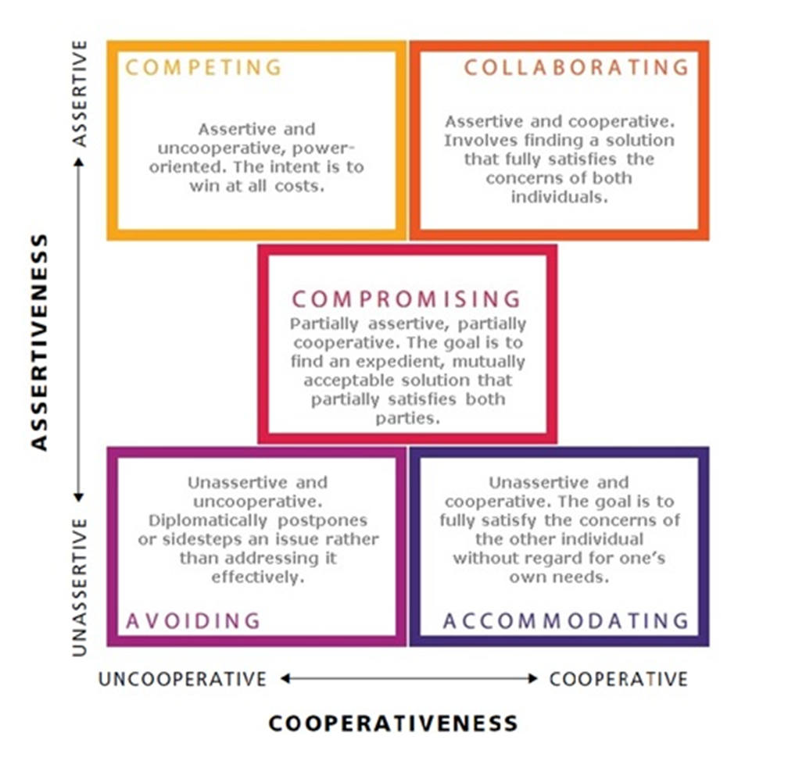
Conflict Management Styles
tools.mheducation.ca/college/mcshane4/student/olc/4obm_sa_13.html
16

Slide 6
Nature and Causes of Conflict
Structural
Relationship
Values
Facts/Data
Interests
10

Slide 7
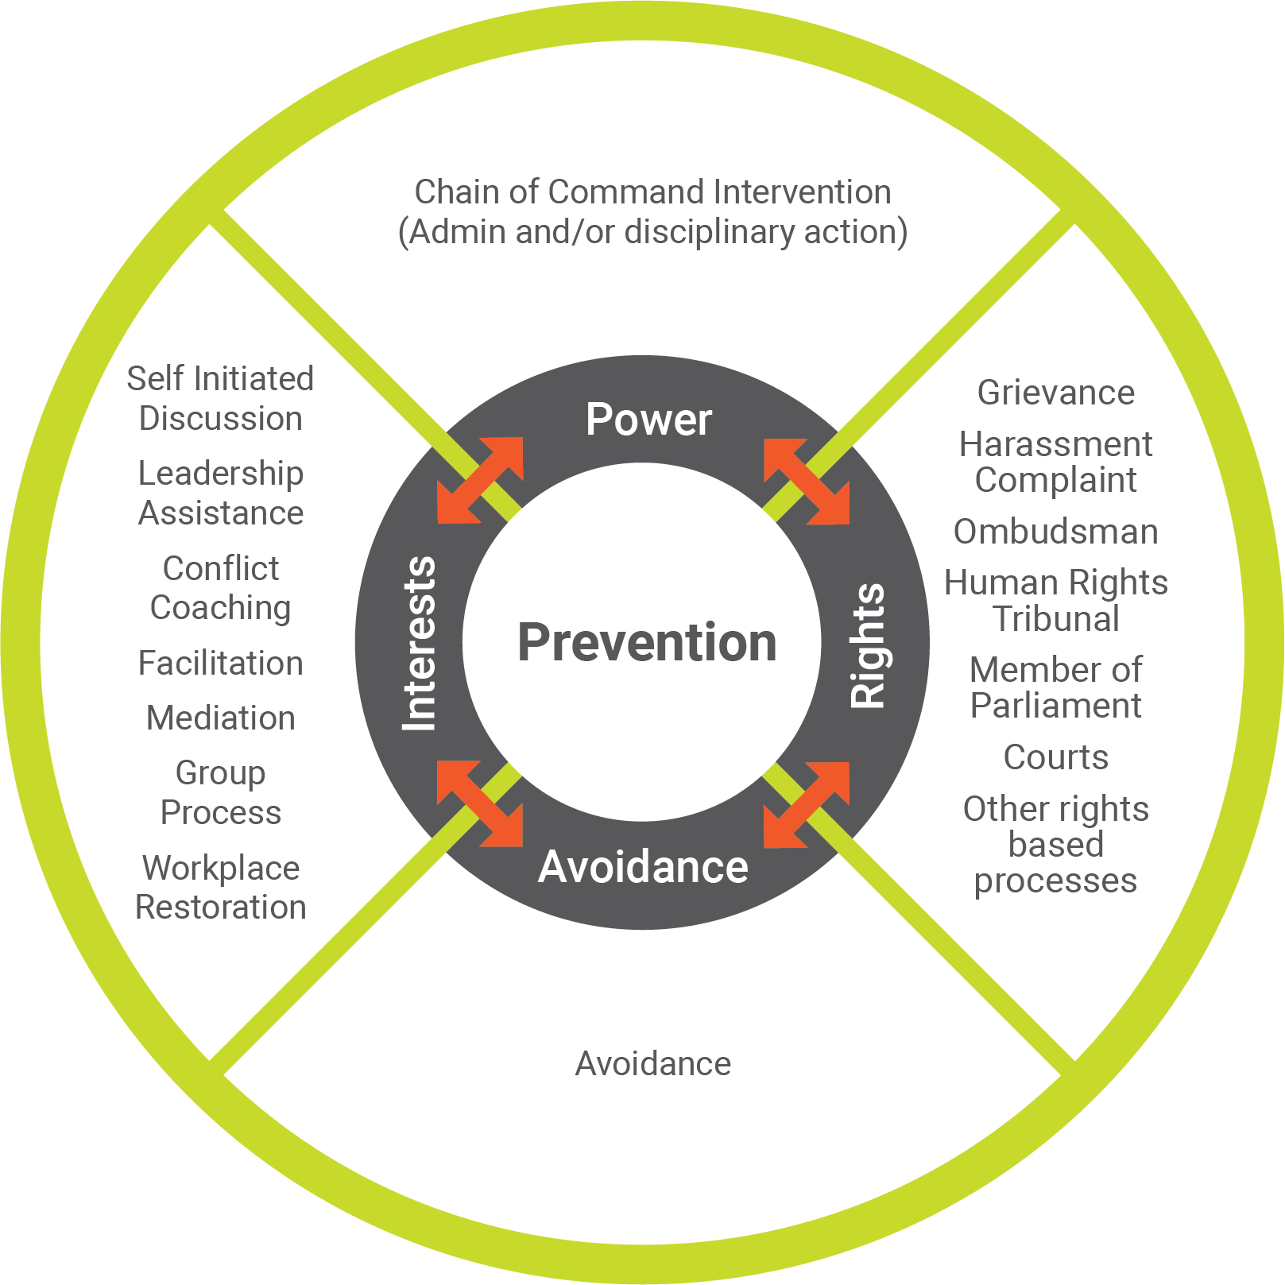
Resolution Options
15
Notes:
Use wheel analogy - each approach represents a spoke within a wheel. The integrity of a wheel would be compromised if there was only one or two spokes. If there were only one or two options to resolve conflict in DND, the integrity of the organization would be compromised and its ability to function affected.
SOME LEADERS tend to utilize a specific conflict resolution approach more often than others, it’s their comfortable zone. However, the approach may not necessarily meet intended outcome.
SKILLED LEADERS weigh the risks and benefits of each approach, aware that each approach is likely to lead to a different outcome and make an informed decision as to the best approach for the situation.
INTENTION ------- COA ------- END STATE
The conflict resolution system is fluid; hybrid approach may be applicable.
**Use scenario to go through MCpl’s options and assess viability of each option**
Power-Based Approach to Conflict Management
A power-based approach is common in organizations that have a hierarchical structure. In this case, the decision-maker determines resolution. The views, needs and interests of the affected parties may not be considered.
Pros : no discussion, possible winner/loser, immediate action & decision imposed, demonstrates that certain behaviours are unacceptable, build faith in CoC, shows a level of control by CoC
Cons: workplace strain, sides taken by others, gossip, team mbrs not speaking, situation could escalate, decision but no resolution for mbrs, perception of favourtism
Avoidance Approach to Conflict Management
The avoidance approach to conflict resolution can be a conscious or unconscious choice that is used when people do not know how to handle the situation, hope it will go away or are waiting for heightened emotions to settle. Avoidance does not address the issues and therefore will not build relationships through its usage. This approach is recommended in situations where the relationship and the issue is of little importance. Knowing your options will help you decide if avoidance is the appropriate approach.
Excerpt from Brene Brown’s Book Braving the Wilderness (pgs. 79-80) “people often silence themselves, or ‘agree to disagree’ without fully exploring the actual nature of the disagreement, for the sake of protecting a relationship and maintaining connection. But when we avoid certain conversations, and never fully learn how the other person feels about all of the issues, we sometimes end up making assumptions that not only perpetuate but deepen misunderstandings, and that can generate resentment. These results are sometimes worse for the relationship than having the so-called ‘argument’ would be.”
Pros: Issue may resolve itself, one person is happy, allow time for heightened emotions to settle
Cons: Situation might escalate, one person unhappy, issues not addressed, increase stress, sick leave, decrease productivity, gossip, workplace relationships strained
Interest-Based Approach to Conflict Management
Focuses on the underlying needs/interests of the parties involved. Parties work together to create their own solutions to the situation based on their interests, needs, and values. Interest-based processes tend to cost less, preserve or build relationships, harness creativity, and encourage follow-through of agreements. Parties are encouraged to use this approach when addressing conflict, sometimes having a neutral third party to facilitate communication can be helpful.
Pros: win-win approach, timely, restores team cohesion, improves communication, parties work together for their solution, empowering, focus on what is important to both parties, parties aware of their own contribution to the conflict, faster than rights-based approach, cost savings, increased productivity, preserves reputation of both parties.
Cons: Parties may think they have to give in or give up something, possible gossip, conflict could escalate if communication between parties breaks down.
Rights-Based Approach to Conflict Management
A rights-based approach utilizes formal doctrine or procedure to resolve the conflict. This approach focuses on settling the issue rather than meeting the interests of the involved parties. Decisions based on relevant policies, directives and findings in investigations.
ADR has been integrated into to most formal rights-based processes. This means that during a formal process, both parties can elect to try ADR as a way to resolve issues through direct communication, thereby regaining control over the outcome.
Pros: Decision based on laws or policies, no discussion, winner/loser, shows authority, accountability, consequences for action
Cons: Decision could be overturned based on laws and policies, sides taken, winner/loser, workplace strained, gossip, decreased productivity, increased stress, sick leave, process takes long time, decision based on process and not on relationships
Prevention
Prevention includes such activities as briefings, instruction on career courses, training courses, respectful communication in the workplace. It is providing the knowledge and communication skills to increase competencies so conflicts can be either prevented, or identified for early and local resolution.
Speak of the other products the CCMS offers: Resolving Conflict Effectively, Conflict Management for Leaders, and Civility at Work for Employees.
RCE Course Description (3-day crse): focuses on addressing workplace conflict. The skills gained can be easily applied also to any relationships outside a workplace context. This is a hands-on course involving extensive individual participation and group work. Participants focus on how to collaboratively resolve a conflict of their own, i.e., one in which they are a principal party. This course will assist an individual to be an effective participant in and positive influence on addressing conflict.
CML Course Description (2-day crse): allows leaders to draw on their own practical experiences and the skills developed in the pre-requisite, Resolving Conflict Effectively course. Participants develop strategies and techniques to deal effectively with emerging conflict situations among members and employees within their workplace. Participant does not have to be in an official leadership position to participate.
Civility At Work for Employees: a 4-hour workshop that contributes to creating and maintaining a healthy, respectful and supportive workplace. The creation and maintenance of a healthy workplace is a shared responsibility by all employees, and is something that can be enhanced or eroded through daily civil or uncivil interactions. Civility is defined as courteous and polite conduct. It is being mindful of how our words and actions may impact others. Incivility is being rude, insensitive or disrespectful. It can be a barrier to effective communication, learning and performance.
At the end of the Civility at Work for Employees session, employees will be able to identify civility and incivility in the workplace and the associated impacts, use communication skills to respond to incivility and contribute to a respectful workplace, and understand how Alternative Dispute Resolution and Conflict and Complaint Management Services can be a resource for addressing incivility in the workplace. These objectives will be achieved through discussion, exercises and practice
ASK: How is ADR different to other approaches? (Look for answer that individuals have the control over the outcome). The focus is on the interests of the parties; it is not who is right or wrong, winner/loser.

Slide 8
Steven Covey…
“We judge ourselves by our intentions; we judge others by their behaviour…..”

Slide 9
Questions?

