Slide 1
Difficult conversations? Let’s talk about it! NMC Managers Connect 2023 – Montreal November 7th 2023

Slide 2
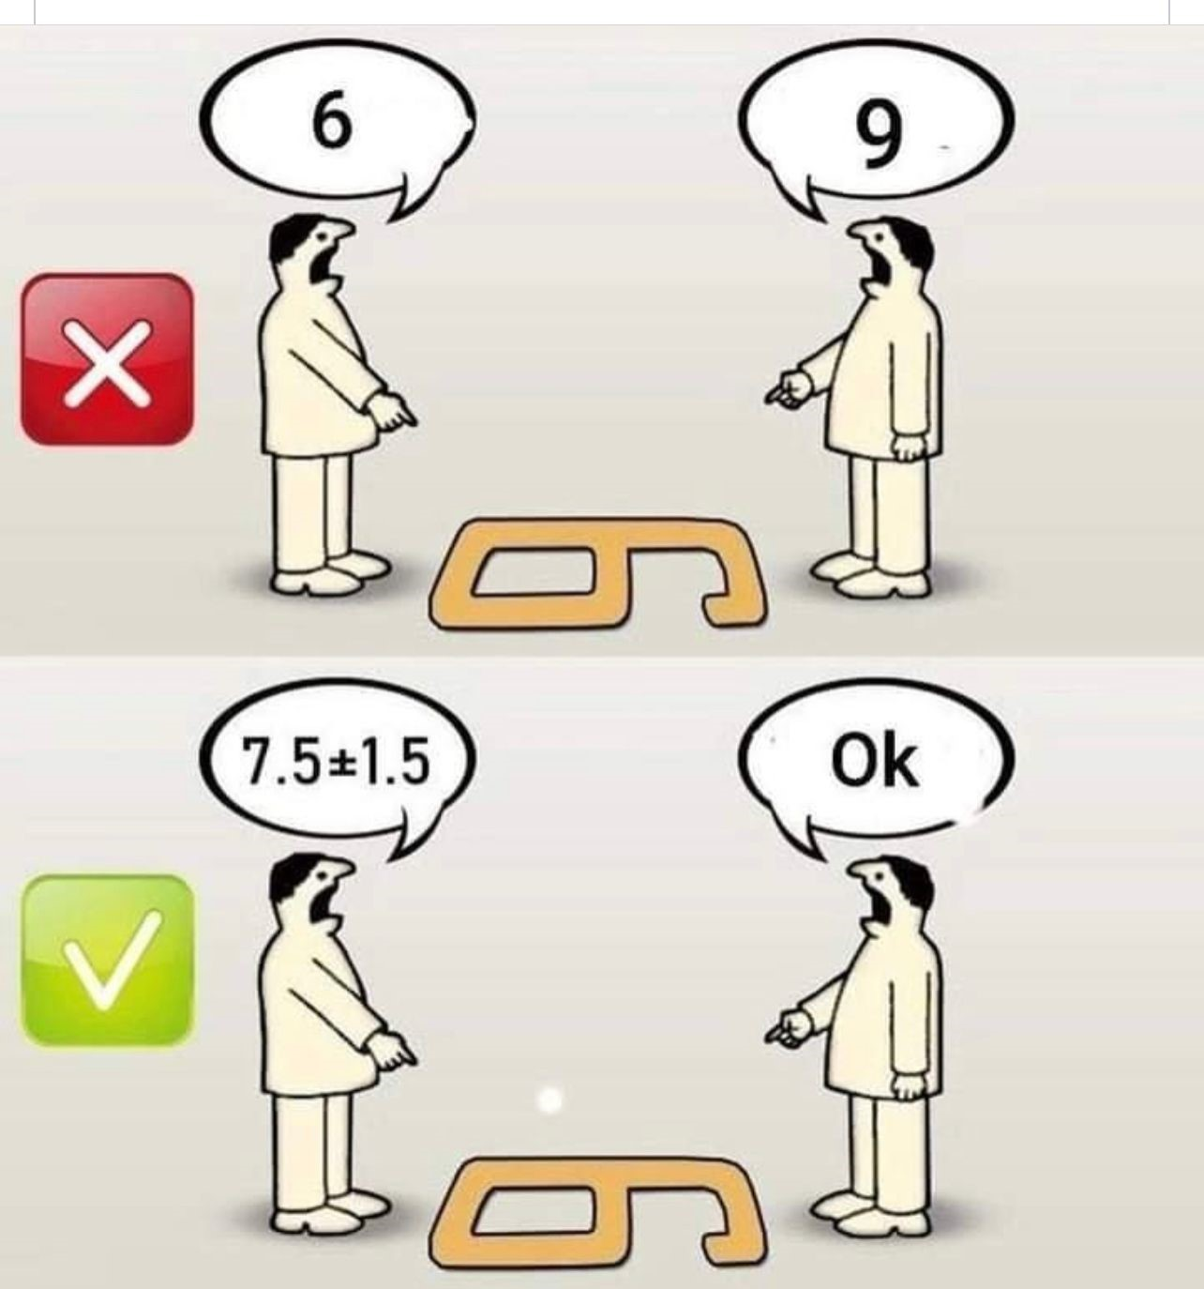
Do we (really) understand each other ?
" Between
What I think,
What I mean,
What I think I'm saying,
What I am saying,
What you want to hear,
What you think you hear,
What you hear,
What you want to understand,
What you think you understand,
What you understand,
There are ten possibilities that we will have difficulty communicating, but let's try anyway...“
Adapated from Bernard Werber « L’Encyclopédie du Savoir Relatif et Absolu »

Slide 3
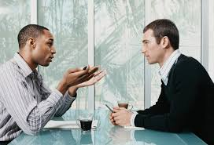
Difficult conversations?
I am about to provide sensitive feedback to an employee. How can I share it?
There are a lot of tensions and divisions within my team. How can I manage?
I don't get along well with my colleague. How can I tell her?

Slide 4
Sources of conflict
Conflict is an apparent disagreement that occurs when another person’s action or inaction threatens something that is important to us (needs, values or identity).
Respect
Reputation
Recognition
Work life-balance
Justice
Identity at work
Objective sources (tasks) | Subjective sources (interpersonal)
Lack of clarity in roles, expectations and goals Rivalry for scarce resources Differences in methods and procedures | Lack of communication Communication style Personal history (education, trauma) Emotional intelligence Mental health disorder Cultural differences

Slide 5
3 levels of conversation
Facts
(The problem)
Emotions (Feelings)
Identity
(Internal dialogue)
Source: Adapted from ‘’Difficult conversations’’ by Stone, Patton et Heen, 1999.

Slide 6
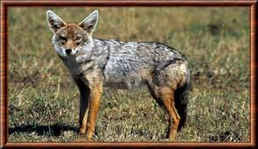
The (conflictual) blaming communication style
Blame
Judge
Punish
« You »
Example:
Person A: You didn't do anything of what you had to do.
Person B: Wrong, I did some of it. The rest…because it's your fault!

Slide 7
Listen to understand and to learn
Positions
Interests
Needs
Notes:
Position: I refuse to work with them
Interests: Because my input is not being considerated
Needs: collaboration and recognition (knowledge and experience)

Slide 8
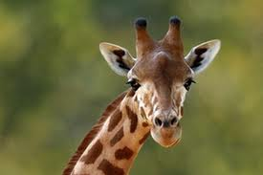
Nonviolent communication model
Contribution
Understand
Collaborate
« I »
Example:
Person A: I, too contributed to this outcome. How can I better support you?
Person B: I have my share of responsibility in this situation. How can I be more useful?

Slide 9
Nonviolent Communication Model by Marshall Rosenberg
Steps | Conversation
Observations (Neutral, factual, non-judgmental, non-evaluative description of behaviour, such as a description of an image, photo) | “When I see, that you cc other people on your response to my email…” “When I hear, that you raise the tone of your voice…” “When I observe, that you roll your eyes when I speak …”
Impact (on me, on the team, on the organisation) | On me : “I feel….” (Identify feelings : confused, anxious, frustrated, disconnected) B. On the organisation, the clients, the expected results, our reputation, the team morale: “The impact is ....”
Need | “Because I need… (Insert a need, such as consideration, support, cooperation, security, calm, recognition, etc..»
Request | “Can you.... accept to reply to my email in the future without sending it to the whole team? » "...to make an effort to keep your tone of voice down when you talk to me?" "I would appreciate it if you could ...show some openness when I communicate an idea, when I speak ..."

Slide 10
Emotions and needs (Vern Neufeld Redekop model)
Anger
Disengagement
Meaning/
Justice
Fear
Action/
Autonomy
SELF
Security
Connectedness
Recognition
Sadness
Frustration
Source: Vern Neufeld Redekop, 2003.

Slide 11
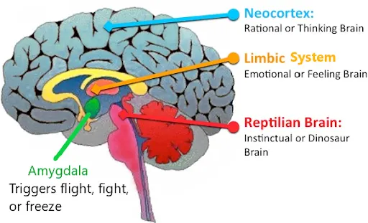
The brain reaction in a conflict situation
https://www.theroadtosiliconvalley.com/personal-development/leadership-eq-emotional-intelligence/
The Human Limbic System: The Brain's Emotional Core - HubPages
(Box breathing relaxation technique)
Notes:
Loic
Paul MacLean – 3 Brain Theory (in Daniel Goleman, Emotional Intelligence)
Dr. MacLean American, physician and neuroscientist, said we do not have 1 brain but 3. Each brain evolved over time one by one over the older brain until there were 3 distinct brains interconnected with their own purpose and function. This is called the Triune Brain Model. This controls breathing, heart and organ functions
1st – Reptilian (Primitive) is at the brain stem, root brain.. It is a part of the brain which cannot be reprogrammed since it regulates your body. Its goal is to make sure you stay alive and reproduce.
2nd – Limbic (Emotional) sits over the primitive brain and is impulsive and powerful. It controls how you feel to certain stimulus. Knowing something is right in your heart. It connects information to memory and works best during emotionally charged context.
We like to believe that our decisions are based on our thought but in reality they are based on our “emotional state of mind”, how we feel at the time. It’s important to know that there was an emotional brain long before rational brain.
3rd – Neocortex (Rational) is the newest part of our brain and is also referred to as the “thinking brain”. It sits on top of the emotional brain and it controls higher level processes such as logic, reasoning, creative thinking, language etc.
The emotional brain is known to hijack your rational mind when it its basic needs for survival & reproduction are threatened sending a storm of messages to the lower brain to execute pre-programmed instructions in a fight or flight response .
+The active amygdala also immediately shuts down the neural pathway to our prefrontal cortex so we can become disoriented in a heated conversation. Complex decision-making disappears, as does our access to multiple perspectives. As our attention narrows, we find ourselves trapped in the one perspective that makes us feel the most safe: “I’m right and you’re wrong,” even though we ordinarily see more perspectives.

Slide 12
Conflit escalation
Arbitration (formal)
Incompatibility
Conciliation
Mediation
Balancing damage
Communication breakdown
Losing sight of the initial objective
Everyone wants to win
Facilitation
Personalization of conflict
Looking for peer support
Negociation
Seeking support for one's point of view
Simplification bias
Problem solving
Bias, prejudice, stereotypes
Confrontation spiral vs. dialogue
Perception bias
Incident, uncivil behavior
Notes:
*Make sure to elaborate by walking through the stages with specific examples.
The six phases of escalation
1. Perceptual bias: An event occurred and there are always two sides to every story. In other words what one person might find offensive, another might find inoffensive. Everyone has boundaries and trigger points and even a seemingly inoffensive event can trigger someone.
2. Simplification: Without having a discussion with the other party with whom you are experiencing a conflict, you are likely to resort to simplistic explanations and might start focusing on the person rather than on the behaviour.
For example: You might say: “What do you want? They’re like that. I’m not surprised they would act that way!”
The reaction comes as no surprise given their character.
3. Support of peers: When conflict starts to escalate in the workplace, you try to find people to talk to, either to gain insight or to get people to come to your side. It When you start triangulating with someone (to purposely involve someone who is outside of the conflict), you risk creating alliances and polarizations in the workplace.
This can very quickly lead to cliques and groups of people who hang out together and deliberately exclude others.
Remember: Social exclusion is a form of indirect aggression, which has been identified by the Treasury Board as a form of harassment.
4. Lose sight of initial objectives: At this point you’ve moved past the ability to see clearly and to identify the real issue. You’re on a war path and want to destroy the other person. It’s the proverbial “I’m right, they’re wrong!” attitude and it’s unlikely that you’ll be in a frame of mind to be introspective.
5. Balance the damage: At this point, you are completely enmeshed in what has been labeled the Poor Me Syndrome stage. It’s where you only focus on the hurt you experienced and why the other party isn’t acknowledging that they did or said something that offended you. You are annoyed at the fact that they are getting away with being offensive in the workplace, so this is where tempers usually flare. You are constantly seeking a form of retribution.
6. Incompatibility: At this stage, the conflict has escalated to the point where there is the possibility that either harassment has occurred or is occurring or even the risk that an incident of workplace violence has occurred or is occurring. At this stage, it is highly unlikely that one or both parties will want to engage in informal conflict management services (ICMS) by way of facilitated discussion or mediation. In fact, it is likely that at this stage the separation of the parties will occur and the conflict will have remained unresolved. When you get to this stage, nobody wins.

Slide 13
5 modes of handling conflict
Collaboration requires dialogue and mutual needs and interests to be taken into account
High
Competition
(dominant)
Collaboration
Interests
Concern for own goals/needs
Compromise
Avoidance
Accomodation
Relationship
Concern for the relationship/empathy/needs of others
Sources: Thomas et Kilmann, 1974.
Low
High

Slide 14
The trust attributes
Loyalty: Quality, character of someone who is honest, and who arouses an emotional attachment.
Respect: A feeling of consideration for others, which leads to treating them with special consideration.
Transparency: Quality of the person who fully informs about their way of working, their practices and who is inclined to share information.
Good faith: State of mind of someone sincere, loyal, animated by good intentions.
Cooperation: Mutual aid between partners/colleagues who demonstrate reciprocity towards a common goal.
Reliability: Person you can rely on who acts and speaks according to their commitments, and who proves to be trustworthy.
Commitment: The act of committing by a declaration, a promise, an agreement, an obligation towards the other.
Confidentiality: Which has the secret and personal character belonging to the exclusive relationship of the partners/colleagues.
Competence: Who demonstrates a level of mastery and a sense of duty that inspire confidence.
Fairness: A just appreciation and absolute respect for what is owed to everyone.
Source : Loïc Berthout 2023

Slide 15
The dynamic of trust in the team
Discover the importance of the trust attributes, for oneself, for others and for the team
The whole
The team
The other
Self
Foster openness, understanding and reciprocity to maintain balance in mutual trust
Source : Loïc Berthout 2023

Slide 16
How do we work?
Guiding principles
Voluntary basis
Confidentiality
Impartial and neutral third party
Types of interventions
Consultation (Informative)
Conflict coaching
Facilitated conversations (between parties)
Mediation
Conciliation
Group / Team conflict management
Training (Workshops)
Our values
Listening - Trust - Collaboration – Learning - Neutrality
1. Connect (Trust)
2. Acknowledge (Awareness)
3. Empower (Support)

Slide 17
Contact
Informal Conflict Management Services
Throughout Canada
(819) 956-7724
''There are no two persons who don't get along, there are only two persons who haven't talked.‘’
Wolof proverb

