Slide 1
Global Health Approach at CISSS Montérégie-Est November 2023

Slide 2
Global health our culture, our DNA !
https://youtu.be/YC8LLYMp4M4?si=LOtfvBj4uV7sPL3v
We play as a team and have fun!
Balance is everyone’s business
Mutual support, collaboration, respect, communication, boldness and courage

Slide 3
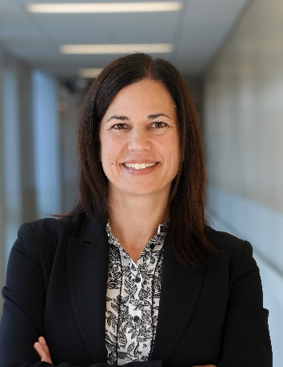
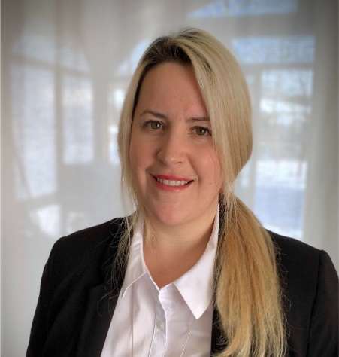
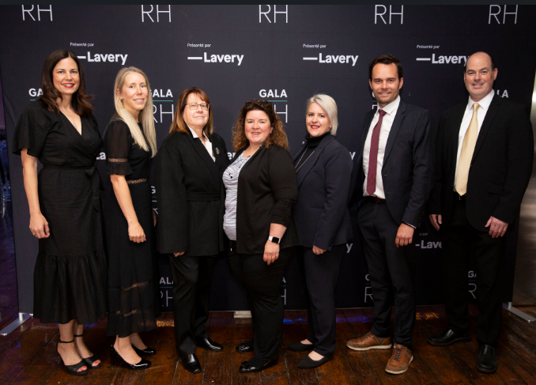
Who we are
Manon Beaudet, Graduate diploma CIRA
Deputy Director Employee experience Leader and organisational culture
Jacynthe Boisvert, Dps. CIHR
Assistant to the Director of Human Resources, Communication and Legal Affairs
Commited team ☺

Slide 4
Agenda
1st part: A little bit of history
Organisational gamble: moving from a culture of hours to a culture of balance
The meaning of our approach: our guiding principles
2nd part: Lifting the veil on the mystery
How have we succeeded despite the pandemic? (examples of concrete measures)
Examples of bold actions

Slide 5
1st part A little bit of history

Slide 6
Origins of the GH approach at CISSSME
X 47
Employees absence every day
(out of 12,000 employees at the moment)

Slide 7
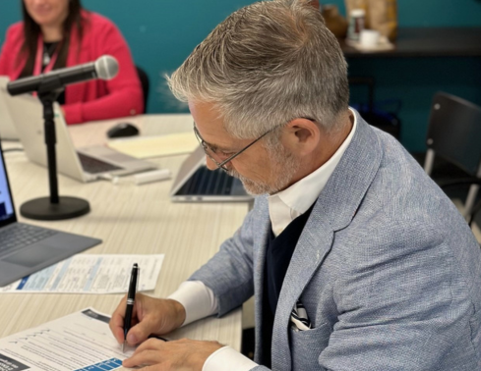
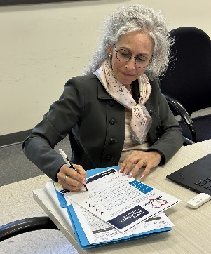
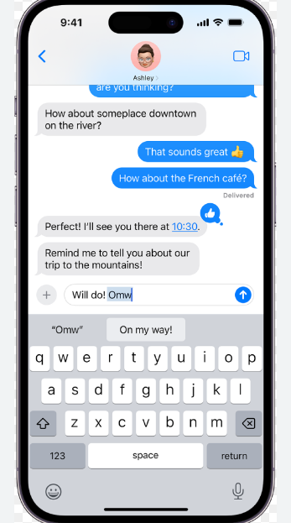
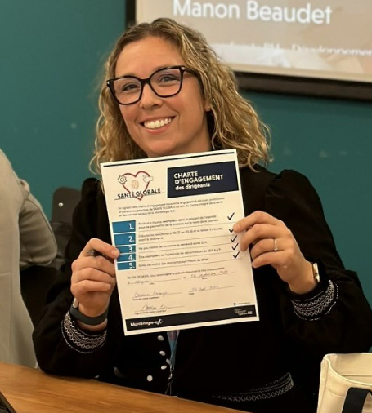
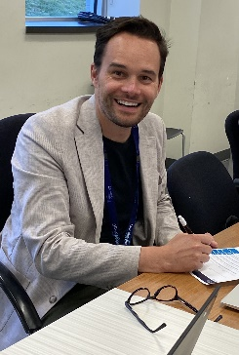
Organisational gamble : positive cascade and reinforcement
Our CEO and CEOA
CEO's friendly ticket
Users
Employees
Managers
Setting an example

Slide 8
Workplace experience
Integrate into our management system: strategic anchoring in our culture

Slide 9
Guiding principles of the approach
Guiding principles of the approach
« OUT OF THE BOX » VISION
SIMPLIFY
FUN
PREVENTIVE

Slide 10
2nd part Lifting the veil on the mystery

Slide 11
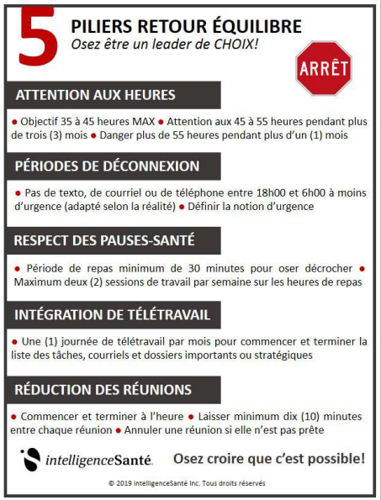
What exactly is the global health approach?
Allow ourselves to talk truly;
Taking simple, practical steps to achieve balance;
Encouraging and promoting a healthy culture of balance;
Allowing ourselves to be preventive (cascade burn in/burn out).

Slide 12
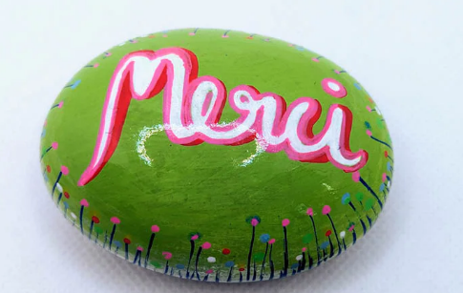
5 simple, concrete practices
greet
call
smile
thank
apply

Slide 13
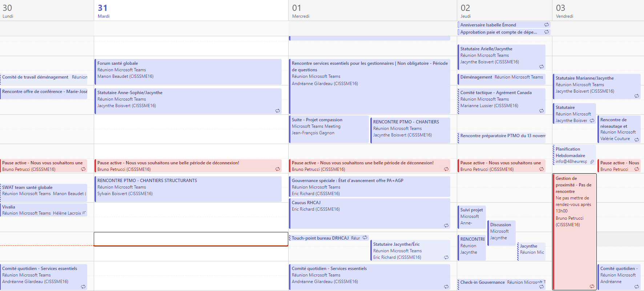
Organisational measures
Disconnect 18h-6h
Meetings starting at 0:05/0:35
Schedule proximity
An active health break at lunchtime set aside in the diary by the CEO
Organisation of working time

Slide 14
Top 10 challenges
A culture of hours
A CEO working a lot of hours
Being the guardian of meaning in the midst of a pandemic
Certain Directors didn’t believe in it.
Distinguishing between equity and equality!
Taking into consideration the 24/7 reality
The reality of our doctors' practices
Non-adherence to our Department of Health and Social Services measures: everyone working overtime
It's never the right time speech
Several new managers with manpower issues
Capacity issues for the GH team because of its popularity
People were spreading rumours about my departure date!
Cultivate hope

Slide 15
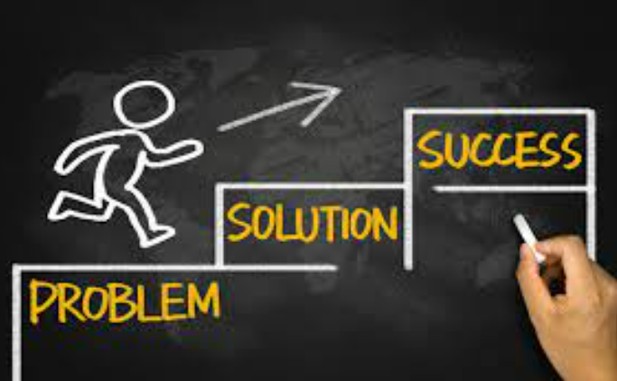
Examples of solutions
Progressive deployment of measures despite the pandemic
Disconnection calendar
Executive OT watch
Communications plan: distinguishing between being responsible and being on-call with our business partners (BPs)
Add the Maintaining and Restoring Balance tool to the contribution assessment process
Legitimise disconnection by sending out friendly fines
Distinguish between exceptional situations and disconnection at all costs.
Demystify the notion of urgency - Communication code and tool for sending delayed messages
Doctors' projects
Checklist: reducing intensity
Mandatory health leadership training for all new managers
Work in collaboration with BPs, coach environments to develop expertise
Integrating global health into our employer brand

Slide 16
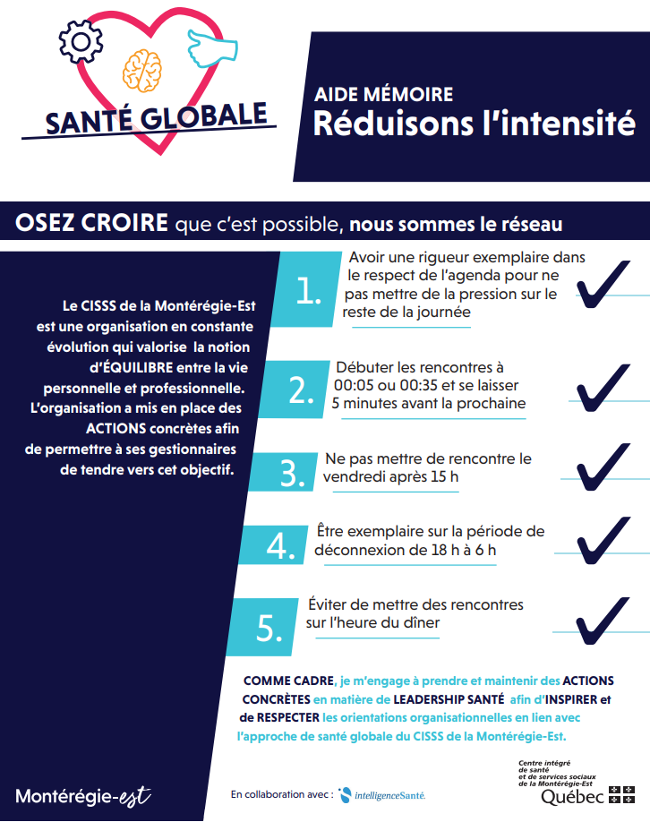
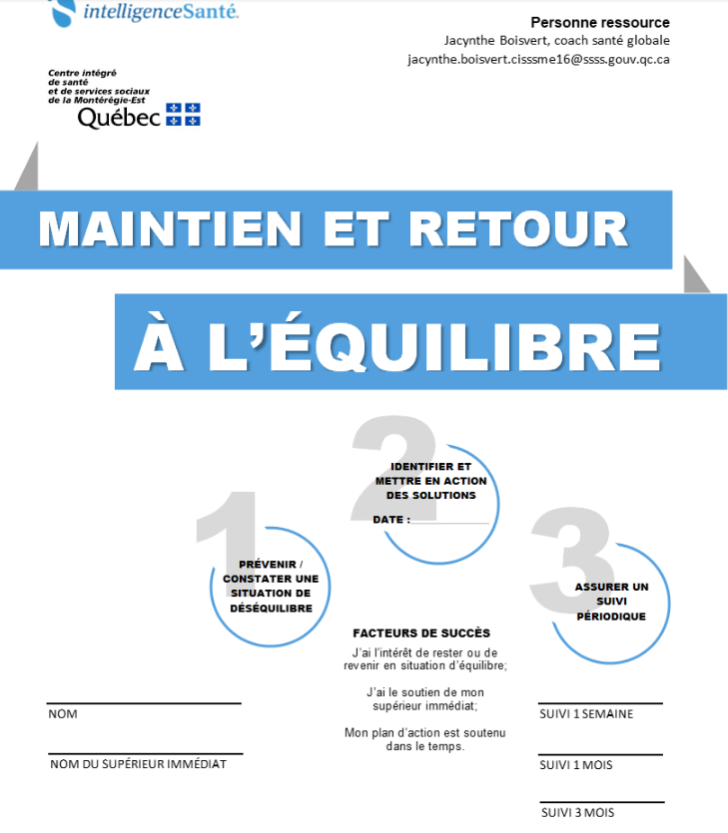
Maintaining and restoring balance

Slide 17
Vacation and communications code

Slide 18
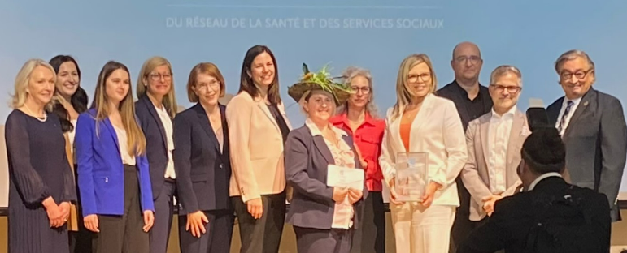
Examples of bold actions
Holiday conference for our employees and their families
Integrating play and fun into our organisational executive's development day
Posture-credibility-pleasure

Slide 19
Progressive roll-out in brief!
Before 2021
2021
2022
2023
Level of roll-out
Managers
Employees
Doctors
Examples
Of actions:
Regain your Maintaining and restoring balance momentum
Hiring of a Organisational health management consultant
Welcome course for new employees
Holiday code
Meeting 00:05
Communication code
Meeting code
No meeting area
Psychological health barometer
Flexible working hours
Active lunch break
Management Academy
Management Day
Health and psychological first aid Ambassadors
Partnerships with universities
Holiday for all training
Managers' Voice
Addition of management positions
Global Health Plan 2.0
Notes:
)

Slide 20
What sets us apart: our multi-level service
Coaching global health
52 unbalanced executives received global health coaching;
25 % openly expressed that they had avoided leaving on disability or the organisation following the coaching;
The unspoken approach
Workshops on practices
94 % average satisfaction on global health support initiatives;
+40 % of senior managers use consultancy services for their teams or themselves
Actions in strategic projects
Planning session
Development day
350 health ambassadors trained at various levels
95 % average satisfaction health leadership training

Slide 21
A healthy environment, personal development and organisational performancele
Découvrez notre vidéo (cliquez sur l’image)

Slide 22
And now!
Would you be prepared to make a commitment?
Always start with yourself ☺
What action(s) can you take?

Slide 23
QUESTIONS

Slide 24
THANK YOU!

