Slide 1
Leading in a Digital World: Strategies for Modern Managers
Presented by: Roy Nader
Digital Culture Lead at OSFI
Feb 21, 2024

Slide 2
This session will be recorded
By participating in this event, you consent to audio recording and its release.
Please note, Microsoft Teams settings will not allow camera feeds, and microphones will be muted by default to respect your privacy. Your participation implies consent to these conditions.

Slide 3
Leading in a Digital World: Strategies for Modern Managers
Presented by: Roy Nader
Digital Culture Lead at OSFI
Feb 21, 2024

Slide 4
Agenda
Introduction
Fun quiz
Impact of changing perception
Build and lead a team
Develop a flexible and adaptable team
Deliver effectively
Hedge for emerging challenges
Prepare the team for a moment’s notice
Questions

Slide 5

Slido Quiz

Slide 6
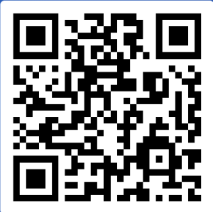
Introduction
Have fun
Use the Chat to comment
Use the Q&A to ask questions
Sharing is caring
Participate for muscle memory
Slido.com
#DigitalCulture

Slide 7
Objective
This session is successful if:
You learn 2 new things that you can apply after the session.
Slido.com
#DigitalCulture

Slide 8
Slido Quiz

Slide 9
What can we learn
Accelerated Impactful Challenges
Increased complexity
Higher risk
Requires new skills and ways of working
Constant awareness and adoption

Slide 10

Share in the chat
If you need support to deliver an accessible presentation, where do you go?

Slide 11
Change your perception, it increases your chances of success!
Found online within few minutes of search:
GC Workplace Accessibility Passport Team
Office of Public Service Accessibility (TBS)
Accessibility Learning Series – CSPS
Accessibility, Accommodation and Adaptive Computer Technology

Slide 12

Shannon Lord
Executive Director
Health Canada

Slide 13
Your new mission…
  Build and lead a flexible and adaptable team able to deliver effectively and ready to take on emerging challenges in a moment notice.

Slide 14
Achieving the Digital Leader Framework
  Build and lead a flexible and adaptable team able to deliver effectively and ready to take on emerging challenges in a moment’s notice.

Slide 15
AI impact on the workforce, by level
Executives
set the vision and culture
Managers
set and deliver the strategy,
Employees enhanced critical thinking

Slide 16
Build and lead a team
      1- Enhance your strategic approach with this 5-question template:
      Am I supporting the overall department’s strategic goals?
      Have I fully assessed all the stakeholders' impacts?
      Are there other risks that I need to consider and hedge for?
      How will this drive innovation or upskill the team?
      How will success be measured?

Slide 17
Build and lead a team
Post pandemic communication
  Mastering communication as a leader (LinkedIn Learning)
  Start with why -- how great leaders inspire action | Simon Sinek |TEDx
  Generative AIs as editors (unclassified)
Change Management
  Lead change in an unpredictable world (TRN412)
  ADKAR model explained on YouTube

Slide 18
Build and lead a team
Risk management
  Low risk
  Medium risk
  High risk
  Introduction to Risk Management (TRN209)
Emotional intelligence
  Emotional Intelligence for Successful Leadership (TRN151)
  Developing your emotional intelligence

Slide 19
Develop a flexible and adaptable team
Hire for the future - bring new skills
Upskill internally

Slide 20
Isa David
Manager, L&D
Office of the Chief Information Officer

Slide 21
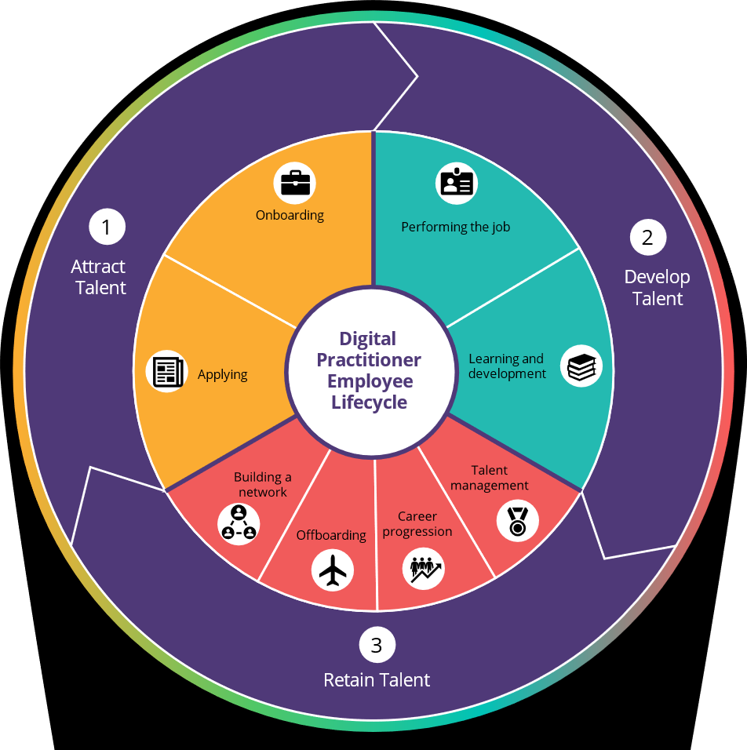
Attract, Retain & Develop Digital Talent
Notes:
Putting people at the heart of Strategy
The GC Digital Talent Strategy takes a human-centred approach. It was developed using the Employee Life Cycle for Digital Talent as its framework.
This cycle, as illustrated in the graphic, maps out the various stages that digital talent go through as they navigate their careers in public service, from the beginning to development and transition.
Each of the phases represents a strategic point where we, as a government, can take concrete actions to attract, develop and retain digital talent.
As we lead the way in Government of Canada-wide initiatives for digital talent, our key areas of attention include:
Recruitment: Bringing in the best talent
Learning and development: Ensuring our talent keeps growing
Talent management: Effectively utilizing our workforce
Offering job and career guidance within our organizations
Recognizing accomplishments through events
Engaging with our community for collaboration and growth

Slide 22
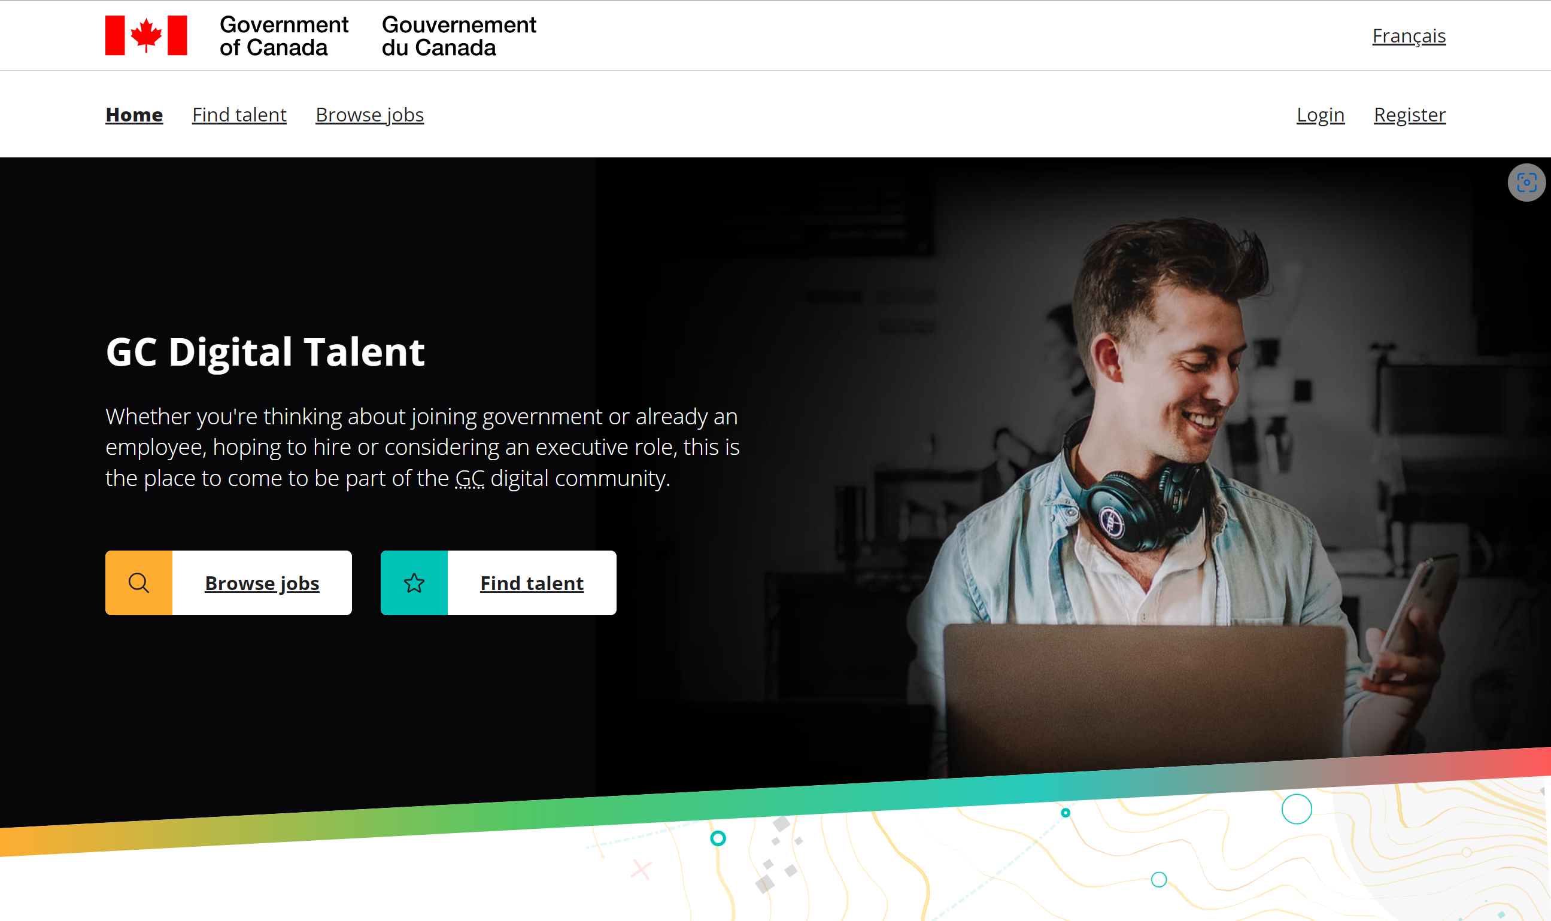
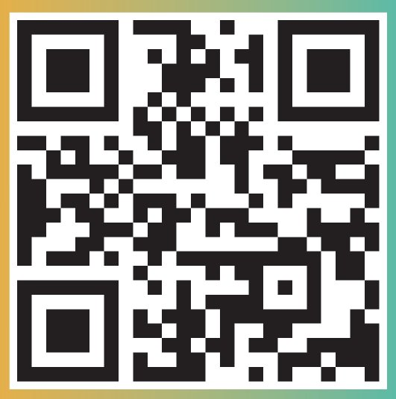
Attract talent
Attract talent
The Talent Platform: talent.canada.ca

Slide 23
Erica Vizeau
Director General
EFPC DIGITAL ACADEMY

Slide 24
CSPS Digital Academy
The CSPS Digital Academy provides free GC-specific learning on the skills, knowledge, and attitudes public servants need to design and deliver digital-era programs, policies, and services.
Self-paced and instructor-led courses
Learning events
Microlearning (articles, job aids, videos)
Digital Accelerator program
Digital Literacy and Leadership, Emerging Tech, Cyber, Cloud
Service Design, Agile,
Product Management
Data, Artificial Intelligence

Slide 25
1. Take a course
All Public Servants
Managers
Digital in Practice (DDN202)
Discover Cyber Security (DDN235)
Discover GC Cloud (DDN104)
A Self-Directed Guide to Understanding Data (DDN303)
The Role of Data in Digital Government (DDN301)
Foundations of Data Analysis: The Analytical Process (DDN320)
Discover Artificial Intelligence (DDN210)
Ethical Considerations in Artificial Intelligence (DDN243)
Using Generative AI in the Government of Canada (DDN321)
OpenAI's ChatGPT Explained
Introduction to Human-Centred Design (DDN207)
Modernizing Public Services for Managers (DDN206)
GC Cloud for Managers and Executives Learning Path (DDN1-PA1)
Discover Digital for Executives (DDN204)
GC Cloud for Managers and Executives Learning Path (DDN1-PA1)
Executives
* A full list of available courses is listed by theme in the Annex.
Notes:
All public servants includes managers and executives.

Slide 26
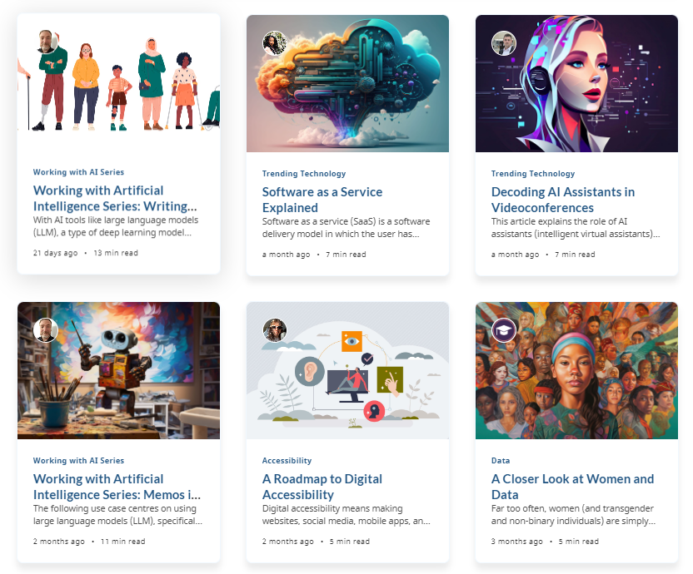

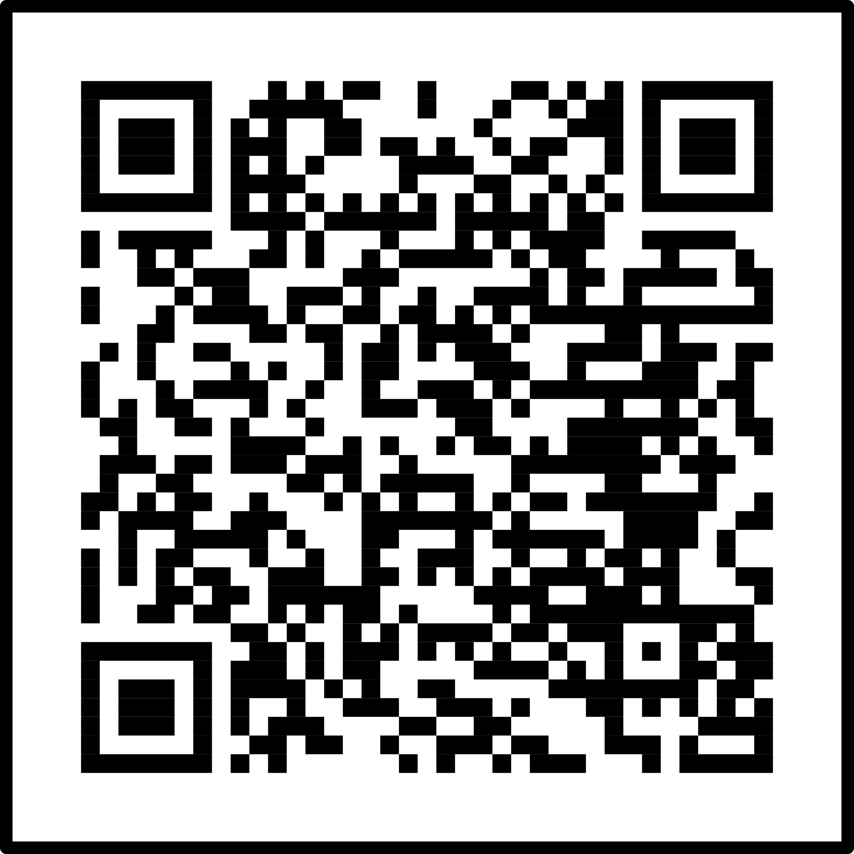
2. Make Learning a Routine
Microlearning Articles
Scan the QR code and subscribe to the
CSPS Digital Academy Newsletter
We’re sharing new digital courses, events, micro-learning and more straight to your inbox. Sign up to keep up with digital trends, skills, and resources.
Explore articles
Notes:
The goal of microlearning is to enhance digital literacy by breaking down complex topics into smaller, more manageable concepts that appeal to different learning styles.

Slide 27
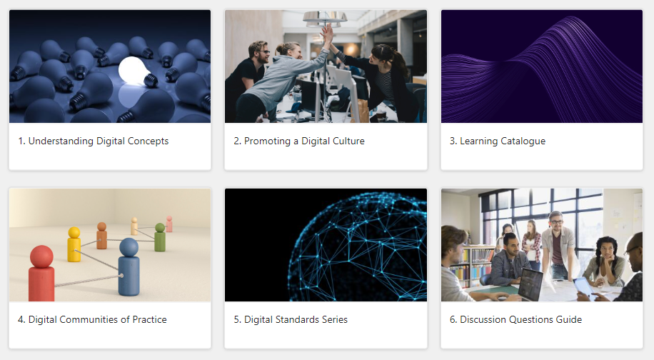
3. Explore the Digital Learning Promotion Toolkit
Online evergreen toolkit on GCXchange
Notes:
This online evergreen toolkit on GCXchange aims to equip individuals, teams, and organizations with the right tools to create learning opportunities and promote digital literacy within their sector.

Slide 28
Deliver effectively
Behavioural competencies:
  Design thinking
  Enabling Accessibility and Inclusion
  Agile
  Automating processes
  Data literacy – Visualize instant data

Slide 29
Exercise
Please email Roy.Nader@osfi-bsif.gc.ca
Subject: type one of the following choices
  Banana
  Orange
  Kiwi
  Feel free to send more than one email.

Slide 30
Deliver effectively
Technical competencies:
  Basic knowledge:
  Power Automate, Power Apps, Power BI, Visio, List
  Intermediate knowledge :
  Word, Excel, Whiteboard, Stream, Forms, Loop, Canva, a Generative AIs, LinkedIn, Edge browser, Work mobile
  Advanced knowledge:
  Outlook, PowerPoint, OneNote, OneDrive, Teams, Planner

Slide 31
Deliver effectively
Potential support:
  IT Client Relationship Managers (CRM or BRM)
  Innovation hubs
  Learning and Development
  Internal communities
  Interdepartmental communities - GCxChange
  CSPS/Digital Academy
  YouTube

Slide 32
Hedge for emerging challenges
      Continuous learning to increase resiliency.
          Add a 5 min learning segment in each team meeting
          Develop a two-year learning path for you and your team
      FutureOps Challenge:
      Develop team challenges on a quarterly basis to brainstorm strategies and tactics for challenging scenarios

Slide 33
Prepare the team for a moment’s notice
Learn to ask the right questions:
  Shadow your Director
  Use Generative AI as a job aid
  Take the following courses
  How to Ask Better Questions | Mike Vaughan | TEDx
  How to ask productive questions
Build a strong Network
  Tools: Geds, LinkedIn, Facebook groups, GCTools, Meet up groups

Slide 34
Amanda Bernardo
Director,
Change Management and Service Design
Shared Services Canada

Slide 35

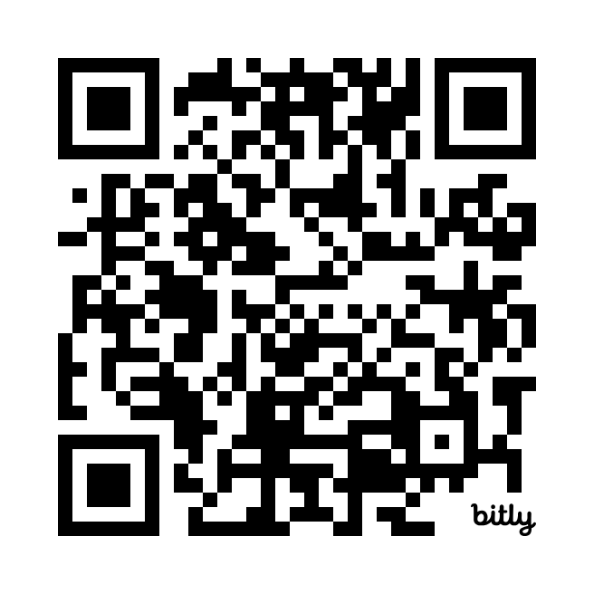

Questions?
https://www.linkedin.com/in/roynader

Slide 36
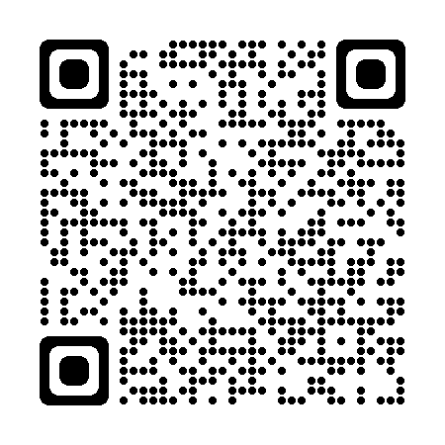
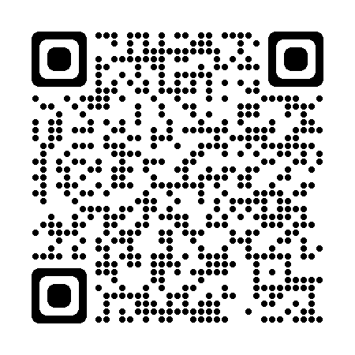
About the National Managers Community
NMC website
Contact us
nmc-cng@csps-efpc.gc.ca
Follow us
LinkedIn / Twitter
Subscribe to NMC News

