Slide 1
NMC MANAGERS CONNECT -
ÉCHANGES ENTRE GESTIONNAIRES DE LA CNG
Date: NCR - November 1, 2023
Toronto / May 1 – 1er mai 2024

Slide 2
Agenda Ordre du jour
9:00-9:15 am Welcome & Opening Remarks
Camille Beausoleil, ED, NMC
Meredith Richmond, RL (Ontario), NMC
9:15–10:10 am Coaching through Complaints
Workshop, Susan Badame & Julie Wills
10:10-10:40 am Break
10:40-11:50 am What is Peer Coaching?
Workshop, Susan Badame & Julie Wills
11:50 am-1 pm Lunch (not included)
1:00-2:15 pm Difficult Conversations – Executive Panel Discussion with Jaime Burke, Lorraine Edinboro, Hilary MacDonald, Jim Daskalopoulos; moderated by Alicia Seifert
2:15-2:30 pm Break
2:30-3:40 pm Speed Mentoring Session
3:40-3:45 pm Closing Remarks
3:45-4:30 pm Informal Networking
Bienvenue et Mots d’ouverture
Camille Beausoleil, DE, CNG
Meredith Richmond, DR (Ontario), CNG
Coaching dans le cadre des plaintes
Atelier, avec Susan Badame et Julie Wills
Pause
Qu’est-ce que le coaching par les pairs ? Atelier, avec Susan Badame et Julie Wills
Dîner (pas inclus)
Les conversation difficiles – un panel de discussion de cadres avec Jaime Burke, Lorraine Edinboro, Hilary MacDonald, Jim Daskalopoulos; modéré par Alicia Seifert
Pause
Session de mentorat éclair
Mot de conclusion
Réseautage informel

Slide 3
Coaching Workshop
Part 1: A Coaching Approach to Move from Complaints to Solutions
Part 2: What is Peer Coaching and How Can It Help Me?

Slide 4
What to Expect?
Part 1: A Coaching Approach to Move from Complaints to Solutions
Check In
Learning Environment
What is Coaching in this Context?
Tool #1: Conversation Model
Tool #2: 6-Pack Starter Kit
Practice in Pairs
Debrief
Part 2: What is Peer Coaching and How Can It Help Me?
Roles & Process in a Peer Coaching Circle
Asking Open-Ended Questions
Demo of Peer Coaching Circle
Group Practice
Debrief & Wrap-Up

Slide 5
Check In
Who are you?
Where do you work?
What two words would describe you best right now?

Slide 6
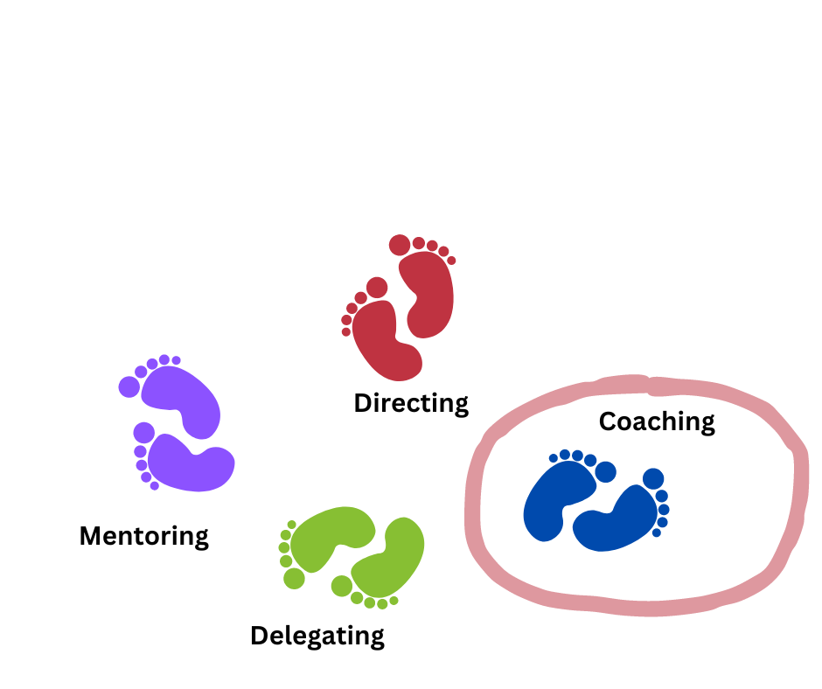
Managing People – a Dance of Skills

Slide 7
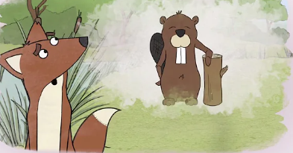
What is Coaching?
What coaching is (https://www.youtube.com/watch?v=Esh75mbmucY )

Slide 8
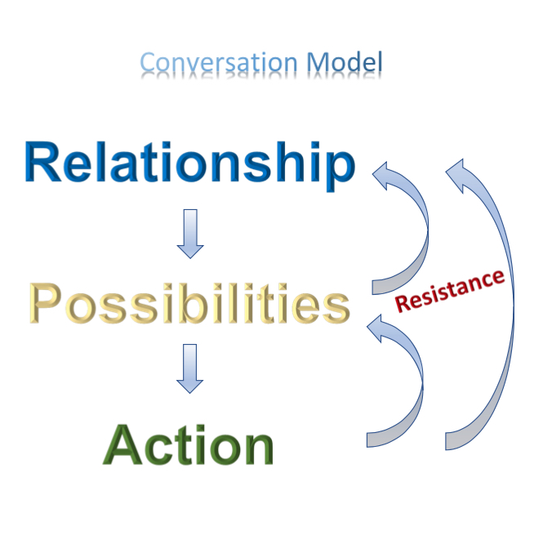
Conversation Model
Lack of confidence in relationship/trust in coach
Not ready to share personal details
Stuck in anger or frustration at situation
Not willing to decide/too committed to the complaint
Too soon to take action/ move forward
Afraid to implement an action

Slide 9
Coaching Through Working with Complaints
In every complaint, we are stuck and committed to something
In this exercise, you will practice:
to uncover what in the complaint has you stuck, and
to begin to explore possibilities and solutions

Slide 10
6-Pack Starter Kit
Coaches:
Listen to your coachee’s complaint (this is their story)
Ask your coachee:
What is important to you?
What would success look like?
What have you tried?
What are one or two possibilities you could explore?
What is one action you could take as a next step?

Slide 11
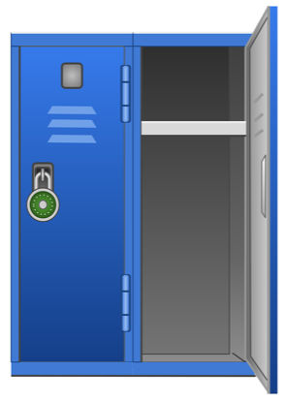
The Locker
No advice giving
No advice asking
…for today

Slide 12
Debrief
Coaches:
What was it like to ask questions?
What did you notice about yourself?
Coachees:
What was it like to be listened to in this way?
What did you notice about yourself?

Slide 13
- BREAK -

Slide 14
What to Expect?
RECAP
Part 2: What is Peer Coaching and How Can It Help Me?
What is Peer Coaching
Roles & Process in a Peer Coaching Circle
Asking Open-Ended Questions
Demo of Peer Coaching Circle
Group Practice
Debrief & Wrap-Up

Slide 15
What is Peer Coaching?
Helping others to discover new possibilities and solutions by being curious and asking them open-ended questions.

Slide 16
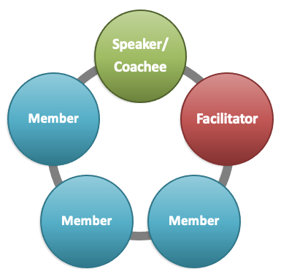
Roles
Coachee
Presents their topic
Members
Ask questions
Facilitator
Moderates, supports and ensures that coachee is not overwhelmed

Slide 17
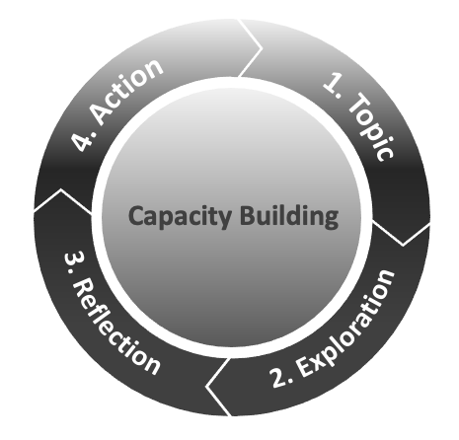
The Process

Slide 18
Setting the Stage - Capacity Building
Asking open-ended questions
Hint: they start with - What, How, Where, When, Who
Keeping questions short
Having less words creates clarity

Slide 19
To Be Avoided
Closed Questions – They illicit ‘yes’ or ‘no’ response
Leading Questions – “Have you tried…”
Over-paraphrasing - “So what I hear you say is….,”

Slide 20
6-Pack Starter Kit
Coaches:
Listen to your coachee’s complaint (this is their story)
Questions you could ask:
What is important to you?
What would success look like?
What have you tried?
What are one or two possibilities you could explore?
What is one action you could take as a next step?

Slide 21
Wrap-Up
What did you learn about yourself through the Peer Coaching Circle process?
What is one takeaway that you will practise in conversations going forward?

Slide 22
Peer Coaching Circles Offer:
a networking opportunity
practical, replicable, implementable tools to use in everyday conversations
a chance to enhance peer relationships
a safe, non-judgmental and confidential place to share experiences
an opportunity to experience the power of open-ended questions whether you ask or answer them
a way to learn coaching relevant practices by trying them out and practicing them with peers while tackling real issues in the workplace
an exploration of ways and approaches to generate practical actions and next steps

Slide 23
Coaching Resources
Video resources:
Joining a Peer Coaching Circle? What to Expect: https://youtu.be/H1ZNjTjEFZE
Selecting a Coaching Topic: https://youtu.be/qg1s0CoRtT4
The Feedback Model Video: https://youtu.be/noz3ViNZssk
Canada School of Public Service coaching courses and job aids:
Coaching for Effective Leadership (TRN402) (3-hour virtual course)(prerequisite for TRN401)
Developing Successful Coaching Relationships (TRN439) (1-hour online self-paced course)
Introduction to Peer Coaching (TRN401) (3-hour virtual course)
Introduction to Coaching (TRN4-V21) (micro-video)
Selecting and Sharing a Coaching Topic (TRN4-J37) (job aid)
Using the GROW Model in a Coaching Approach (TRN4-J31) (job aid)
Peer Coaching Process: Using the GROW Model Approach (TRN4-J32) (job aid)

Slide 24
Reflection during lunch:
What caught your attention
so far here today?
Réflexion pendant le dîner :
Qu’est-ce qui a capté votre attention ce matin jusqu’à maintenant ?
Back at 1 pm / De retour à 13h

Slide 25
Having Difficult Conversations with
Jaime Burke, Lorraine Edinboro, Hilary MacDonald and Jim Daskalopoulos
Moderator: Alicia Seifert

Slide 26
Sample Mentor Questions
What is one of the most valuable lessons you’ve learned in your public service career?
What is the most fulfilling aspect of your job and why?
What characteristics are you looking for in a leader within your organization?
If you were to change one thing in the public service today, what would that be?
What is the most challenging part of your job and why?
In an effort to advance my career and others in a similar position, what are three tips you can provide to managers looking to take the next step?
Over the course of your career, you have likely met people whose careers have not met their obvious potential. What do you think is the most common reason when this happens? How can this be prevented?
Did you ever take a job that turned out to be a bad fit? What did you do?
Do you have any best practices to share in terms of identifying potential employees and suggested hiring practices when it comes to valuing the importance of diversity and inclusion within our organizations?
What are some tips to ensure ongoing communication and feedback between employees and managers to ensure both parties are well supported?
How does the Government of Canada promote knowledge sharing and best practices across different departments and agencies?
How do you navigate the challenges of maintaining professional boundaries while building a close mentor-mentee relationship?
What strategies do you use to keep your employees motivated and engaged, especially during challenging times?
What was the most valuable piece of advice you received to date, and how did it impact your career?
In what ways has mentorship shaped your approach to leadership within the public service?
How do you effectively navigate bureaucratic processes to implement innovative solutions or drive change within your department or agency?
What strategies do you employ to foster collaboration and communication among diverse teams, particularly when working with stakeholders from various governmental bodies or sectors?
Can you share an example of a challenge you faced in managing a project with limited resources or tight deadlines? How did you overcome it, and what lessons did you learn from the experience?
In your experience, what are the most effective methods for balancing compliance with regulations and policies while still promoting efficiency and effectiveness in governmental operations?
As a manager in the GC, how do you stay updated on emerging technologies, trends, and best practices to ensure your department or agency remains forward-thinking and adaptable to change?
How often have you changed positions and when did you realize that a job is no longer the right fit for you?
Was there ever a leadership role you applied for and landed, but weren’t 100% qualified to do? How did you overcome the challenges you faced?
How can I be more strategic in pursuing my career goals in management?
Any tips for having difficult conversations with employees (i.e. performance reviews or constructive feedback)? Do you have any courses or resources to recommend on this front?
What are the key objectives and goals of your branch/sector, and how do they align with broader government initiatives?

Slide 27
- BREAK -

Slide 28
Speed Mentoring Session
Session de mentorat éclair
Three (3) rounds of 20 minutes each / Trois (3) tours de 20 minutes chacun
The Mentor takes 2 minutes to briefly present themselves /
Le/la mentor se présente brièvement, en 2 minutes;
Each participant takes 30 seconds to introduce themselves: name, title and department/agency /
Chaque participant-e prendra 30 seconds pour se presenter: nom, titre et ministère/agence;
You have about 15 minutes for questions and exchanging – a signal will let you know you have 2 minutes left to wrap up /
Vous disposez d'environ 15 minutes pour poser des questions et échanger - un signal vous indiquera qu'il vous reste 2 minutes pour conclure.

Slide 29
QR code for the evaluation form
Thank you et merci!
National Managers’ Community
Communauté nationale des gestionnaires
Subscribe to the NMC News
S'abonner aux nouvelles de la CNG

