Slide 1
Thinking About a Diverse and Inclusive Public Service Workplace?
LiveWorkPlay is a resource to assist you, as a manager, along with your team, with facilitation through the recruitment, hiring, onboarding, retention, and career advancement of individuals with intellectual disabilities and / or autistic persons into the Public Service.
Help us, help you create more diverse, inclusive, and welcoming workplace teams.
Got Jobs? – LiveWorkPlay

Slide 2
The Canadian Network Supporting Inclusive Public Service Employment (CNSIPSE)
LiveWorkPlay created CNSIPSE to assist the Canadian Public Service with hiring, onboarding, and retaining individuals with an intellectual disability and / or autistic persons on a national scale. CNSIPSE Partners are Employment Support Service Providers, like LiveWorkPlay, from across the country.
The CNSIPSE Partner in Halifax, Nova Scotia is TEAM Work Cooperative.
Job Seekers | TEAM Work Cooperative | Halifax

Slide 3
Canadian Network Supporting Inclusive Public Service Employment (CNSIPSE)
Landing Page
Canadian Network Supporting Inclusive Public Service Employment (CNSIPSE) / Réseau canadien pour l’emploi inclusif dans la fonction publique (RCSEIFP) – LiveWorkPlay

Slide 4
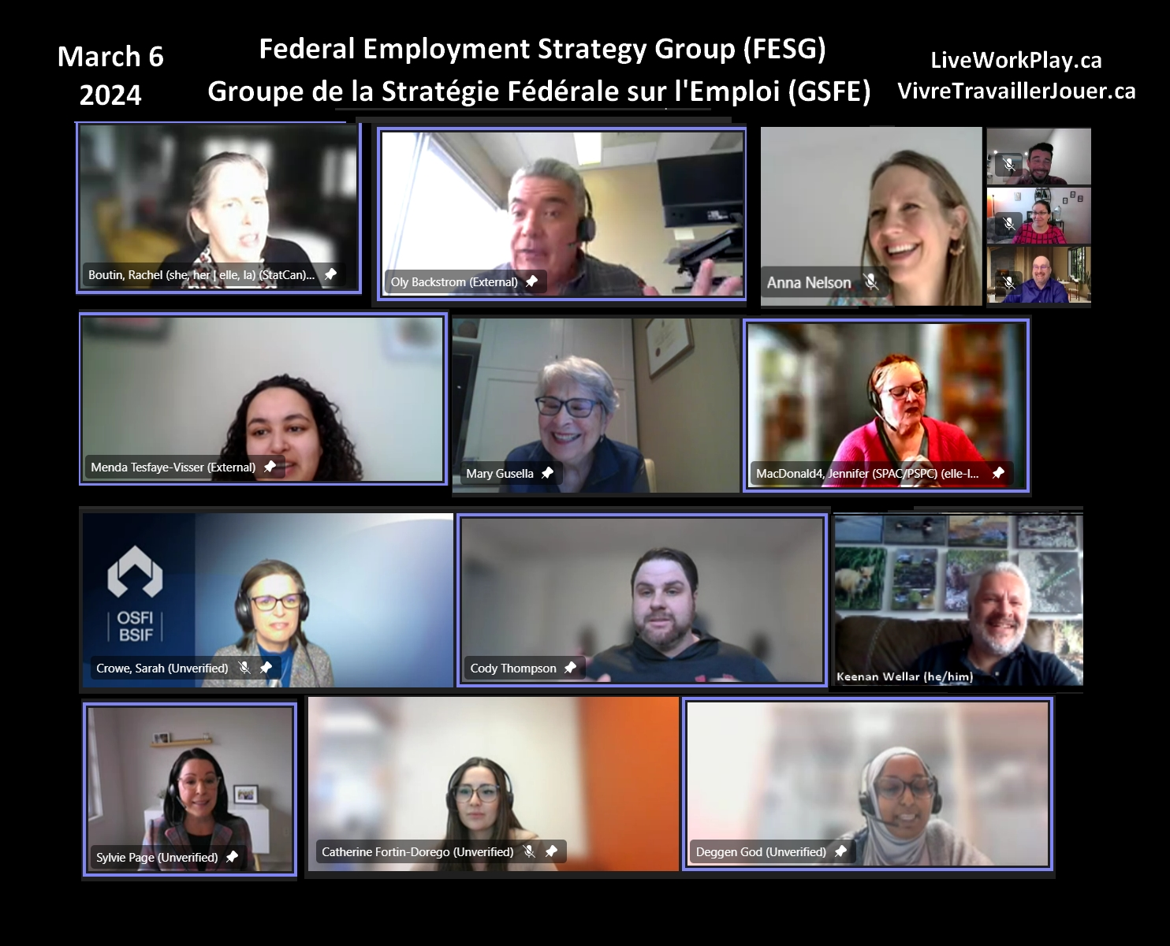
The Federal Employment Strategy Group (FESG)
The FESG, created and managed by LiveWorkPlay, is comprised of representatives from multiple departments and agencies, representing varied positions across the Federal Public Service. The group comes together to share stories, collaborate on ideas, and discuss best practices in relation to welcoming individuals with intellectual disabilities and autistic people into the Federal Public Service by creating accessible and supportive workplaces.

Slide 5
Federal Employment
Strategy Group (FESG)
Landing Page
Federal Employment Strategy Group (FESG) | Groupe de la stratégie fédérale sur l’emploi (GSFE) – LiveWorkPlay

Slide 6
Case Study: “Making employment within the Public Service of Canada accessible and successful for people with intellectual disabilities and autistic persons” Case Study: “Making employment within the Public Service of Canada accessible and successful for people with intellectual disabilities and autistic persons” – LiveWorkPlay

Slide 7
LiveWorkPlay - Finance Canada Video in English with FRENCH Subtitles

