Slide 1
Coaching Workshop
Part 1: Coaching Techniques to Move to Solutions
Part 2: Peer Coaching for Effective Leadership

Slide 2
What to Expect?
Part 1: Coaching Techniques to Move to Solutions
Check In
Learning Environment
What is Coaching in this Context?
Tool #1: Conversation Model
Tool #2: 6-Pack Starter Kit
Practice in Pairs
Debrief
Part 2: Peer Coaching for Effective Leadership
Roles & Process in a Peer Coaching Circle
Asking Open-Ended Questions
Demo of Peer Coaching Circle
Group Practice
Debrief & Wrap-Up

Slide 3
Check In
What two words would describe you best right now?
In three words, what is the biggest challenge facing public servant managers right now?

Slide 4
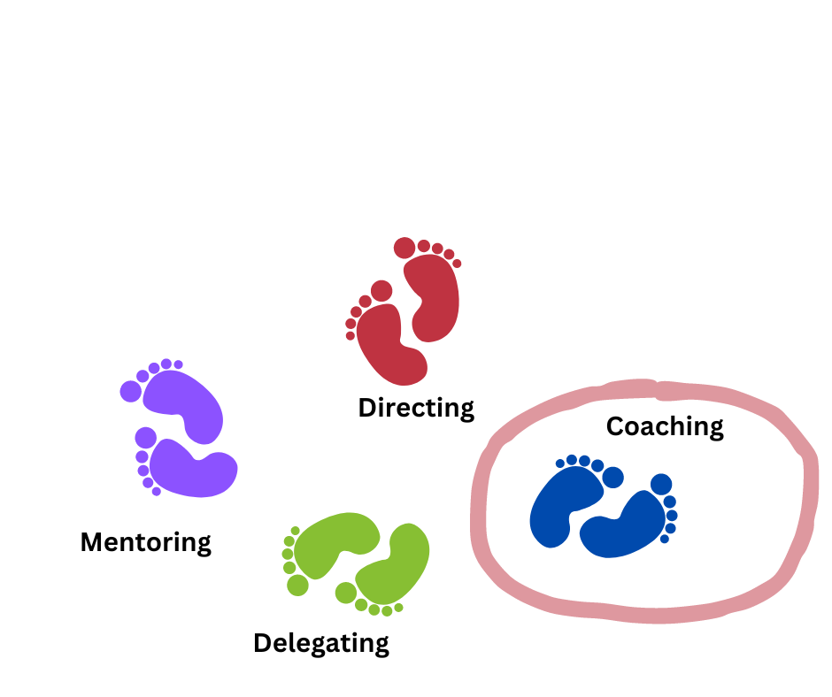
Managing People – a Dance of Skills

Slide 5
What is Coaching?
What coaching is (https://www.youtube.com/watch?v=Esh75mbmucY )

Slide 6
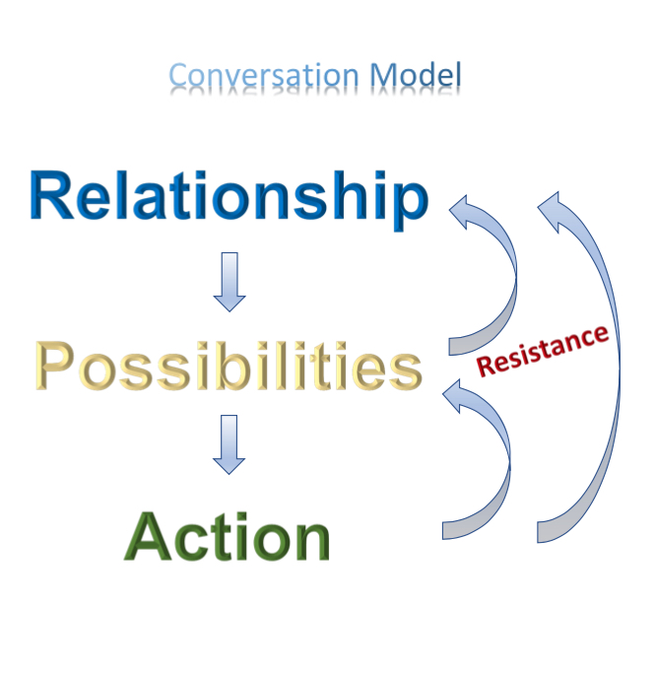
Conversation Model
Lack of confidence in relationship/trust in coach
Not ready to share personal details
Stuck in anger or frustration at situation
Not willing to decide/too committed to the complaint
Too soon to take action/ move forward
Afraid to implement an action

Slide 7
Coaching Through Working with Complaints
In every complaint, we are stuck and committed to something
In this exercise, you will practice:
to uncover what in the complaint has you stuck, and
to begin to explore possibilities and solutions

Slide 8
6-Pack Starter Kit
Coaches:
Listen to your coachee’s complaint (this is their story)
Ask your coachee:
What is important to you?
What would success look like?
What have you tried?
What are one or two possibilities you could explore?
What is one action you could take as a next step?

Slide 9
The Locker
No advice giving
No advice asking
…for today

Slide 10
Debrief
Coaches:
What was it like to ask questions?
What did you notice about yourself?
Coachees:
What was it like to be listened to in this way?
What did you notice about yourself?

Slide 11
- BREAK -

Slide 12
What to Expect?
RECAP
Part 2: Peer Coaching for Effective Leadership
What is Peer Coaching
Roles & Process in a Peer Coaching Circle
Asking Open-Ended Questions
Demo of Peer Coaching Circle
Group Practice
Debrief & Wrap-Up

Slide 13
What is Peer Coaching?
Helping colleague managers to explore new possibilities and discover solutions to presented concerns/challenges/situations by remaining curious and asking open-ended questions.

Slide 14
Peer Coaching Circles Offer:
a networking opportunity
practical, replicable, implementable tools to use in everyday conversations
a chance to enhance peer relationships
a safe, non-judgmental and confidential place to share experiences
an opportunity to experience the power of open-ended questions whether you ask or answer them
a way to learn coaching relevant practices by trying them out and practicing them with peers while tackling real issues in the workplace
an exploration of ways and approaches to generate practical actions and next steps

Slide 15
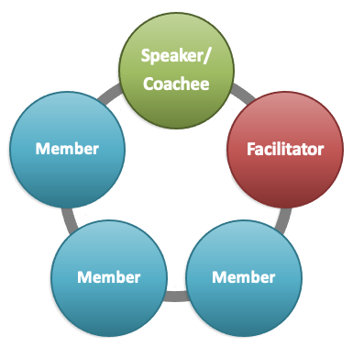
Roles
Coachee
Presents their topic
Members
Ask questions
Facilitator
Moderates, supports and ensures that coachee is not overwhelmed

Slide 16
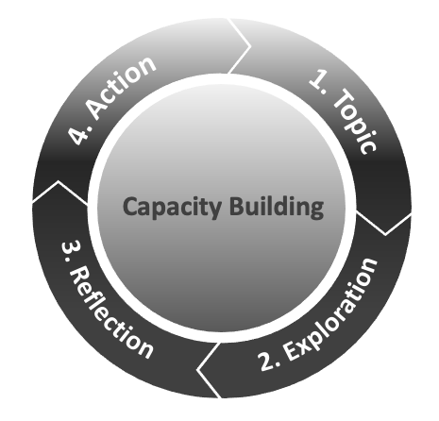
The Process

Slide 17
Setting the Stage - Capacity Building
Asking open-ended questions
Hint: they start with - What, How, Where, When, Who
Keeping questions short
Having less words allows for better clarity

Slide 18
To Be Avoided
Closed Questions – They illicit ‘yes’ or ‘no’ response
Leading Questions – “Have you tried…”
Over-paraphrasing - “So what I hear you say is….,”

Slide 19
REMINDER: 6-Pack Starter Kit
Coaches:
Listen to your coachee’s situation (this is their story)
Questions you could ask:
What is important to you?
What would success look like?
What have you tried?
What are one or two possibilities you could explore?
What is one action you could take as a next step?

Slide 20
Wrap-Up
What did you learn about yourself through the Peer Coaching Circle process?
What is one takeaway that you will practise in the workplace going forward?

Slide 21
Peer Coaching Circles Offer:
a networking opportunity
practical, replicable, implementable tools to use in everyday conversations
a chance to enhance peer relationships
a safe, non-judgmental and confidential place to share experiences
an opportunity to experience the power of open-ended questions whether you ask or answer them
a way to learn coaching relevant practices by trying them out and practicing them with peers while tackling real issues in the workplace
an exploration of ways and approaches to generate practical actions and next steps

Slide 22
Coaching Resources
Video resources:
Joining a Peer Coaching Circle? What to Expect: https://youtu.be/H1ZNjTjEFZE
Selecting a Coaching Topic: https://youtu.be/qg1s0CoRtT4
The Feedback Model Video: https://youtu.be/noz3ViNZssk
Canada School of Public Service coaching courses and job aids:
Coaching for Effective Leadership (TRN402) (3-hour virtual course)(prerequisite for TRN401)
Developing Successful Coaching Relationships (TRN439) (1-hour online self-paced course)
Introduction to Peer Coaching (TRN401) (3-hour virtual course)
Introduction to Coaching (TRN4-V21) (micro-video)
Selecting and Sharing a Coaching Topic (TRN4-J37) (job aid)
Using the GROW Model in a Coaching Approach (TRN4-J31) (job aid)
Peer Coaching Process: Using the GROW Model Approach (TRN4-J32) (job aid)

Slide 23
Please let us know what you thought of the day:
QR code for the evaluation form
Thank you et merci!
National Managers’ Community
Communauté nationale des gestionnaires
Subscribe to the NMC News
S'abonner aux nouvelles de la CNG

