Slide 1
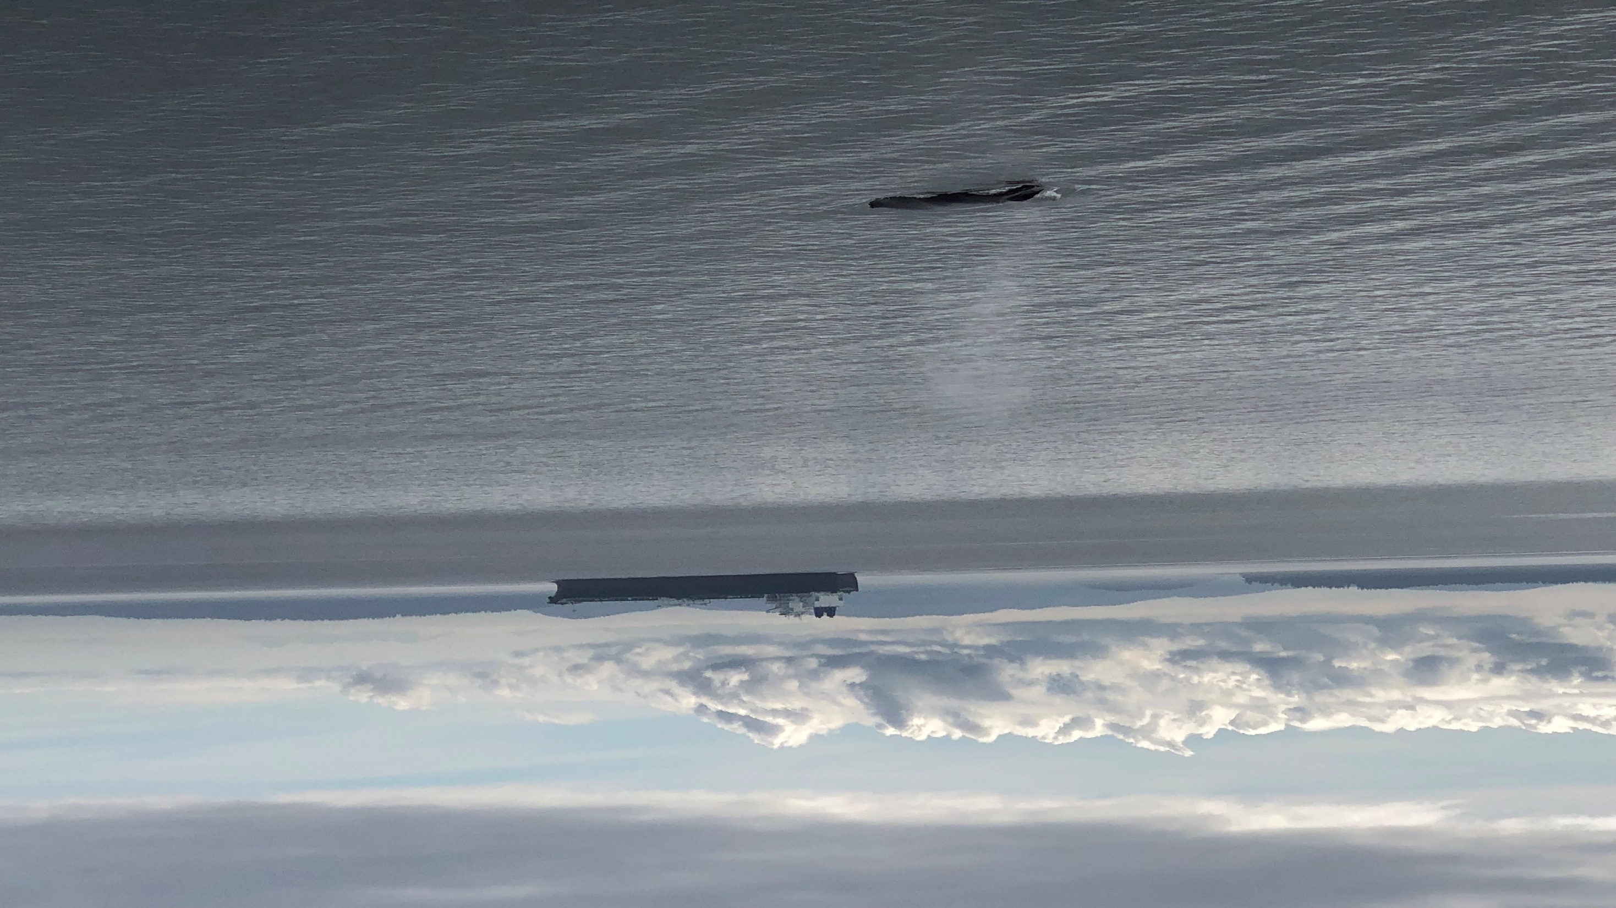
Transport Canada
Boundary Pass Underwater Listening Station Data Management

Slide 2
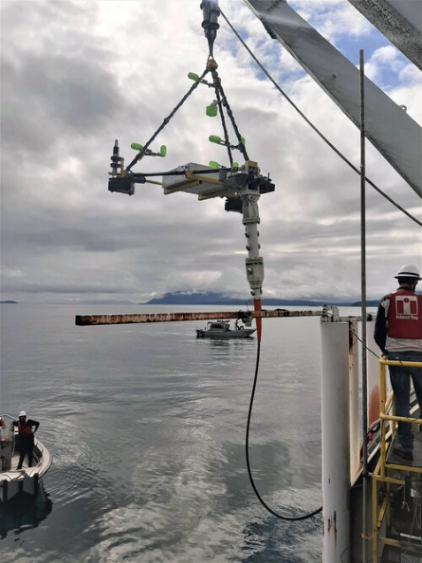
Underwater Listening Station Project
Project partners include Transport Canada, Jasco Applied Sciences and the Port of Vancouver’s ECHO Program
Located in the shipping lanes of Boundary Pass and cabled to shore on East Point of Saturna Island, BC.
The project primary goals are to:
accurately measure the noise emissions of thousands of large ships transiting Boundary Pass
detect and localize calling marine mammals
measure and track ocean noise levels over several years
Cabled system was deployed in May 2020 and has operated close to 100% of the time since
Notes:
One of the two arrays being deployed in May 2020.

Slide 3
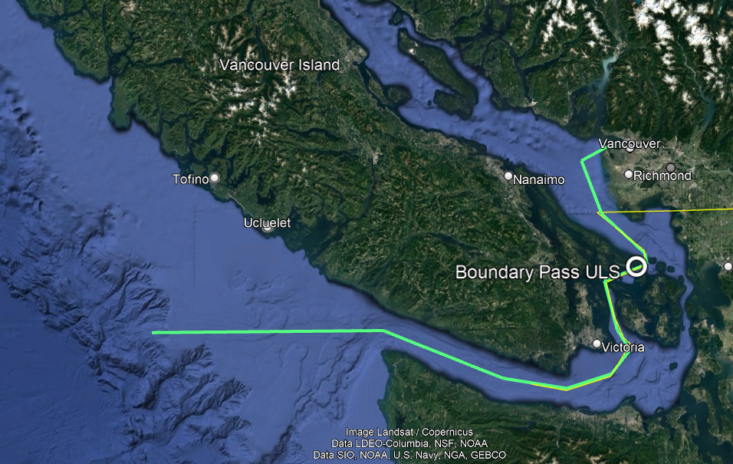
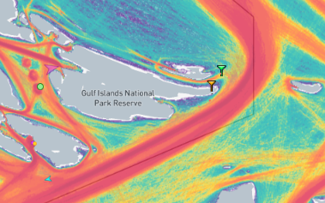
Location
Boundary pass is located under the shipping lanes leading to Vancouver, British Columbia, Canada
Inbound and outbound shipping lanes are adjacent, so traffic in both directions can be monitored
The site is deep enough (190 m) to make ship URN measurements conforming with ANSI S12.64 and ISO 17208-1
Relatively high density of endangered Southern Resident killer whales, so marine mammal behaviour in the presence of ships can be monitored, and vessel impacts mitigated

Slide 4
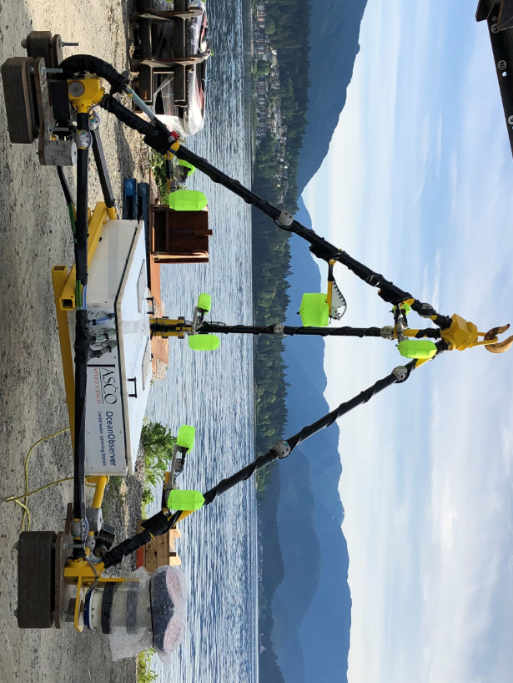
Sensors
Acoustic data – 8 hydrophones: 4 HTI-96-MIN and 4 GeoSpectrum M-36
JASCO Observer DAQ, sample rate 512 kS/s, 24-bit, with RPY and compass and power monitoring
Acoustic Projector: GeoSpectrum M18C-4.0 with JASCO AMAR controller
Water currents: Teledyne RDI 150 kHz Acoustic Doppler Current Meter (ADCP)
Temperature and Salinity: Onboard AML RTS CTD’s
Video cameras with lights
On-Shore
AIS receiver (vessel position and speed)
Weather data from East Point Park weather station, 2 km from the ULS site
GPS – synchronized NTP server

Slide 5
Deploying the Hydrophone Arrays

Slide 6
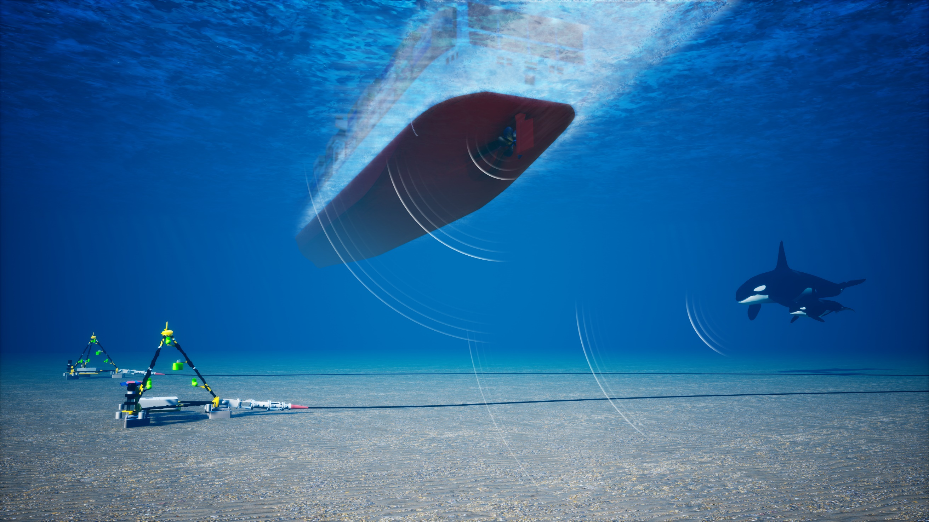

Slide 7
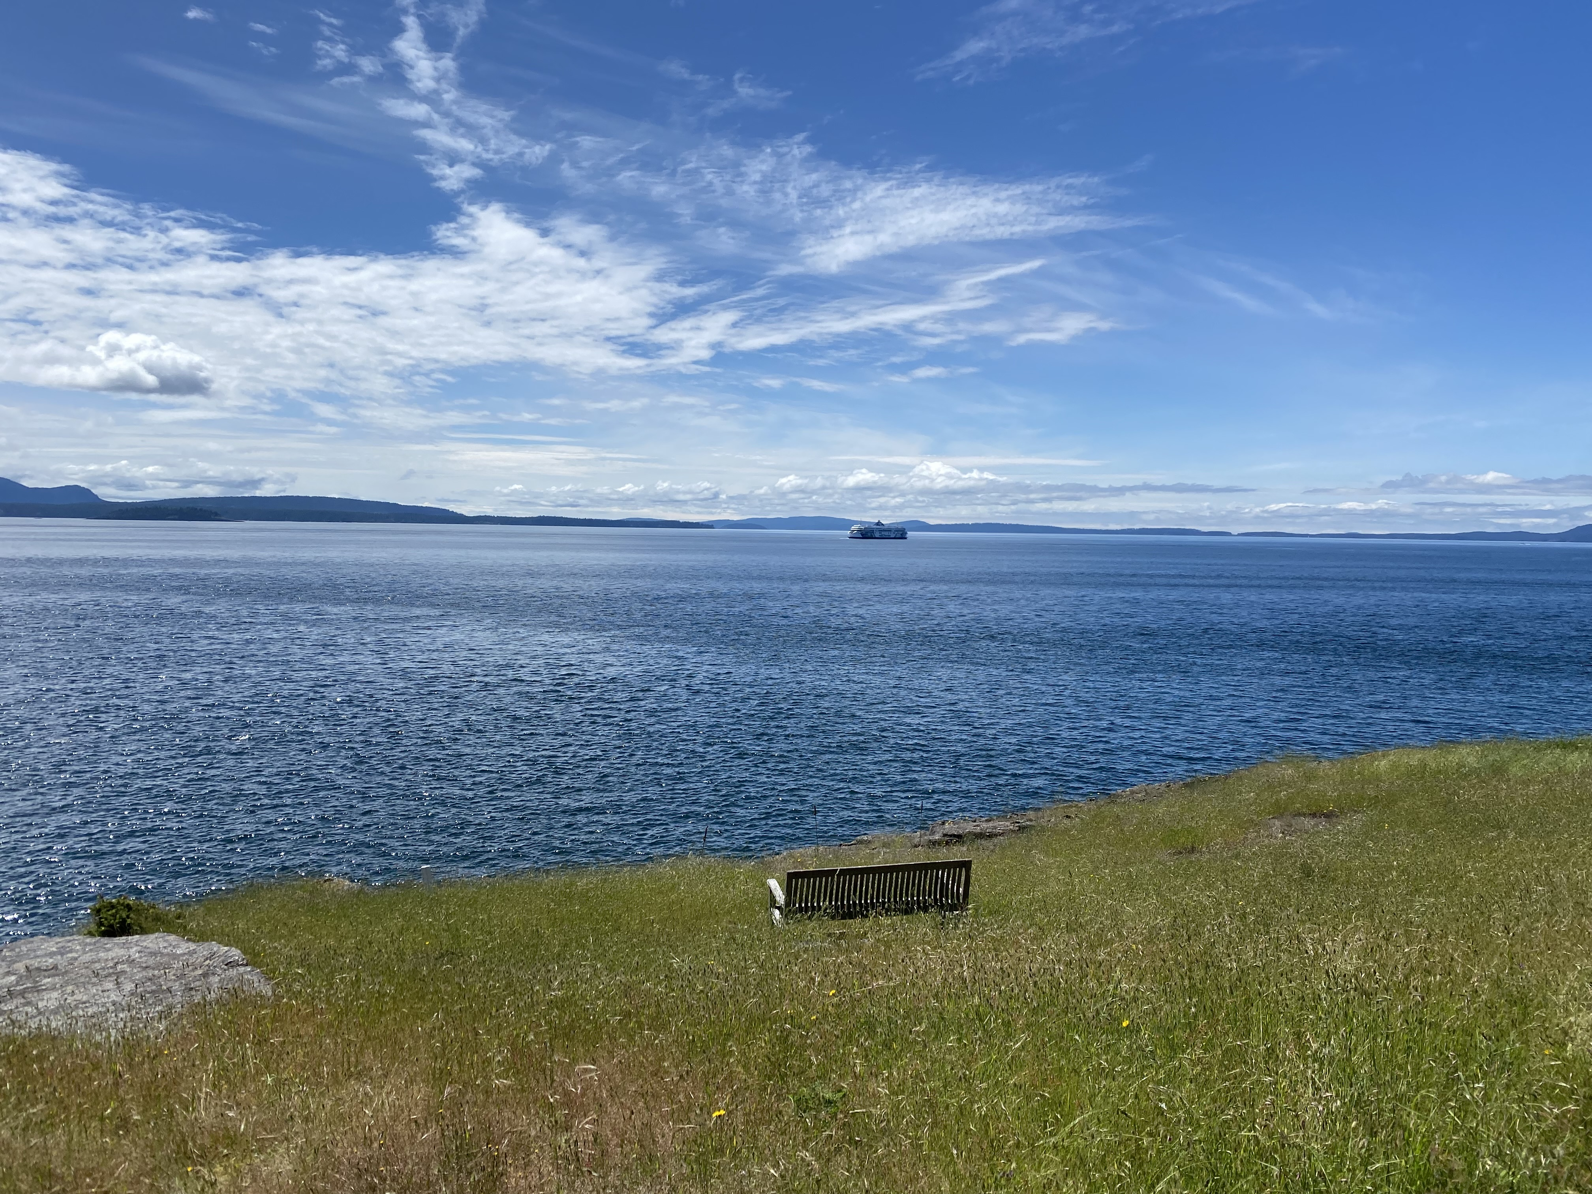
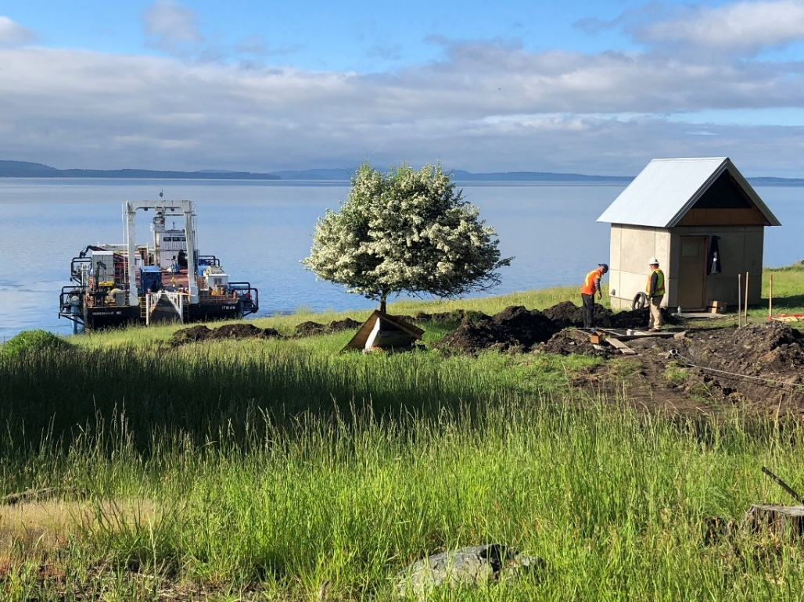
Shore Station Data Storage
ULS frames are individually cabled to shore by two 2.8 km armoured electrical and fiber optic cables
The cables terminate in a server room with disk storage systems and data processing systems
Streamed data are initially stored in 5-minute wav files on a RAID disk drive array
Two “milking servers” create working and backup copies of the data. These copies are saved on separate hot-swappable hard drive systems
The full disks in the hot-swappable systems are manually extracted each month
Approximate real-time (up to 5-minute delay) automated data analysis is performed on the working copy files

Slide 8
Data Analysis and Result Format
JSON format example
{"id":"sog-echoarray1-3-477300500201801271220","deploymentId":"sog-echoarray1-3","stationId":"echo-node-1","mmsi":“XX300X00","imo":“XX0080X","vesselName":“Anon","vesselType":91,"vesselTypeAlt":1,"jascoVesselClass":3,"shipLength":294.0,"shipBreath":32.0,"staticDraught":9.0,"destinationId":"f673725d-8a4f-4a5f-97c0-f7f240152cdf","destination":"CAVAN","softwareVersion":"0.10","timestampCpa":1517055606179,"timestampStart":1517055597000,"timestampStop":1517055620000,"coordinatesCpa":[49.044514,-123.31593],"coordinatesStart":[49.04396,-123.31495],"coordinatesStop":[49.04509,-123.31694],"distanceatStart":197.13261,"distanceatCpa":171.44093,"distanceatStop":196.77946,"radius":7000,"track":[{"timestamp":1517054861,"coordinates":[49.00455,-123.24613]},{"timestamp":1517054867,"coordinates":[49.004883,-123.2467]},
Three Primary analyses are performed:
Ambient Noise Analysis
Marine mammal call detections
Ship URN measurements
All results derived from acoustic and non-acoustic data are saved to JSON-formatted files and uploaded to a non-relational database (MongoDB)
Advantages of JSON are that it stores key-value pairs, arrays, and embedded URL links to related files
JSON is also human-readable and most software packages have routines for decoding it
An extensive set of web tools is available for interacting with non-relational databases

Slide 9
Ship Noise Measurements
The ShipSound application accesses the non-relational database and allows users to interact extensively with the ship measurement data, including viewing, selecting and downloading information
The available information includes decidecade band levels, spectra, spectrograms, navigational tracks, ship metadata, and environmental data
Users can also download acoustic files (wav format) and generate PDF reports for each vessel measurement

Slide 10
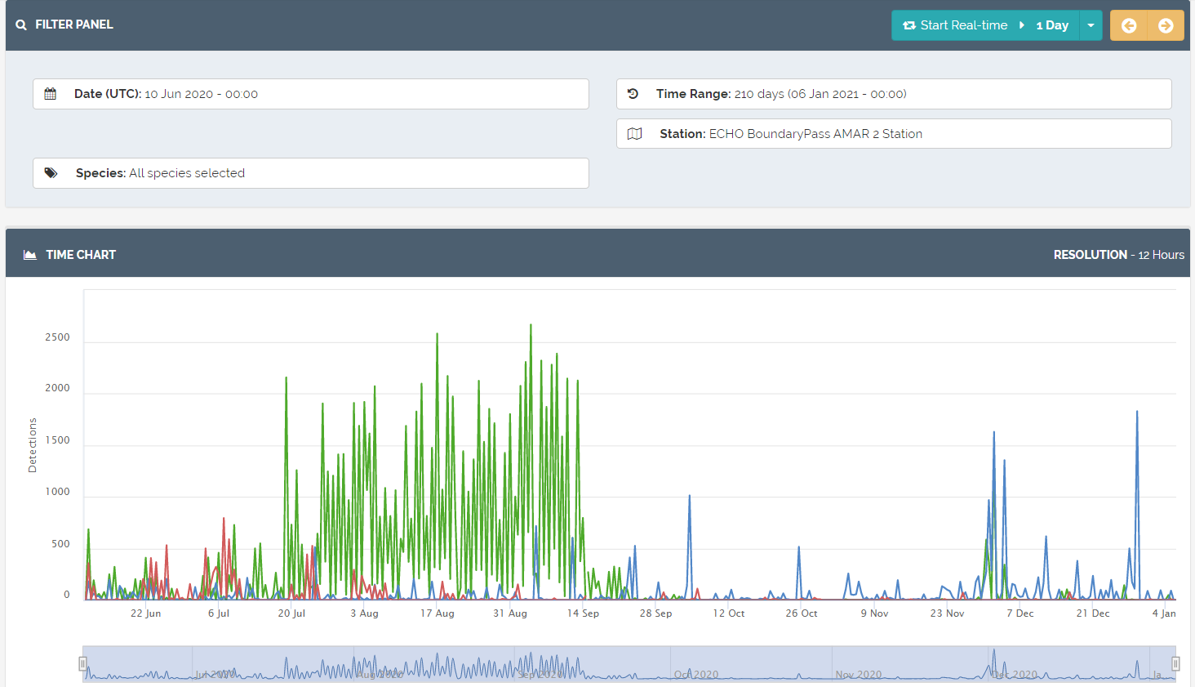
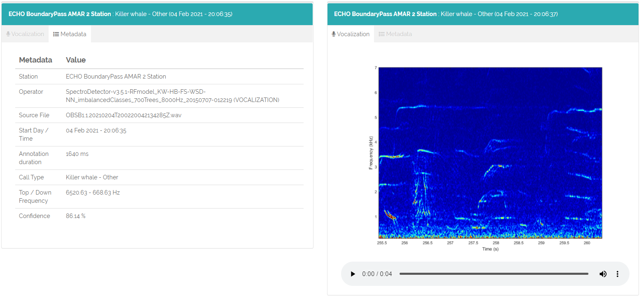
Marine Mammal Detections
The PAMView application allows users to view detection histories by species for any selected time period
A time zoom feature lets users see detections to 1 minute resolution
Individual detections can be selected, and the user can view detection metadata, a spectrogram, and listen to a short sound snip
Privileged users can manually review and approve, reject, or change species for individual or groups of detections
Filters are available to show only approved, rejected, or pending detections, or all

Slide 11
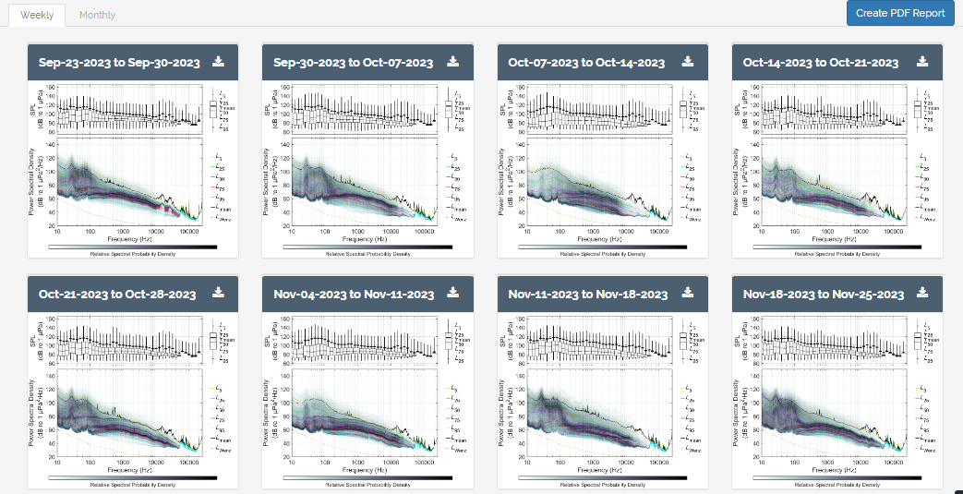
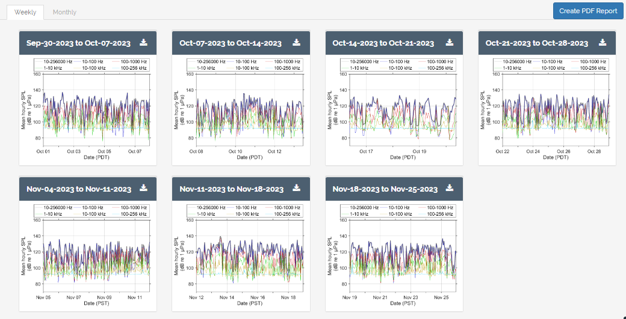
Ambient Noise
The AmbientView application allows users to view and download ambient noise metrics and statistics
Monthly and weekly graphics are available for any selected time period
Formats presently include: hourly SPL, spectral probability density, daily and weekly cadence plots, spectrograms, and box and whisker quartile plots
Clicking on a graph opens a higher- resolution version
Tabular data in CSV format can be downloaded for most plot types
A “Create Report” button generates a PDF of all graphs for the selected time period, with explanatory text for each format

Slide 12
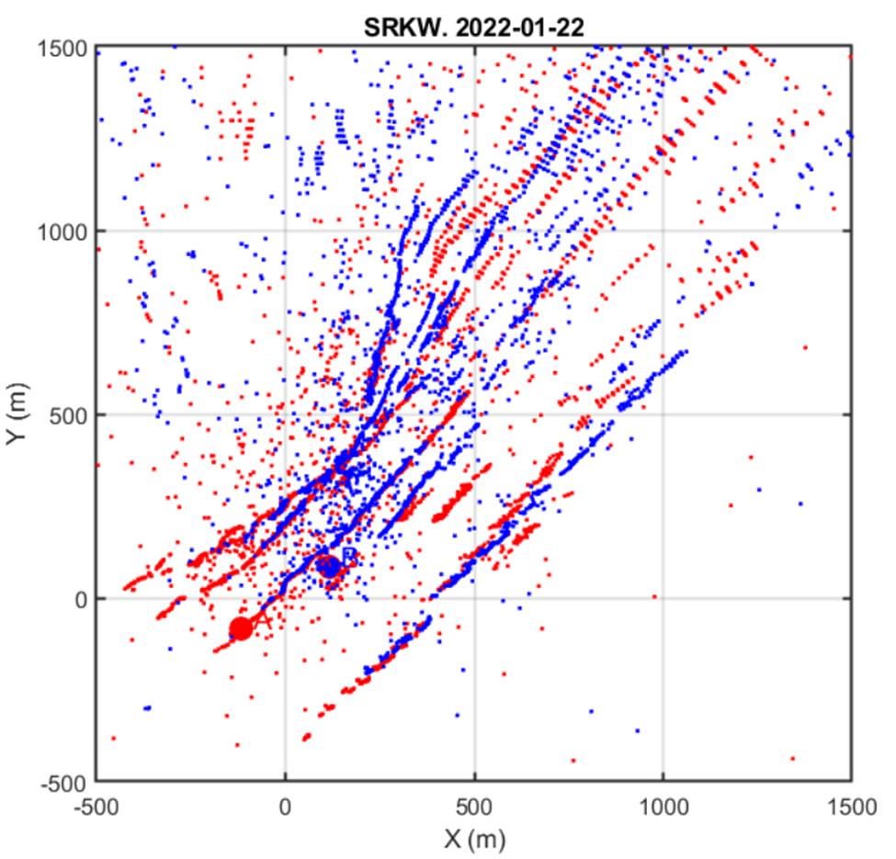
Marine Mammal Localization
Individual animals in groups/pods can be localized and tracked
SRKW are excellent candidates for tracking due to high vocalization and echolocation rates
Group distribution, swim speed, dive depths and other movement parameters can be measured

Slide 13
Data Management
The Boundary Pass ULS collects over 1 TB of acoustic data per day, not including backup copies
Over the past 3.5 years, this has amounted to over 1.2 petabytes of data, and the same amount of backups. These data are stored on approximately 250 hard disk drives
The real-time analysis produces data products that are stored in an on-line, searchable database that is easy to maintain
Results are available and easily accessible to authorized users through an advanced web interface
Ad hoc database queries are also frequently performed to extract larger sets of data – for example, to obtain all decidecade RNL levels of containerships, or all validated killer whale call detections

Slide 14
Acknowledgments

