Slide 1
Diversifying the Leadership Bench

Slide 2
(Lack of) Leadership Diversity Not New News
Research and News on Diversifying the Leadership Bench
Women in Leadership and Implications for Affirmative Action
Journal of Educational Equity and Leadership
(1984)
Women in Leadership: The Battle to Advance Continues
Business Source Corporate Plus
(2000)
Diversity in Leadership: Where’s the Love for Racioethnic Minorities?
Business Journal of Hispanic Research
(2010)
Representation Matters: Addressing the Latinx Leadership Crisis
University of Maryland
(2020)
1980
1990
2000
2010
2020
Who Will Fight for the Worth of Women's Work? Women in Leadership Can Make a Difference
Vital Speeches of the Day
(1982)
The New Leaders: Guidelines on Leadership Diversity in America
Human Resource Development Quarterly
(1994)
Demographic Diversity in the Boardroom: Mediators of the Board Diversity-Firm Performance Relationship
Journal of Management
(2009)
How to Get Black Women Leaders Into the C-Suite
Journal of Accountancy
(2020)
Source: Gartner
Notes:
Presenter's Name
Presenter's Name

Slide 3
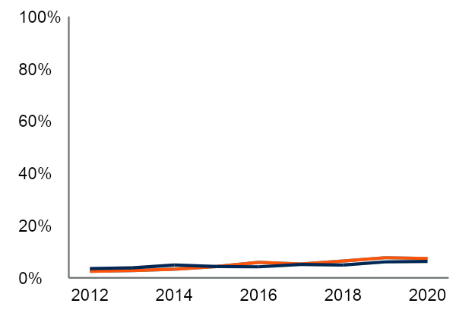
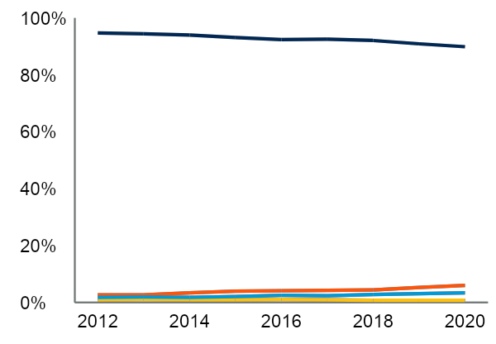
Little Progress to Show
Share of Female CEOs of Large Enterprises, United States and European Union
Share of Racially/Ethnically Diverse CEOs, Fortune 500 and S&P 500
Female CEOs in the US
White
Female CEOs in the EU
Hispanic/Latino
African American
Asian/Indian
In large enterprises in 2020, women occupied 7% of CEO roles in the EU and 6% of CEO roles in the US.
In 2020, racial/ethnic minorities comprised 10% of CEO roles in the Fortune 500 and S&P 500.
n = 1,400 companies in the European Union; 674 companies in the Fortune 500 and S&P 500
Source: European Institute for Gender Equality, Gender Statistics Database. Crist Kolder Associates, Volatility Report of America’s Leading Companies. (2020).
n = 674 companies in the Fortune 500 and S&P 500
Source: Crist Kolder Associates, Volatility Report of America’s Leading Companies. (2020).

Slide 4
Mounting Pressure
The Rise of Pressure for Organizations to Make Progress on DEI
CEO, Board
“Our board has made it clear that diversity is something we need to prioritize...They want to see rapid month-month pace of that change, so that’s what we are working toward.”
CHRO, Finance Organization
Nearly 2,000 CEOs have signed the CEO Action for Diversity & Inclusion pledge.
Employees, Shareholders
76% of employees and job seekers say a diverse workforce is important when evaluating companies and job offers, and 37% wouldn’t apply to a company that had negative satisfaction ratings among people of color.
Due to institutional shareholder pressure, nearly half of the S&P 100 will publicly disclose an EEO-1 in 2021 compared to 14% in 2020.
Customers, Communities
“Our partners are prioritizing DEI more than ever. They are saying if you don’t make changes, we’ll make changes to how we fund you.”
Chief Diversity Officer, Nonprofit Organization
Twitter saw 85% more mentions of inclusive talent processes in 2020 compared to 2016.
Source: CEO Action for Diversity and Inclusion; Glassdoor Diversity & Inclusion Workplace Survey (September 2020); Office of the New York City Comptroller; Gartner Analysis of Twitter Data (2016-2020)

Slide 5
The Journey Is Still Moving Us One Step at a Time
Many leaders believe incremental progress will lead to desired change over time.
“Our team has focused on leveraging inclusion nudges as a key part of our DEI strategy. If we focus on making small, incremental changes to our processes and people, we will eventually get to where we need to go.”
Head of HR, Finance Organization
“Our organization has prioritized diversity & inclusion, but we recognize that DEI is a journey, and we just have to take it one initiative at a time.”
Head of HR, Retail Organization
Source: Gartner

Slide 6
Our Study Question
How can organizations accelerate and sustain diversity in their leadership bench?

Slide 7
Our Research Approach
Employee Data and Survey Analysis
3,500+ Employees
24 Industries
21 Functions
6 Regions
HR Leader Interviews
HR Leader Survey
We interviewed HR leaders at 100+ organizations to determine their challenges and strategies for diversifying the leadership bench.
We surveyed 50+ HR executives to determine how organizations are diversifying their leadership benches.
What We Measured
Leader Diversity
Employee Outcomes
Gender diversity of organization’s leadership
Inclusion: The practice or policy of providing equal access to opportunities and resources for people who might otherwise be excluded or marginalized.
Racial/ethnic diversity of organization’s leadership
Psychological Safety: An environment that encourages, recognizes and rewards individuals for their contributions and ideas by making individuals feel safe when taking interpersonal risks.
Source: Gartner

Slide 8
Many Focus on Diversifying the Pool
Organizations Focus on Diversifying Early-Career Talent
HR leaders cited not having enough diverse leadership talent in the pipeline as the top challenge to diversifying the bench.
Organizations focus on recruiting diverse early-career talent to expand the pool, eventually feeding the leadership pipeline.
Frontline Employees
Source: Bureau of Labor Statistics, Current Population Survey

Slide 9
But Recruiting Alone Doesn’t Solve the Problem
Underrepresented Talent in the Leadership Pipeline
Progression of underrepresented talent stalls in the middle; they experience slower rates of promotion and worse perception of leadership potential.
C-Suite
29% Women
17% Racial Minorities
Organizations focus on recruiting diverse early-career talent to expand the pool, eventually feeding the leadership pipeline.
Midlevel and Senior Leaders
41% Women
25% Racial Minorities
Frontline Employees
56% Women
31% Racial Minorities
Source: Bureau of Labor Statistics, Current Population Survey
Note: Data is cited for management, professional and related occupations in the United States.

Slide 10
Leaders at the Center of Talent Progression
Leaders’ Responsibility in Talent Progression
An organization’s leaders are the driving factor in progressing diverse talent through the leadership pipeline.
Advocate in Talent Reviews
Provide Opportunities for Visibility
Evaluate Performance
Select Successors
Fill Open Roles
Nominate for Stretch Projects
Assign Work on Teams
Steward Inclusive Culture
Identify High-Potential Talent
Source: Gartner

Slide 11
Need for More Leader Accountability
HR Leaders’ Top Barriers to Diversifying the Leadership Bench
Top 3 of 16 Barriers
What are your organization’s biggest barriers to diversifying the leadership bench?​ | Rank​
We don’t have enough diverse leadership talent in the pipeline to promote internally​. | #1​
Leaders are not held accountable for advancing DEI goals in the organization​. | #2​
Direct managers do not advocate for diverse employees​. | #3​
"I think it starts with the accountability. It’s important to make sure DEI is seen as a business priority, not an HR initiative."
CHRO, Insurance Organization
n = 53 HR leaders
Source: 2021 Gartner Diversifying Leadership Survey

Slide 12
Instilling Collective Accountability Across All Leaders
Responsibility of Leaders in DEI
Many HR leaders are working to instill a sense of Collective Accountability across the organization to make all leaders feel committed to and responsible for moving DEI forward.
"I think when we talk about being accountable, it’s about committing ... and expecting the same from others."
Organizational Effectiveness Leader, Healthcare Organization
"The biggest challenge [to diversifying the leadership bench] is the accountability. It’s everybody’s job -- everybody should be responsible."
Head of Talent and D&I, Technology Organization
Source: Gartner

Slide 13
Focusing on Three Strategies for Collective Accountability
Common Strategies for Creating Collective Accountability for Leaders
Shift Leaders’ Mindsets
Cascade DEI Goals
Track DEI Metrics

Slide 14
Strategy #1: Shift Leaders’ Mindsets
Common Strategies for Creating Collective Accountability for Leaders
Shift Leaders’ Mindsets
Cascade DEI Goals
Track DEI Metrics
79% of HR leaders say their organizations offer unconscious bias trainings.
n = 53 HR leaders
Source: 2021 Gartner Diversifying Leadership Survey

Slide 15
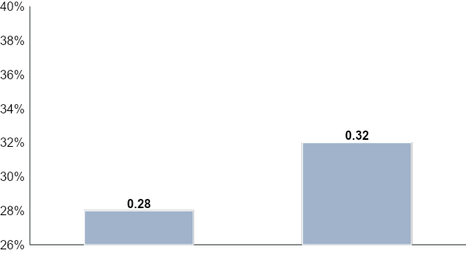
Bias Still Pervades Decision Making
Shortfall: Training Leaders on Biases Doesn’t Consistently Impact Decision Making
Senior Leaders Stating Their Organization’s Performance Management System Is Unbiased
Unconscious bias training has no significant impact on bias in performance management processes.
Organizations Offer No Unconscious Bias Training
Organizations Offer Unconscious Bias Training
n = 268 senior leaders, segmented from total 3,523 employees
Source: 2021 Gartner Leadership Progression and Diversity Survey

Slide 16
Strategy #2: Cascade DEI Goals
Common Strategies for Creating Collective Accountability for Leaders
Shift Leaders’ Mindsets
Cascade DEI Goals
Track DEI Metrics
70% of HR leaders selected “Communicating the Organization’s DEI agenda and policies” as a high priority for 2021.
n = 53 HR leaders
Source: 2021 Gartner Diversifying Leadership Survey

Slide 17
Cascaded Goals Alone Create a Vague Path Forward
Shortfall: Goals Without Guidance Lead to Inaction
Leader’s Reaction to DEI Goals
I’m not sure what this means for my team.
How far am I from this goal right now?
What should I focus on first?
Source: Gartner

Slide 18
Strategy #3: Track DEI Metrics
Common Strategies for Creating Collective Accountability for Leaders
Shift Leaders’ Mindsets
Cascade DEI Goals
Track DEI Metrics
76% of HR leaders say their organization tracks metrics to measure DEI efforts and outcomes.
n = 53 HR leaders
Source: 2021 Gartner Diversifying Leadership Survey

Slide 19
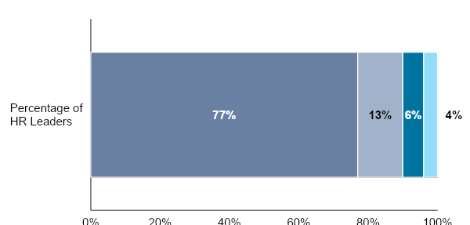
Metrics Missing "Teeth"
Shortfall: Tracking DEI Metrics Creates Awareness, but Not Results
“To What Extent Do DEI Measures Influence Leaders’ Overall Performance Evaluations?”
No
Incorporated Into Leadership Expectations
Central Category of Performance
Required for Progression to Leadership
HR leaders say DEI measures have little impact – if any – on evaluations of leaders’ performance.
n = 53 HR leaders
Source: 2021 Gartner Diversifying Leadership Survey

Slide 20
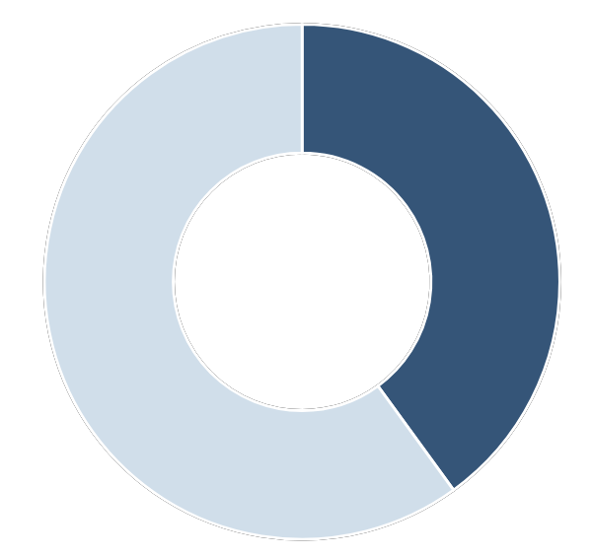
Collective Accountability Results in Nominal Commitment
“Leaders at My Organization Are Committed to a Culture of Diversity, Equity and Inclusion.”
Priority Level of DEI Goals for Leaders
Illustrative
2021 Leadership Goals
More Important Goals:
40%
Agree
Launch plan for new cross-functional project
Improve client partnerships
60%
Neutral/Disagree
Less Important Goals:
Increase diverse representation in business unit managers
n = 1,718 non-management employees, segmented from total 3,523 employees
Source: 2021 Gartner Leadership Progression and Diversity Survey
55% of HR leaders state DEI goals are less important than other business goals at their organization
n = 53 HR leaders
Source: 2021 Gartner Diversifying Leadership Survey

Slide 21
Current Path Leads to Collective Accountability
Approaches That Create Collective Accountability Don’t Produce Results on DEI Outcomes
Shift Mindsets​
Cascade Goals​
Track Metrics
Collective Accountability
Creates diffuse leader responsibility for DEI outcomes
+
+
=
Source: Gartner
Notes:
Presenter's Name
Presenter's Name

Slide 22
New Path Leads to Consequential Accountability
Individual Leaders Should Be Consequentially Accountable
Shift Mindsets​
Cascade Goals​
Track Metrics
Collective Accountability
Creates diffuse leader responsibility for DEI outcomes
+
+
=
Inform Decision Making
Use objective criteria and integrated data to drive equitable talent decisions.
Customize Strategies
Support customized strategies to enable leader execution of DEI goals.
Require Progress
Expect and require progress on DEI goals for any leader to advance in the organization.
Consequential Accountability
Meaningfully impacts behavior and outcomes for individual leaders
+
+
=
Source: Gartner
Notes:
Presenter's Name
Presenter's Name

Slide 23
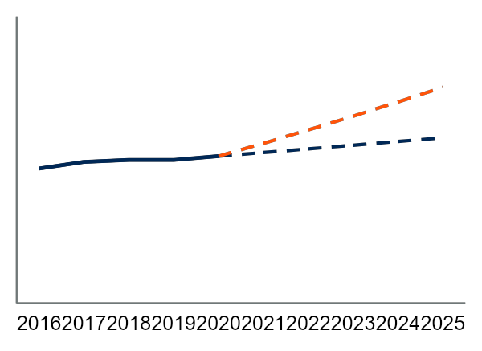
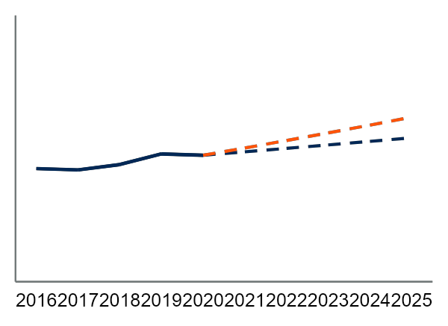
Consequential Accountability Accelerates Diversity
Women on the Leadership Bench
Racially Diverse Employees on the Leadership Bench
Projected to 2025
Projected to 2025
Consequential Accountability
Consequential Accountability
Collective Accountability
Collective Accountability
55%
35%
40%
25%
25%
15%
Organizations creating Consequential Accountability will save up to 13 ​years to reach gender parity on the leadership bench, compared to the current rate of change.
Organizations creating Consequential Accountability will save up to 6 ​years to reach racial parity on the leadership bench, compared to the current rate of change.
n = 3,523 employees ​
Source: Bureau of Labor Statistics, U.S. Department of Labor; UK National Office of Statistics; Australian Bureau of Statistics; 2021 Leadership Progression and Diversity Survey, Growth rates projected based on 4-year CAGRs. Delta due to strategy difference estimated through regression modeling. Gender projection is based on data from the US, UK, and Australia. Racial diversity projection is based on data from the US and includes Black/African American, Asian, and Hispanic/Latino employees.

Slide 24
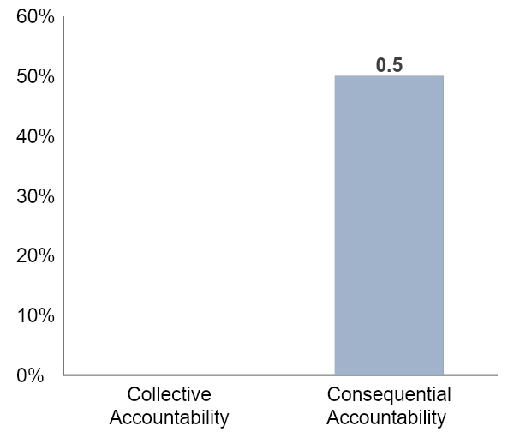
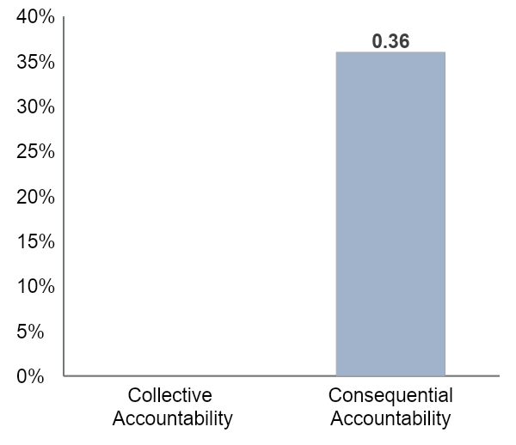
Consequential Accountability Drives Other Key Outcomes
Max Impact of DEI Strategies on Employee Outcomes
Employee Inclusion
Psychological Safety
n = 3,523 employees​
Source: 2021 Gartner Leadership Progression and Diversity Survey
Inclusion and psychological safety are critical to sustaining diversity in the organization.

Slide 25
Creating Consequential Accountability
1
2
3
Inform Leader Decision Making | Customize Strategies | Require Progress
Use objective criteria and integrated data to drive equitable talent decisions. | Support customized strategies to enable leader execution of DEI goals. | Require DEI outcomes for leader advancement.​
Leadership Criteria Debiasing | Contextualized DEI Strategies | DEI Aiming Points
Data-Integrated Talent Decisions | Localized DEI Goals | Guide to Accountability With Consequences

Slide 26
Creating Consequential Accountability
1
2
3
Inform Leader Decision Making | Customize Strategies | Require Progress
Use objective criteria and integrated data to drive equitable talent decisions. | Support customized strategies to enable leader execution of DEI goals. | Require DEI outcomes for leader advancement.​
Leadership Criteria Debiasing | Contextualized DEI Strategies | DEI Aiming Points
Data-Integrated Talent Decisions | Localized DEI Goals | Guide to Accountability With Consequences

Slide 27
A Focus on Shifting Leader Mindsets
Sample Strategies for Shifting Leader Mindsets
Internal DEI Messaging
Communicate importance of DEI to leaders to inform leader behavior and actions
Inclusion Nudges
Remind leaders to make more equitable decisions in the moments that matter
B
Bias Interrupters
Call leaders out on biased decisions in talent conversations to prevent inequitable outcomes
Unconscious Bias Training
Spread awareness of leaders’ biases and prevent biased decisions in the future
Source: Gartner

Slide 28
Mindset Interventions Fail to Influence Decisions
Leader Making Talent Decisions
How Organizations Hope Leaders Make Decisions
How Leaders Make Decisions
I should make this decision based on their performance and potential …
… but I feel like I trust George more, so I’ll promote him.
I know I have biases so I need to be careful making this decision …
… but I think I can make the right decision based on my instincts.
42% of employees feel underrepresented talent are not equally considered for progression at their organization.
n = 3,523 employees​
Source: 2021 Gartner Leadership Progression and Diversity Survey

Slide 29
Where Leader Decision Making Breaks Down
Two Key Breakdowns in Equitable Leadership Decisions
Biased Leadership Criteria
Instincts Over Data
1
2
Only 30% of employees agree that the criteria at their organization accurately assess their skills and capabilities.
Employees cite leadership decisions being mostly political as the biggest barrier to leadership progression.
n = 3,523 employees​
Source: 2021 Gartner Leadership Progression and Diversity Survey
Notes:
Presenter's Name
Presenter's Name

Slide 30
Inform Leader Decision Making
Inform Leader Decision Making
Use objective criteria to drive equitable talent decisions.
Integrate data into existing decision-making processes to maximize objectivity.
Leadership Criteria Debiasing
Data-Integrated Talent Decisions

Slide 31
Leadership Criteria Present Hidden Biases
Sample Leadership Criteria and Hidden Biases They Present
Illustrative Leadership Criteria
Hidden Biases
Aggressively pursues client needs
Aggressiveness is traditionally a quality associated with masculine behavior and often portrayed as a negative attribute in women.
Demonstrates assertive leadership
Men and women can be perceived differently when exhibiting assertive behaviors in the workplace.
Exhibits executive presence
Executive presence is often defined based on traditional conceptions of male leadership.
Realization
When Höganäs’ leadership team created new leadership behaviors for their performance management process, they realized that their newly created behavior definitions had hidden biases that favored masculine behaviors.
Source: Adapted From Höganäs
Notes:
Presenter's Name
Presenter's Name

Slide 32
Redefine Gendered Leadership Criteria
Höganäs’ Approach to Debiasing Leadership Behaviors
Seek Diverse Perspectives to Pressure-Test Behaviors
Integrate Behaviors Into the Performance Management Process
Source: Adapted From Höganäs
Critical First Step to Establish Organizational Readiness
Create the Environment for Discussing Diversity:
To ensure diverse talent feels comfortable contributing to organizational efforts, focus on building trusting partnerships between HR, senior leaders, and employee resource groups. Höganäs built relationships with employee networks by recognizing these groups’ work and regularly seeking their input.
Source: Adapted From Höganäs
Notes:
Presenter's Name
Presenter's Name

Slide 33
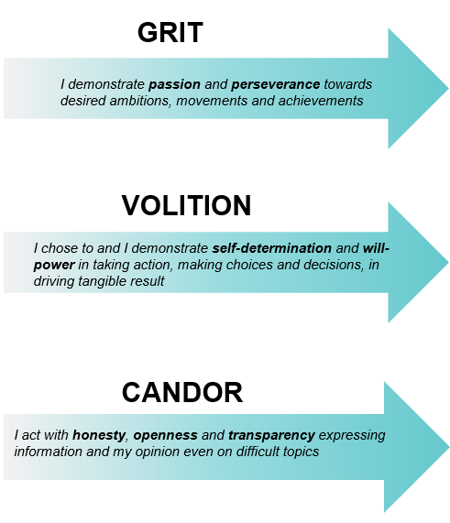
Seek Diverse Perspectives to Pressure-Test Behaviors
Perspectives to Consult to Test Behaviors
Illustrative
ERG Leaders
Leadership Team
Leverage Diverse Perspectives
Consult diverse perspectives across the organization to highlight potential bias in leader behavior definitions.
ERG Members
Employee Focus Groups
Leadership Behaviors
Source: Adapted From Höganäs
Höganäs’ Guiding Assumptions for Discussion in Workshops
Illustrative
How could these behaviors be interpreted in other ways beyond their stated meaning?
How could other interpretations of these behaviors advantage people on the basis of gender?
How do we ensure frequent calibration/feedback between the manager and co-worker throughout the year?
How do we ensure managers and co-workers have a dialogue around Höganäs’ strategies, directions, the function contribution, and “must wins” to drive success?
Test Behaviors for Relevance
Ask questions to assess the relevance of new criteria and confirm that diverse talent can see themselves reflected in the new behavior definitions.
Source: Adapted From Höganäs
Notes:
Presenter's Name
Presenter's Name

Slide 34
Seek Diverse Perspectives to Pressure-Test Behaviors (Cont.)
Höganäs’ Workshops
Illustrative
Behavior Definitions Before Workshop
Sample Feedback from the More Women Network
Behavior Definitions After Workshop
“Works hard and puts in long hours when necessary.”
“This behavior focuses on performance at the expense of individual wellbeing.”
“I show perseverance in reaching results and when faced with challenges.”
“I contribute to the team to con­stantly meet (and exceed) expectations. It is not a one-man show.”
“This language is explicitly gendered the way it is worded.”
“I contribute to the team to con­stantly meet (and exceed) expectations. It is not a one-person show.”
“I avoid taking risks.”
“There are gender differences in how men and women are perceived when taking risks.”
Behavior eliminated
Source: Adapted From Höganäs
Notes:
Presenter's Name
Presenter's Name

Slide 35
Inform Leader Decision Making
Inform Leader Decision Making
Use objective criteria to drive equitable talent decisions.
Integrate data into existing decision-making processes to maximize objectivity.
Leadership Criteria Debiasing
Data-Integrated Talent Decisions

Slide 36
Integrate Data to Influence Leaders’ Decisions
Key Shifts to a Data-Driven Approach
Data-Aware Decision Making
Data-Informed Decision Making
Overreliance on leader judgment
Strengthen partnership between leaders, HR and talent analytics team.
High volume of descriptive data
Create curated and contextualized insights that highlight leaders’ DEI hotspots.
Episodic use of data, often disconnected from decision points
Integrate relevant data across all key decision-making moments.
Source: Gartner

Slide 37
Data-Informed Leader Decision Making
Data Integration Across Talent Decision-Making Moments
Sample Data Inputs
Before the Talent Decision
During the Talent Decision
After the Talent Decision
Objective and explicit criteria
DEI hot spots (urgent and pressing pain points, specific to the leader’s business unit or function)
DEI goals and priorities
List of underrepresented HIPO and promotion-eligible talent
List of talent outside the leader’s business unit or function
Aggregate demographic data for relevant level of talent being discussed
DEI goals and priorities
DEI implications of finalized talent plans
Progress against DEI goals and objectives
Source: Gartner

Slide 38
Data-Informed Leader Decision Making (Cont.)
Sample Leader Decision-Making Points in Talent Reviews
Decision 1: Create Shortlist of Promotion Candidates
Decision 2: Calibrate Talent
Decision 3: Approve Individual Talent Outcomes
“I’ve known and worked with him for years. And he just did such a great job on the big product launch. I’m confident he’s ready for the
next role.”
“He has a finance background and based on my own experiences there, the function grooms high quality talent — I’d prefer a successor with that skillset.”
“Robert’s persuasion skills strike again — his direct reports always seem to be selected for promotions.”
Use data to objectively assess candidates and reveal potential blind spots in leader's selection.
Use data to analyze the health of succession pools, guarding against subjective preferences based on profiles of existing leaders.
Use data to conduct equity checks, reviewing leaders’ talent decision outcomes.
Source: Gartner

Slide 39
Key Take-Aways for Informing Leader Decision Making
1
Work with diverse groups of employees to identify bias in leadership criteria.
2
Redefine the criteria leaders use to make talent decisions with a focus on eliminating bias.
3
Integrate objective data into talent processes around leaders’ key decision-making moments.

Slide 40
Creating Consequential Accountability
1
2
3
Inform Leader Decision Making | Customize Strategies | Require Progress
Use objective criteria and integrated data to drive equitable talent decisions. | Support customized strategies to enable leader execution of DEI goals. | Require DEI outcomes for leader advancement.​
Leadership Criteria Debiasing | Contextualized DEI Strategies | DEI Aiming Points
Data-Integrated Talent Decisions | Localized DEI Goals | Guide to Accountability With Consequences

Slide 41
DEI Goals Cascaded From the Top
Levels at Which Organizations Set DEI Goals
79% of organizations set DEI goals at the organizational level.
43% of organizations set DEI goals at the individual function/business unit level.
19% of organizations set DEI goals at the individual leader level.
n = 53 HR Leaders
Source: 2021 Gartner Diversifying Leadership Survey

Slide 42
Goals Alone Don’t Help Leaders Execute
Traditional Leader Concerns With DEI Goals
What can I do to help besides bias training?
Do I just need to promote more diverse talent generally?
These don’t feel like the right goals for my business unit.
These global goals don’t apply to my region.
Business Leader
Only 13% of HR leaders state managers at their organization are very effective at promoting diversity.
n = 53 HR Leaders​
Source: 2021 Gartner Diversifying Leadership Survey

Slide 43
Customize DEI Strategies to Drive Leader Action
Customize Strategies
Co-create actionable DEI strategies contextualized for local business units.
Establish localized DEI goals and action plans based on country context, culture, and demographic makeup.
Contextualized DEI Strategies
Localized DEI Goals

Slide 44
Contextualize DEI Strategies to Drive Action
Components of BBVA’s Contextualized DEI Strategies
1
2
3
Spotlight Gaps in Leader Promotions to Drive Urgency
Drive Ownership Through Contextualized Strategies
Mobilize Agile Community of Practice for Shifting Needs
Source: Adapted From BBVA
Notes:
Presenter's Name
Presenter's Name

Slide 45
Drive Ownership Through Contextualized Strategies
BBVA Has Diversity CoP Work With Business Leaders
Sales, Region A
IT, Region B
Operations, Region C
Unique Challenges
“Our LGBTQ employees do not feel comfortable being their authentic selves.”
“We have difficulty recruiting women for tech positions.”
“We only have 20% women represented in leadership positions.”
Contextualized DEI Strategy Conversation Guide
Contextualized Support
What barriers are preventing you from achieving the globally reported DEI goals?
What other DEI goals are important to your function or region that may not be captured in the global goals?
How can the DEI team support you in achieving these goals?
HR
Impactful, Achievable, Contextualized Goals
Goal: Launch an LGBTQ employee resource group.
Goal: Increase the % of women employees by 20%.
Goal: Increase the % of women at VP level by 10%.
Source: Adapted From BBVA
Notes:
Presenter's Name
Presenter's Name

Slide 46
Drive Ownership Through Contextualized Strategies (Cont.)
BBVA’s Contextualized DEI Strategy Conversation Guide
Contextualized DEI Strategy Conversation Guide
Identify barriers to success (leader mindset, legacy processes, external factors, etc.).
What are the biggest DEI-related challenges your business unit faces today?
What barriers prevent you from achieving the globally reported DEI goals?
What DEI initiatives have you tried to implement before?
What DEI initiatives do you think would have the most impact?
What other DEI goals are important to your function or region that may not be captured in the global goals?
Understand why previous strategies have failed to produce results.
Uncover diversity goals unique to the region or function.
Objective: Develop a contextualized diversity plan and goals for the region or function.
Business Leader
Diversity Leader/CoP Member
Source: Adapted From BBVA
Notes:
Presenter's Name
Presenter's Name

Slide 47
Mobilize Agile Community of Practice for Shifting Needs
BBVA’s DEI Community of Practice (CoP)
Assess Need for Support
The local diversity leader assesses the demand of region-specific DEI projects to justify additional support.
Mobilize Community of Practice
Assemble Community of Diversity Experts
The CoP works with local DEI leaders, ERG members and DEI champions who offer localized diversity knowledge.
The CoP shares knowledge and diversity expertise to co-create DEI solutions and provide additional DEI support.
Source: Adapted From BBVA
Notes:
Presenter's Name
Presenter's Name

Slide 48
Key Take-Aways for Customizing Strategies
1
Help local leaders uncover unique challenges or concerns that may prevent them from taking action on DEI goals.
2
Spotlight diversity gaps in pools and progression to drive urgency.
3
Establish localized DEI teams designed to support business leaders as they implement their own DEI solutions.

Slide 49
Creating Consequential Accountability
1
2
3
Inform Leader Decision Making | Customize Strategies | Require Progress
Use objective criteria and integrated data to drive equitable talent decisions. | Support customized strategies to enable leader execution of DEI goals. | Require DEI outcomes for leader advancement.​
Leadership Criteria Debiasing | Contextualized DEI Strategies | DEI Aiming Points
Data-Integrated Talent Decisions | Localized DEI Goals | Guide to Accountability With Consequences

Slide 50
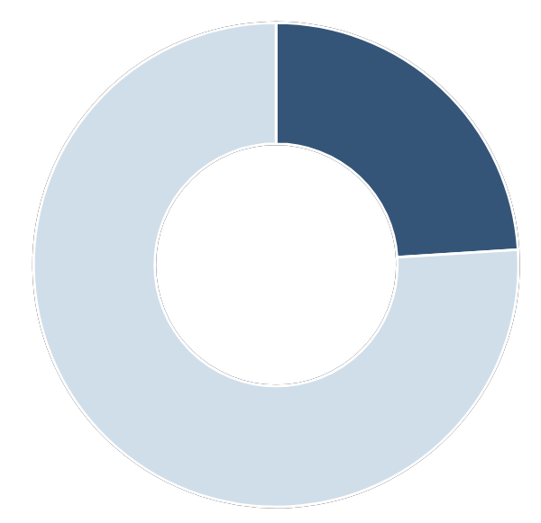
No Shortage of DEI Metrics Tracked
The Extent to Which Organizations Track DEI
Top DEI Metrics Tracked at Organizations
“Does your organization track metrics to measure DEI efforts and outcomes?”
Illustrative
Underrepresented talent attrition
24%
No
Underrepresented talent engagement
Underrepresented talent in recruiting pools
Veteran status
Underrepresented talent inclusion
Percentage of underrepresented talent promoted
Disability status
Percentage of leaders participating in DEI training
LGBTQ+ representation
76%
Yes
Gender representation
n = 53 HR Leaders
Source: 2021 Gartner Diversifying Leadership Survey
Source: Gartner
Notes:
Presenter's Name
Presenter's Name

Slide 51
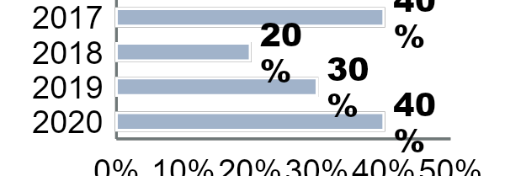
Transparency Alone Does Not Drive Personal Urgency
DEI Dashboard Example
Underrepresented Talent Engagement Scores (Year Over Year)
Attrition of Diverse Talent (Year Over Year)
“We’ve been talking about leader accountability for a long time—in the form of metrics, competency models, etc.—but it’s simply not enough. To drive meaningful change, we need to hold leaders individually responsible for meeting bold and ambitious DEI targets.”
HR Leader, Technology Organization
Diverse Talent Recruitment
Gender Representation Across Business Function
2020
2021
Source: Gartner
Notes:
Presenter's Name
Presenter's Name

Slide 52
Require DEI Progress for Leader Advancement
Require Progress​
Operationalize accountability to reinforce DEI as a clear priority for leaders.
DEI Aiming Points

Slide 53
An Opportunity for Accelerated Progress
Altria’s Previous Diversity Aspiration
Diversity-Only
Without a measurable inclusion goal, the initiative limits progress on culture change.
Illustrative
Altria’s Previous (2015) Diversity Goals
At Altria, diversity and inclusion is part of the fabric of how we work. As such, the leadership team is committed to fostering a diverse and inclusive workplace environment.
To demonstrate our continued commitment to diversity, we are rolling out an exciting diversity initiative, which we’ve named 20/20 by 2020. We commit to achieving 20% female and people of color representation in VP roles by 2020.
Limited Impact Focusing only on the most senior 1% doesn’t account for diversity in other parts of the organization.
Goal-, Not Action-, Oriented
An emphasis on goals without clearly articulating individual responsibility can result in leaders who cheer DEI on or simply watch from the sidelines.
Realization: Although Altria met its initial diversity goals, senior leaders realized the need for broader and more ambitious diversity and inclusion targets were unlikely to be realized without leadership commitment and support.
Source: Adapted From Altria
Notes:
Presenter's Name
Presenter's Name

Slide 54
Transform Leaders Into DEI Owners
Key Shifts Underpinning Altria’s Approach
Use a top-down approach to create and set goals.
Communicate organizational goals without clarifying leader priorities.
Silo or restrict the accessibility of leaders’ DEI information.
Include inclusion as an add-on to leadership goals or competencies.
Conventional Approach
Altria’s Approach
Co-create aiming points to build consensus.
Monitor leaders’ scorecards to track progress.
Foster
peer-to-peer transparency to reinforce DEI goals.
Rate leader advocacy and establish requirements for progression.
Source: Adapted From Altria
Notes:
Presenter's Name
Presenter's Name

Slide 55
Co-Create Aiming Points to Build Consensus
Key Stakeholders in the Co-Creation Process
Chief Diversity Equity & Inclusion Officer ensures aiming points align and are integrated with other DEI strategies.
CHRO assesses HR implications and clarifies how HR could best drive change in support of DEI initiatives.
Executive Leaders contribute perspectives based on the unique contexts of the business functions and units they oversee.
CEO provides strategic considerations, ensuring aiming points align with organizational capabilities, objectives and vision.
ERG Leader(s) represents and promotes the perspectives of different employee segments within the organization.
Aiming points: Specific, yet aspirational, measures of the organization’s and leaders’ diversity and inclusion goals.
Source: Adapted From Altria
Notes:
Presenter's Name
Presenter's Name

Slide 56
Monitor Leaders’ Scorecards to Track Progress
Standardized Leader Scorecard
Illustrative
Monitor progress across each business unit and identify problem areas.
Bernadette Scorecard, Chief Technology Officer
Agree or Strongly Agree | White |  | Black |  | Hispanic |  | Asian |  | Two or More
 | Men | Women | Men | Women | Men | Women | Men | Women | Men | Women
I feel comfortable being myself at work.
My opinions seem to count.
Everyone at my company has an equal opportunity to reach their goals.
My manager seeks diverse perspectives to help drive results.
I feel a sense of belonging at my company.
Regardless of background, everyone at Altria has an equal opportunity to succeed.
Disaggregate collected data for a holistic understanding of diversity and inclusion across different demographic groups.
Racial and ethnic breakdown of women at Altria (%)
 | Total | Asian | Black | Hispanic | 2+
VP+
Dir.
Aiming Point: Increase our VPs and directors who are LGBTQ+, a person with a disability, or veteran
Current status against aiming point (%):
 | Aiming Point | VP+ | Dir. | 13-12 | 11-10 | 9 & Below
Number
LGBTQ+ | 8%
PWD | 7%
Veterans | 6%
Aiming Point: At least 30% VPs and directors are Asian, Black, Hispanic or two or more races
Current status against aiming point (%):
 | Aiming Point | VP+ | Dir. | 13-12 | 11-10 | 9 & Below
AAPI Women | 4%
AAPI Men | 4%
Black Women | 6%
Black Men | 6%
Hispanic Women | 5%
Hispanic Men | 5%
2+ Women | 2%
2+ Men | 2%
Leading Indicators (Jan 1, 2020 – Dec, 2020)
 | Promotions |  |  |  |  | Starts and Exits |  | % of Employees
 | Total | To 13-12 | To Dir. | To VP | VP+ | Starts | Exits
Number
Identify leading indicators to monitor how, and how quickly, leaders are tracking against goals.
Source: Adapted From Altria
Notes:
Presenter's Name
Presenter's Name

Slide 57
Foster Peer-to-Peer Transparency to Reinforce Goals
Greater DEI Plan and Scorecard Sharing
Create standard scorecards. Standardized scorecards across business functions and operating companies increases visibility into leaders’ contributions to enterprise goals and creates a common set of key metrics.
Foster transparency to motivate leaders. Senior leaders are encouraged to share DEI plans and scorecards with peers and across their organizations. By doing so, Altria seeks to motivate leaders toward action and reinforce DEI as a shared leadership priority.
Altria’s Leader Scorecards
Reed Scorecard
Reed Improvement Plan
Stessy Scorecard
Stessy Scorecard
Stessy Scorecard
Stessy Scorecard
Past 30 Minute Thursday Topics:
Leading through technology
Recognizing your team virtually
Getting productive with google tools
Driving empathy on a remote team
Description | Comments
Inclusive Team | …
Gender Parity | …
Team Diversity | …
Planned Initiatives | … | …
Expected Outcome/ Measurement | … | …
Support & Resourcing | … | …
Socialize insights and learnings. Leaders share plans to address gaps and areas of improvement, enabling them to celebrate wins, acknowledge challenges and share learnings.
Source: Adapted From Altria
Notes:
Presenter's Name
Presenter's Name

Slide 58
Rate Leader Advocacy and Establish Progression Requirements
Altria’s Inclusion Rating System
Articulate specific sample behaviors. Leaders are evaluated on explicit behaviors and actions to ensure inclusion is more than a ‘check-the-box’ exercise.
Integrate inclusion into development goals. Leaders work toward advocacy by engaging their managers around specific work or focus areas where they plan to create and track inclusion objectives.
Operationalize inclusion as a must-have. Leaders must be assessed an “ally” or “advocate” to earn an “exceptional” performance rating and/or advance. Altria plans to assess ratings distribution going forward and, where necessary, recalibrate expectations.
Source: Adapted From Altria
Notes:
Presenter's Name
Presenter's Name

Slide 59
Altria’s Approach Delivers
Altria’s Increased Organization-Wide Diversity and Inclusion
“Our new approach has given me a new way of thinking about these issues and a renewed sense of urgency, especially as I think about how to meaningfully bring inclusion and a focus on diversity into my day-to-day work as a leader. This shift is already having a positive impact on my team’s ability to integrate this work with our other business strategies.”
Altria Senior Executive
“I was initially skeptical of this revamped strategy but have since come around. It’s been heartening to see commitment to these ideals and the accountability measures to keep leaders honest and on track. Now all leaders understand that diversity, equity, and inclusion is central to success in their positions.”
Altria ERG Leader
Notes:
Presenter's Name
Presenter's Name

Slide 60
Gartner’s Guide to Accountability With Consequences
Spectrum of Leader Accountability Measures
Additive Bonus Payment
Create an additive bonus for leaders who demonstrate success against organizational diversity goals.
Bonus Modifiers
Modify leader bonuses to reflect progress against organizational diversity goals.
DEI Improvement Plan
Require leaders to create an action plan outlining methods to achieve diversity and inclusion goals.
Rewarding
Corrective
DEI Leader Awards
Reward and recognize leaders who demonstrate inclusion and champion progress against organizational DEI goals.
Strategic Chats With CEO
Recognize leaders who have successfully performed against DEI goals with a 1:1 conversation with the CEO.
Transparent Leader Scorecards
Require leaders to track and share DEI progress across teams and broader organization.
Withhold Leader Progression
Require rising leaders to demonstrate DEI progress to advance in the organization.
Source: Gartner

Slide 61
Key Take-Aways to Requiring Progress
1
Engage leaders from the start in developing a DEI strategy to build mutual understanding of, and commitment to, DEI as a strategic priority.
2
Create standardized mechanisms to monitor and track leaders’ progress against individual DEI goals.
3
Establish peer-to-peer leader transparency around DEI measures to motivate individuals toward action.
4
Integrate DEI measures into performance evaluation processes to ensure leaders’ inability to lead inclusively is a barrier to high performance and advancement.

Slide 62
Creating Consequential Accountability
1
2
3
Collective Accountability
Inform Leader Decision Making | Customize Strategies | Require Progress
Leadership Criteria Debiasing | Contextualized DEI Strategies | DEI Aiming Points
Data-Integrated Talent Decisions | Localized DEI Goals | Guide to Accountability With Consequences
Consequential Accountability
Shift leader mindsets.
Cascade DEI goals.
Track DEI metrics.
Inform leader decision making.
Customize DEI strategies.
Require progress for DEI outcomes.

Slide 63
Key Take-Aways
1
Rising Pressure to Meet the Moment: In 2021 more than ever before, CEOs, employees, and the general public are expecting organizations to prioritize and make demonstrable progress on Diversity, Equity, and Inclusion.
Most Focus on Diversifying the Talent Pool, but Recruiting Alone Doesn’t Solve the Problem: Many HR leaders focus on expanding the pool at more junior levels to eventually feed the leadership pipeline, but progression of underrepresented talent stalls in the middle levels of leadership.
Need for More Leader Accountability: One of the top challenges HR leaders cited was instilling accountability in leaders, who play a central role in talent progression through the leadership pipeline, for DEI outcomes.
Collective Accountability Results in Nominal Commitment: Many HR leaders are working to instill a sense of Collective Accountability across the organization, to make all leaders feel responsible for moving DEI forward. However, this approach creates diffuse leader responsibility for DEI outcomes and fails to drive results.
Consequential Accountability Drives Diversity: Organizations pursuing a strategy to create Consequential Accountability – which meaningfully impacts behavior and outcomes for individual leaders – will save 13 years to reach gender parity in the leadership bench and 6 years to reach racial parity.
2
3
4
5

Slide 64
Key Take-Aways (Cont.)
6
Use Objective Criteria and Integrated Data to Drive Equitable Talent Decisions: 79% of organizations offer unconscious bias training to their employees, but these trainings have no significant impact on a bias in performance management processes. Instead, progressive organizations update their criteria and inputs into talent decisions to inform leaders' decision making in the moment and maximize objectivity.
Customize DEI Strategies Based on Unique Contexts of Individual Business Units: Most organizations cascade DEI goals without further support, leaving leaders unsure how to take action and execute. Realizing that different parts of the organization have different DEI needs and starting points, progressive organizations support customized DEI strategies based on the unique contexts of individual business units.
Require DEI Outcomes for Leader Advancement: Although 76% of organizations track DEI metrics to measure efforts and outcomes, 77% of HR leaders said DEI measures have no impact on evaluations of leaders’ performance. The best organizations elevate DEI outcomes to the same priority as other business goals for individual leaders by making DEI outcomes a requirement to advance in the organization.
7
8

Slide 65
Plan for Action

Slide 66
Action Steps to Create Consequential Accountability
Immediate Action Items
Instructions: Using the action items below as guidance, set three immediate next steps to start building Consequential Accountability at your organization.
1
2
3
Recommended Steps to Create Consequential Approach
Monday Morning: Initiate Change | Potential Partners
Assess Leader Accountability for Diversity & Inclusion Share key insights and take-aways from this study (Diversifying the Leadership Bench) with your team and key HR personnel. Determine which stakeholders to consult in the development of new leadership criteria by leveraging the Stakeholder Consultation Worksheet. Pressure-test leader buy-in for increased DEI accountability with the Leader Accountability Assessment. | HR leadership team Business leaders
Source: Gartner
Notes:
Presenter's Name
Presenter's Name

Slide 67
Action Steps to Create Consequential Accountability (Cont.)
Recommended Steps to Create Consequential Accountability
Next 90 Days: | Potential Partners
Revise Leadership Criteria Meet with stakeholders across the organization to discuss updating existing leadership criteria. Seek perspectives from a diverse range of stakeholders such as employees, ERG members and DEI champions to identify and pressure-test new leadership criteria. Identify DEI metrics to track progress and inform leaders’ talent decisions by using the Metric Checklist for Tracking DEI Progress. | Business leaders HR function representatives from L&D, D&I, talent management ERG leaders Diversity, Equity & Inclusion champions
Partner With Business Unit Leaders to Co-Create DEI Strategies Collect context-specific inputs to inform DEI strategies. Facilitate conversations with business unit leaders from across the organization to co-create customized DEI strategies.
Plan Measures for Accountability With Consequences Assess DEI change readiness to prepare for the implementation of increased accountability measures by completing the DEI Change Readiness Assessment. Identify which accountability approach is the best fit for your organization’s culture by leveraging the Best-Fit Accountability Action Assessment.
Source: Gartner
Notes:
Presenter's Name
Presenter's Name

Slide 68
Action Steps to Create Consequential Accountability (Cont.)
Recommended Steps to Create Consequential Accountability
Next 12 Months: | Potential Partners
Embed Revised Leadership Criteria Into Talent Processes Partner with key HR leaders to embed new leadership criteria within existing talent processes. Integrate DEI data throughout key decision-making points in talent processes to ensure decisions are fair and objective. Monitor and adjust criteria to ensure alignment with the organization and broader diversity, equity and inclusion goals. | HR leaders Business unit leaders Senior leaders DEI champions
Enable Leaders to Achieve DEI Goals Regularly measure and track leaders' progress against diversity, equity and inclusion goals. Source a list of local DEI experts or DEI champions to create a community of practice (CoP) that offers customized support to business unit leaders using the Agile CoP Creation Tool. Deploy the DEI CoP to regularly meet with business unit leaders and ensure progress against DEI goals.
Require DEI Progress Roll out a campaign to communicate to senior leaders why Consequential Accountability is key to DEI progress. Initiate accountability measures with consequences to ensure all leaders are committed to and make progress against DEI goals.
Source: Gartner
Notes:
Presenter's Name
Presenter's Name

Slide 69
Stakeholder Consultation Worksheet
Instructions: Use the list of potential stakeholders below to determine whom to involve in discussions on bias in leadership criteria. Add other relevant stakeholders in the spaces at the end of the table.
Stakeholders
Senior Leaders – Often the ultimate decision makers about criteria and talent processes
HR Team Members – Typically involved in creating and updating leadership criteria
Diversity, Equity and Inclusion Team Members – Bring perspective on DEI issues across the organization
Employee Resource Group Leaders – Can represent and speak on behalf of employee resource groups
Employee Resource Group Members – Bring perspective of the represented diverse group
… [add other relevant stakeholders]
… [other relevant stakeholders]
Source: Gartner
Notes:
Presenter's Name
Presenter's Name

Slide 70
Checklist to Identify Biased Criteria
Instructions: Consult the list of discussion questions below, which are focused on identifying biased leadership criteria. Convene a discussion with the stakeholders identified on the previous page and use these questions to facilitate the conversation.
Questions | Responses
How could these criteria be interpreted in other ways beyond their stated meaning?
Do these criteria use any gendered language?
Could any of these criteria potentially advantage members of any racial or ethnic group?
Is any of the language used in the criteria ableist or exclude individuals with disabilities?
How might other interpretations of these criteria advantage people on the basis of gender?
Could any of these criteria be changed to be more inclusive?
Source: Gartner
Notes:
Presenter's Name
Presenter's Name

Slide 71
Guide to Developing Debiased Leadership Criteria
Instructions: Record identified biased criteria in the left-hand column and include specific feedback about each criterion in the middle column. Discuss as a group to develop updated, debiased criteria and record final language in the right-hand column.
Identified Biased Criteria | Feedback About Criteria | Updated Criteria
Aggressively pursues client needs | “Aggressiveness is traditionally a quality associated with masculine behavior and often portrayed as a negative attribute in women.” | Puts clients at the center
Source: Gartner
Notes:
Presenter's Name
Presenter's Name

Slide 72
Metrics Checklist for Tracking DEI Progress
Instructions: Use this tool to help you consider different metrics to track and make available to inform leaders’ talent decisions. Consider your organization’s data infrastructure, specifically whether you have the capacity and resources needed to collect different data. Use the questions in the last section to guide you as you make your determinations.
Data Type/Category | Potential Data Inputs
Recruiting Metrics | Percentage of underrepresented (on the basis of gender, racial/ethnic minority, sexual orientation, gender identity, disability status, veteran status, etc.) candidates in total pool Percentage of underrepresented candidates receiving interviews Percentage of underrepresented candidates extended offers Percentage of offer acceptance from underrepresented candidates Percentage of compliance with underrepresented candidate slate requirements
Workforce Representation | Percentage of underrepresented talent out of total workforce representation Percentage of underrepresented talent out of total senior leader representation Percentage of underrepresented talent out of total board representation
Internal Talent Mobility | Increase in underrepresented workforce promotions Increase in underrepresented senior leader promotions Increase in underrepresented successor slates Increase in underrepresented internal candidates for open roles
Employee Engagement or DEI Index Scores | Increase in employee engagement scores Increase in employees agreeing the organization values DEI Increase in Net Promoter Scores Increase in an index from employee survey (e.g., Gartner Inclusion Index)
Employee Turnover | Decrease in underrepresented employees/senior leaders with less than two years’ tenure Decrease in underrepresented employees/senior leaders with more than two years’ tenure Decrease in voluntary/involuntary turnover for underrepresented talent
Source: Gartner

Slide 73
Metrics Checklist for Tracking DEI Progress (Cont.)
Instructions: Use this tool to help you consider different metrics to track and make available to inform leaders’ talent decisions. Consider your organization’s data infrastructure, specifically whether you have the capacity and resources needed to collect different data. Use the questions in the last section to guide you as you make your determinations.
Data Type/Category | Potential Data Inputs
Employee Turnover | Decrease in underrepresented employees/senior leaders with less than two years’ tenure Decrease in underrepresented employees/senior leaders with more than two years’ tenure Decrease in voluntary/involuntary turnover for underrepresented talent
Employee Compensation | Pay gap audit conducted Percentage of employees needing pay adjustments Amount spent conducting pay adjustments
Leader Performance | Percentage of leaders achieving DEI-specific MBOs or KPIs Percentage of leaders achieving DEI MBOs or KPIs across the organization
Questions to Consider:
Which metrics should your organization prioritize tracking to better inform leader decision making? Why?
How can your selected metrics be adapted to multiple talent decision making contexts?
Does your organization have the data infrastructure in place to effectively collect these metrics?
Which stakeholders should you involve in conversations around data strategy?
How would you adapt these metrics to demonstrate current DEI progress?
How would you adapt these metrics to highlight organizational need for DEI improvements?
Which of these metrics can help you form a compelling narrative for key stakeholders about DEI at your organization?
Source: Gartner

Slide 74
Leader DEI Accountability Assessment
Instructions: Without leader buy-in of accountability measures, organizations are unlikely to succeed in meeting ambitious DEI goals. Use the statements on the left to review leader consensus around increased DEI accountability. Use the space on the right to consider how to increase leader support for accountability measures.
Checklist to Evaluate Leader Buy-In | Brainstorm How to Achieve Leader Buy-In
Leaders understand and trust the metrics used to monitor and evaluate progress. | Involve leaders in early discussions around which metrics to track and solicit their feedback on the value of different data. Host Q&As with leaders to ensure they understand how talent data is collected, what data they can access, and how they can leverage data for more objective decision making.
Leaders feel they have the resources and ownership necessary to affect relevant DEI outcomes.
Leaders recognize and can articulate why improving DEI outcomes is a business imperative.
Leaders view themselves as DEI champions and are invested in making progress on DEI outcomes.
Leaders model inclusion in how they engage employees in their day-to-day work.
Source: Gartner

Slide 75
Key Considerations to Co-Create Aiming Points
Instructions: Refer to the following steps as you think through how to co-create broader organizational DEI goals and outcomes. Use the box at the bottom of fill out the relevant information.
Target Goal
Time Horizon
Stakeholder Involvement
Reporting and Communication
Consider how to ground your target numbers (e.g., should projected goals be based on your workforce, customer base, communities where you operate).
Consider your ideal time horizon by identifying whether, and how, to time-bound your objectives (long-term, medium-term, short-term, and/or key milestones along the way).
Consider which stakeholders to involve at various points in the co-creation of the objectives.
Consider what data to share and your preferred reporting channels for your goals (who will have access to what data; how often will this be reported; will reporting be public, limited to all employees, or to specific leader/employee segments?).
Target goals for aspirational aiming points:
Example: 21% female representation, based on women with engineering degrees
Target time horizon for aspirational aiming points:
<Target Date>
Target stakeholders to involve throughout the co-creation process:
<Target Stakeholder(s)>
Cadence for monitoring/ reporting progress and reporting audience:
<Cadence/Audience>
Source: Gartner
Notes:
Presenter's Name
Presenter's Name

Slide 76
DEI Change Readiness Assessment
Instructions: Choose the level of agreement you think most accurately reflects your organization by placing an ‘x’ in the appropriate box to the right of the statement. Rate each statement on a scale of 1 to 5 based on your level of agreement. Review and complete all questions, and then tally up the score.
Statements | Disagree (1) | Somewhat Disagree (2) | Neutral (3) | Somewhat Agree (4) | Agree (5)
There is enterprise-wide buy-in around the benefits of DEI at our organization.
Our organization has a set time horizon by which to achieve specific DEI goals.
There is no leader resistance to making DEI-based process and organizational changes (e.g., lack of trust, lack of commitment, lack of psychological safety, fear of change).
There is no employee resistance to making DEI-based process and organizational changes (e.g., lack of trust, lack of commitment, lack of psychological safety, fear of change).
Our organization has a clear strategy that guides its DEI efforts and initiatives.
Source: Gartner

Slide 77
DEI Change Readiness Assessment (Cont.)
Instructions: Choose the level of agreement you think most accurately reflects your organization by placing an ‘x’ in the appropriate box to the right of the statement. Rate each statement on a scale of 1 to 5 based on your level of agreement. Review and complete all questions, and then tally up the score.
Statements | Disagree (1) | Somewhat Disagree (2) | Neutral (3) | Somewhat Agree (4) | Agree (5)
There is broad alignment across the organization on DEI goals, strategy and outcomes.
There is a willingness to change our organization’s talent management processes to better support DEI outcomes.
Our CEO and executive team members are viewed as a DEI champions.
Our organization has an adequate data infrastructure in place to effectively track and monitor progress across various DEI metrics.
Total:
Source: Gartner
Total score from 9-20: Needs to establish organizational readiness and leader buy-in before implementing DEI change initiatives.
Total score from 21-32: Has established foundational readiness but needs additional support to ensure smooth implementation.
Total score 33+: Prepared to implement DEI change initiatives successfully.

Slide 78
Best-Fit Accountability Action Assessment
Instructions: Use the total from the previous exercise to identify which accountability measures best align with your organizational readiness. If the score is under 18, refer to the “reward” section for potential accountability measures to implement. If the score is 19-34, refer to the “incentivize” section for potential accountability measures to implement. If the score is 35-45, refer to the “correct” section for potential accountability measures to implement.
Accountability Action | Accountability Measure
Under 18: Reward. Focus on implementing policies that reward leaders for progress against DEI goals. | Additive Bonus Payment. Create an additive bonus for leaders who demonstrate success against organizational diversity goals. Diversity & Inclusion Leader Awards. Reward and recognize leaders who demonstrate inclusion and champion progress against organizational DEI goals.
19-34: Incentivize. Focus on implementing policies that motivate leaders to prioritize DEI. | Bonus Modifiers. Modify leader bonus to reflect progress against organizational diversity goals. Strategic Chats with CEO. Recognize leaders who have successfully performed against DEI goals with a 1:1 conversation with the CEO.
35-45: Correct. Focus on implementing policies that motivate leaders to prioritize DEI and establish consequences for failure to do so. | Transparent Leader Scorecards. Require leaders to track and share DEI progress across teams and broader organization. DEI Improvement Plan. Require leaders to create an action plan outlining methods to achieve diversity and inclusion goals. Withhold Leader Progression. Rising leaders must demonstrate DEI progress to advance at the organization.
Source: Gartner

Slide 79
Contextualized DEI Strategy Conversation Guide
Instructions: Use this tool as a conversation guide for an upcoming DEI strategy meeting with a business leader. Use the questions shown below to structure you meeting and to help ensure you have a better understanding of the unique challenges and needs of each business unit.
Business Unit
Business Leader
 | Questions | Business Leader Response
Identify | What are the biggest DEI-related challenges your business unit faces today? | Ex: “We have trouble retaining women at our senior director level and above.”
Understand | What barriers prevent you from achieving the globally reported DEI goals? | Ex: “I’m not sure where to start. We’ve communicated our expectations down to the frontline leaders, but they don’t seem to be listening.”
 | What DEI initiatives have you tried to implement before?
 | What DEI initiatives do you think would have the most impact?
Uncover | What other DEI goals are important to your function or region that may not be captured in the global goals?
Desired Outcomes
Source: Gartner

Slide 80
Agile DEI CoP Creation Tool
Instructions: Use this guide to help create new Agile DEI teams. The framework below will help you consider who to include as part of the initial team and how to deploy them. Start with the left-hand column, which contains questions you will need to answer before creating this team.
Considerations | Whom to Include | When to Deploy Them
Duration: Consider how long each team member will be needed for the project. | Diverse backgrounds: Individuals with diverse ethnic and gender backgrounds. | Before the Needs Analysis: To brainstorm ideas and possible barriers to overcome.
Time Commitments: Estimate how much time per week team members will have to commit to the project. | Open to new opportunities: Employees seeking additional experiences and development opportunities. | During Needs Analysis: To help ensure all necessary information is gathered.
Reporting Structure: Propose a reporting structure for the duration of the project. | Diverse skillsets: Employees with diverse skillsets and experiences. | During solution creation: Brainstorming new ideas or sharing previous experiences.
Stakeholder Buy-in: Consider who will need to approve the creation of the DEI team. | Influence in Local Networks: Employees with stablished relationships and proven ability to work well with others. | As one-on-one support: Answer questions and provide recommendations for business leaders.
Source: Gartner

Slide 81
Checklist for Context-Specific Inputs
Instructions: In order to understand the most relevant areas for opportunity related to diversity, equity and inclusion at the local level, it is important to gather both quantitative and qualitative data. Use this checklist to compile relevant data that will serve as an input to goal-setting.
Demographic Data: Compile data on different dimensions, such as gender, race, ethnicity, disability, veteran status, and others depending on availability.
Engagement Surveys: Assess inclusion with questions like “To what extent do you agree with the following statement? ‘I feel that I am treated with dignity and respect.’” Incorporate a free-response field to solicit more detailed employee sentiment on inclusion and equity.
Focus Groups: Leverage employee resource groups or affinity networks to assemble focus groups.
Legal Requirements: Meet with Legal team to discuss restrictions on data collection and reporting obligations to inform goals. For example, if there is an obligation to report on potential gender pay gaps, consider adding more goals and metrics related to gender.
Source: Gartner
Notes:
Presenter's Name
Presenter's Name

Slide 82
Conversation Guide for Co-Creating Localized Goals
Instructions: After collecting and analyzing context-specific inputs, facilitate a conversation with leaders to set localized DEI goals. Use the following questions to guide the conversation.
Steps | Questions to Ask Leaders
Review Qualitative and Quantitative Inputs | What common themes emerged in the qualitative feedback? Are there any legal obligations and restrictions in our country or region? Based on the quantitative data we have, in what areas do we have the largest gaps? In what areas has progress slowed or stagnated?
Discuss Areas for Opportunity | Given recurring themes in employee sentiment, what are our biggest areas of opportunity? Have we already tried to address these areas? How did the implementation go, and what was the impact?
Co-Create Localized Goals | What goals can we create in our business units to directly address those areas of opportunity? Is the goal aspirational? Does it challenge us to progress further? Is the goal meaningful to our leaders and employees? Can we publish the goal to demonstrate our commitment and hold ourselves accountable for progress?
Create an Action Plan | Do these goals feel actionable for you and other leaders and managers at your organization? What steps can you take in the next week to progress toward these goals right now? In the next month? Quarter? Year?
Source: Gartner
Notes:
Presenter's Name
Presenter's Name

Slide 83
Appendix

Slide 84
Contents
Methodology Overview
Employee Survey Demographics p. 86
HR Executive Survey Demographics p. 87
Maximum Impact and Regression Analysis p. 88
Additional Quantitative Findings
Consequential Accountability Yields Greater p. 90
Diversity
Consequential Accountability Accelerates p. 91
Diversity
Consequential Accountability Has the Most p. 92
Impact
Max Impact of Consequential Accountability p. 93
On Diversity
Inclusivity Improves Team Performance p. 94
DEI Improves Effort, Intent to Stay & p. 95
Performance
Psychological Safety Improves Performance p. 96
Additional Case Materials
Höganäs’ Leadership Criteria Debiasing
BBVA’s Contextualized DEI Strategies
Fujitsu’s Localized Diversity & Inclusion Goals
Altria’s DEI Aiming Points
p. 98
p. 104
p. 110
p. 118

Slide 85
Roadmap
Methodology Overview
Additional Quantitative Findings
Additional Case Materials

Slide 86
2021 Leadership Progression and Diversity Survey
Survey Demographics
Region
United States and Canada | 26%
Europe and Africa | 20%
Asia Pacific | 24%
Latin America | 16%
Industry
Aerospace and Defense | 1%
Construction | 1%
Consumer Goods | 2%
Education | 9%
Financial Services | 11%
Food, Beverage and Tobacco | 2%
Government | 11%
Healthcare | 11%
Hotels, Resorts and Leisure | 1%
Insurance | 2%
Manufacturing, Materials and Heavy Industry | 7%
Media, News and Entertainment | 1%
Nonprofit/NGO | 1%
Oil & Gas/Mining/Forestry | 2%
Pharmaceuticals | 1%
Professional Services | 4%
Real Estate | 1%
Restaurant | 1%
Retail | 7%
Technology | 10%
Telecommunications | 3%
Transportation and Shipping | 4%
Utilities | 3%
Other | 6%
Organizational Headcount
1,001 to 5,000 Employees | 35%
5,001 to 10,000 Employees | 20%
10,001 to 50,000 Employees | 19%
50,000+ Employees | 25%
n = 3,523 employees
Source: 2021 Leadership Progression and Diversity Survey

Slide 87
2021 Gartner Diversifying Leadership Survey
Survey Demographics
Region
United States and Canada | 58%
Europe and Africa | 32%
Asia Pacific | 4%
Latin America | 8%
Industry
Aerospace and Defense | 4%
Consumer Goods | 11%
Education | 4%
Financial Services | 17%
Government | 4%
Healthcare | 4%
Hotels, Resorts and Leisure | 2%
Insurance | 8%
Manufacturing, Materials and Heavy Industry | 15%
Nonprofit/NGO | 2%
Oil & Gas/Mining/Forestry | 6%
Professional Services | 6%
Retail | 9%
Technology | 6%
Telecommunications | 2%
Utilities | 2%
Organizational Headcount
1 to 1000 Employees | 13%
1,001 to 5000 Employees | 30%
5,001 to 10,000 Employees | 17%
10,001 to 50,000 Employees | 30%
50,000+ Employees | 9%
n = 53 HR Leaders
Source: 2021 Diversifying Leadership Survey

Slide 88
Methodology Overview
Calculation of Maximum Impact
Consequential Accountability Index
y = b₁x₁ + b₂x₂ + … + b_{n}x_{n} + c
Consequential Accountability Strategies and Behaviors
Outcome variable (y) | Impact (b) Constant (c)
Drivers (X₁…X_{n} ) Consequential Accountability Strategies Control variables Industry Organization Size Region Function | Multiple Regression In order to compute the maximum impact of consequential accountability on leadership bench diversity, we calculated multiple regression models using a version of the outcome variable scaled on a 0-100 index. Our independent variable was an indexed value that represented consequential accountability strategies and behaviors. Control variables included industry, organization size, region, and function.
Consequential Accountability Index
Source: Gartner
Source: Gartner

Slide 89
Roadmap
Methodology Overview
Additional Quantitative Findings
Additional Case Materials

Slide 90
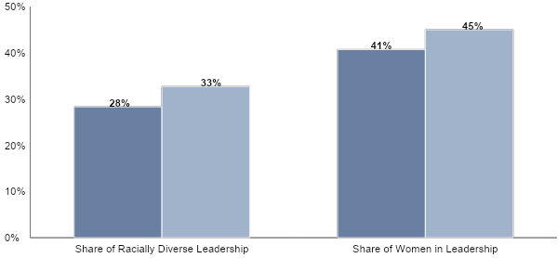
Consequential Accountability Yields Greater Diversity
Leadership Bench Diversity Grouped by Levels of Consequential Accountability
 | Low Consequential Accountability | Consequential Accountability
n = 3,523 employees
Source: 2021 Gartner Leadership Progression and Diversity Survey

Slide 91
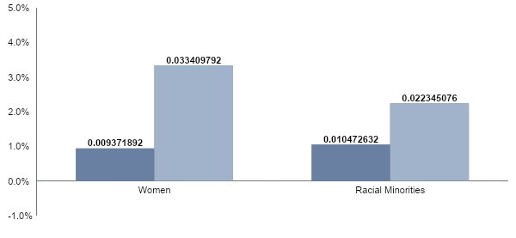
Consequential Accountability Accelerates Diversity
Growth Rates of Racial Minorities and Women on Leadership Bench
 | Collective Accountability | Consequential Accountability
Organizations pursuing Consequential Accountability are projected to diversify their leadership bench faster through a higher growth rate of women and racial minorities in leadership roles
3.6x greater
2.1x greater
n = 3,523 employees ​
Source: Bureau of Labor Statistics, U.S. Department of Labor; UK National Office of Statistics; Australian Bureau of Statistics; 2021 Leadership Progression and Diversity Survey, Growth rates projected based on 4-year CAGRs. Delta due to strategy difference estimated through regression modeling. Gender projection is based on data from the US, UK, and Australia. Racial diversity projection is based on data from the US and includes Black/African American, Asian, and Hispanic/Latino employees.

Slide 92
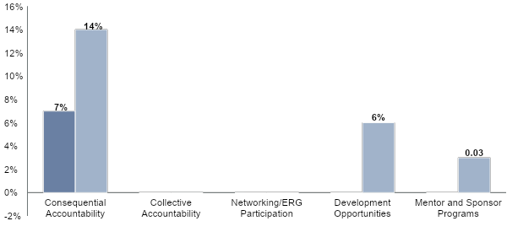
Consequential Accountability Has the Most Impact
Maximum Impact of DEI Strategies on Leadership Bench Diversity
Percentage Points
 | Max Impact on Racial Diversity of Leadership Bench | Max Impact on Women on Leadership Bench
Strategies with 0% impact have no statistically significant impact on racial diversity or women on the leadership bench.
n = 3,523 employees ​
Source: 2021 Leadership Progression and Diversity Survey.

Slide 93
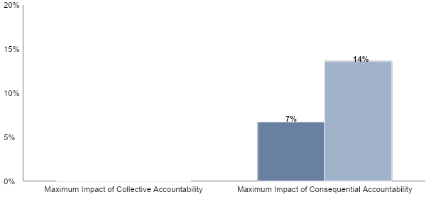
Max Impact of Consequential Accountability on Diversity
Maximum Impact of DEI Strategies on Leadership Bench Diversity, Percentage Points
 | Share of Racially Diverse Leadership | Share of Women in Leadership
n = 3,523 employees
Source: 2021 Gartner Leadership Progression and Diversity Survey

Slide 94
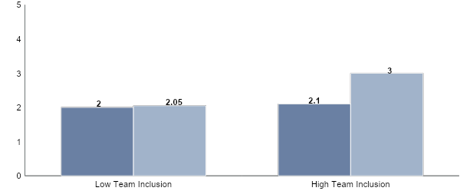
Inclusivity Improves Team Performance
Overall Team Performance, as Rated by Team Leaders (Scale of 1 to 5)
 | Low Gender Diversity | High Gender Diversity
n = 4,397 leaders; 2,758 teams
Source: Gartner
Diversity is incredibly important to increasing team performance, but diverse teams that are also inclusive perform 1.4 times better than diverse teams that are not actively inclusive.

Slide 95
DEI Improves Effort, Intent to Stay & Performance
Sustainable D&I Impact
Illustrative
This 20% increase corresponds to a:
6.2% increase in on-the-job effort
5.0% increase in intent to stay
2.8% increase in performance
+20%
Inclusion
n = 4,397 leaders; 2,758 teams
Source: Gartner
Organizations with sustainable DEI strategies report up to 20% more organizational inclusion compared to their peers without sustainable DEI strategies. This 20% difference corresponds to significant differences in talent outcomes, such as employee performance, on-the-job effort and intent to stay.

Slide 96
Psychological Safety Improves Performance
Impact of Psychological Safety on Performance
Illustrative
As psychological safety increases, employee on-the-job effort, intent to stay and performance also increase.
High Performance & Engagement
Low
Level of Psychological Safety
High
Source: 2019 Gartner Diversity and Inclusion Employee Survey
The 2019 Gartner Diversity and Inclusion Employee Survey found that when organization successfully increase psychological safety, it corresponds with an increase in on-the-job effort, intent to stay and performance.

Slide 97
Roadmap
Methodology Overview
Additional Quantitative Findings
Additional Case Materials

Slide 98
Höganäs’ Leadership Criteria Debiasing
Overview
When senior leaders at Höganäs began to update the company’s leadership criteria, they realized that the updated behaviors were biased toward masculine behaviors. Höganäs brought in diverse perspectives from across the organization to debias their leadership criteria and ensure the new behavior definitions were inclusive of women.
Solution Highlights
Seek Diverse Perspectives to Pressure-Test Behaviors – Leverage diverse perspectives from across the organization to help identify bias and shape new relevant and inclusive leadership behaviors. Integrate Behaviors into the Performance Management Process– Incorporate the behaviors into the performance management process and allow for continued feedback to iterate on the behavior definitions.
Scenario
Höganäs decided to move to a behavior-based performance management system but realized the language in their criteria were perceived as biased and favoring masculine behaviors. Höganäs was concerned that the masculine language and the behaviors the language perpetuated could advantage men over women in the performance management process. To ensure the new behaviors were inclusive of women, Höganäs worked with their ‘More Women Network’ employee resource group to create new debiased behavior definitions.
About the Company
Höganäs
 | Industry: Metals Headquarters Location: Höganäs, Sweden | Revenue: USD 1.07 billion (2019) Employees: Approx. 2,400 (2021)

Slide 99
Leadership Criteria Present Hidden Biases
Sample Leadership Criteria and Hidden Biases They Present
Illustrative Leadership Criteria
Hidden Biases
Aggressively pursues client needs
Aggressiveness is traditionally a quality associated with masculine behavior and often portrayed as a negative attribute in women.
Demonstrates assertive leadership
Men and women can be perceived differently when exhibiting assertive behaviors in the workplace.
Exhibits executive presence
Executive presence is often defined based on traditional conceptions of male leadership.
Realization
When Höganäs’ leadership team created new leadership behaviors for their performance management process, they realized that their newly created behavior definitions had hidden biases that favored masculine behaviors.
Source: Adapted From Höganäs
Notes:
Presenter's Name
Presenter's Name

Slide 100
Redefine Gendered Leadership Criteria
Höganäs’ Approach to Debiasing Leadership Behaviors
Seek Diverse Perspectives to Pressure-Test Behaviors
Seek perspectives from diverse talent to help evaluate criteria for bias and redefine leader behaviors.
Integrate Behaviors Into the Performance Management Process
Incorporate new leadership behaviors into the performance management process to ensure consistent application and continuously iterate based on feedback.
Source: Adapted From Höganäs
Critical First Step to Establish Organizational Readiness
Create the Environment for Discussing Diversity: To ensure diverse talent feels comfortable contributing to organizational efforts, focus on building trusting partnerships between HR and senior leaders, and employee resource groups. Höganäs built relationships with employee networks by recognizing these groups’ work and regularly seeking their input.
Source: Adapted From Höganäs
Notes:
Presenter's Name
Presenter's Name

Slide 101
Seek Diverse Perspectives to Pressure-Test Behaviors
Perspectives to Consult to Test Behaviors
Illustrative
ERG Leaders
Leadership Team
Leverage Diverse Perspectives
Consult diverse perspectives across the organization to highlight potential bias in leader behavior definitions.
ERG Members
Employee Focus Groups
Leadership Behaviors
Höganäs’ Guiding Assumptions for Discussion in Workshops
Illustrative
How could these behaviors be interpreted in other ways beyond their stated meaning?
How could other interpretations of these behaviors advantage people on the basis of gender?
How do we ensure frequent calibration/feedback between the manager and co-worker throughout the year?
How do we ensure managers and co-workers have a dialogue around Höganäs’ strategies, directions and the function contribution and “must wins” to drive success?
Test Behaviors for Relevance
Ask questions to assess the relevance of new criteria and confirm that diverse talent can see themselves reflected in the new behavior definitions.
Source: Adapted From Höganäs
Notes:
Presenter's Name
Presenter's Name

Slide 102
Seek Diverse Perspectives to Pressure-Test Behaviors (Cont.)
Höganäs’ Workshops
Illustrative
Behavior Definitions Before Workshop
Sample Feedback from the More Women Network
Behavior Definitions After Workshop
“Works hard and puts in long hours when necessary.”
“This behavior focuses on performance at the expense of individual wellbeing.”
“I show perseverance in reaching results and when faced with challenges.”
“I contribute to the team to con­stantly meet (and exceed) expectations. It is not a one-man show.”
“This language is explicitly gendered the way it is worded.”
“I contribute to the team to con­stantly meet (and exceed) expectations. It is not a one-person show.”
“I avoid taking risks.”
“There are gender differences in how men and women are perceived when taking risks.”
Behavior eliminated
Source: Adapted From Höganäs
Notes:
Presenter's Name
Presenter's Name

Slide 103
Integrate Behaviors Into the Performance Management Process
Höganäs’ Updated Performance Management Template
Illustrative
1
Höganäs incorporated the new behaviors into the performance management process in order to integrate them into the way leaders make talent decisions.
Behaviors - Candor | Assessment (6 = Role Model)
Manager | 1 | 2 | 3 | 4 | 5 | 6
Employee | 1 | 2 | 3 | 4 | 5 | 6
Candor I act with honesty, openness and transparency when expressing information and my opinion even on difficult topics I speak up and share what’s on my mind, my ideas, my opinions and constructure feedback I challenge existing “truths” with my own ideas I am capable of addressing difficult conversations while acting with integrity I give (and receive) open and honest feedback I create an atmosphere where people can speak their mind | Examples of when employee displayed or lacked candor:
Spoke up about concerns around new talent review process
Gives honest and candid feedback when reviewing project plans
360 degree feedback shows direct reports feel they can speak their minds on the team
2
To continue to improve and debias the behavior definitions after creation, Höganäs solicited further feedback and continued to iterate on the behaviors as they were piloting them.
Source: Adapted From Höganäs
Notes:
Presenter's Name
Presenter's Name

Slide 104
BBVA’s Contextualized DEI Strategies
Overview
Organizations often struggle to set DEI goals that are relevant, ambitious, and actionable for leaders. Often, organization-wide DEI goals are too vague and do not provide leaders with clear actions to advance DEI. In other instances, overly precise goals can feel disconnected or unrealistic to business leaders. To hold leaders accountable for achieving DEI goals, BBVA first helps leaders create customized DEI goals and strategies that are contextualized for each business unit and then supports them through agile DEI teams.
Solution Highlights
To achieve DEI goals, BBVA agreed that additional pressure needed to be placed on business leaders to drive action. Ultimately, BBVA designed a strategy that focused on co-creating actionable DEI goals and strategies contextualized for local business units. This approach includes three main components: Spotlight Stalls in Leader Progression: To drive action, BBVA spotlights gaps in female leader progression through a dashboard that includes DEI as a KPI. Business leaders are required to report progress on a quarterly basis directly to the CEO. Drive Ownership Through Contextualized Strategies: Next, BBVA’s DEI Team provides business leaders with one-on-one support to create contextualized goals and strategies that account for the unique challenges and needs of each business unit. Mobilize Agile Community of Practice for Shifting Needs: An Agile community of practice (CoP) comprised of DEI experts from across the organization is mobilized for a minimum of a three-month rotation based on business needs and capacity. The CoP provides additional, localized support to ensure progress against DEI goals.
About the Company
BBVA
 | Industry: Banking Headquarters Location: Bilbao and Madrid, Spain | Revenue: 24.5B Euro Employees: 135,627

Slide 105
Contextualize DEI Strategies to Drive Action
Components of BBVA’s Contextualized DEI Strategies
Spotlight Gaps in Leader Promotions to Drive Urgency
Drive Ownership Through Contextualized Strategies
Mobilize Agile Community of Practice for Shifting Needs
Progress against global DEI goals is reported directly to the CEO along with all other KPIs.
A global dashboard highlights progress and challenges through metrics segmented by region, employee level, and promotion rates by gender.
DEI and business leaders discuss unique challenges and opportunities not captured in global data for each business unit.
DEI leaders work with business leaders to define contextualized and impactful DEI goals and strategies.
The DEI Team assesses the demand of region-specific DEI goals and strategies to justify the need for additional support.
Global Agile teams of internal employees are mobilized for a minimum of three months to support the creation of new DEI initiatives.
Source: Adapted From BBVA
Notes:
Presenter's Name
Presenter's Name

Slide 106
Spotlight Gaps in Leader Promotions to Drive Urgency
DEI KPI Dashboard Reported by Senior Leaders to CEO
Illustrative
Region A, Diversity KPI
 | % Men | # Men | % Women | # Women
VPs | 70% | 14 | 30% | 6 | Stock
 | 100% | 1 | 0% | 0 | Flow
Sr. Directors | 65% | 167 | 35% | 90 | Stock
 | 83% | 25 | 17% | 5 | Flow
Directors | 52% | 234 | 48% | 216 | Stock
 | 43% | 8 | 57% | 11 | Flow
Stock: The number of employees currently at that level.
Flow: The number of employees promoted to the next level.
Drive leader urgency by spotlighting leadership levels with the largest gaps in gender diversity.
DEI Dashboard Guidelines
What: BBVA tracks leader promotions by comparing gender data at all levels across the organization (stock) with promotion rates (flow) by gender.
Who: Senior business leaders are responsible for reporting business-related KPIs, including progress against DEI, directly to the CEO.
When: Progress is reported on a quarterly basis in order to continuously track success against goals and identify new challenges.
Source: Adapted From BBVA
Notes:
Presenter's Name
Presenter's Name

Slide 107
Drive Ownership Through Contextualized Strategies
BBVA Has Diversity CoP Work with Business Leaders
Sales, Region A
IT, Region B
Operations, Region C
Unique Challenges
“Our LGBTQ employees do not feel comfortable being their authentic selves.”
“We have difficulty recruiting women for tech positions.”
“We only have 20% women represented in leadership positions.”
Contextualized DEI Strategy Conversation Guide
Contextualized Support
What barriers are preventing you from achieving the globally reported DEI goals?
What other DEI goals are important to your function or region that may not be captured in the global goals?
How can the DEI team support you in achieving these goals?
HR
Impactful, Achievable, Contextualized Goals
Goal: Launch an LGBTQ employee resource group.
Goal: Increase the % of women employees by 20%.
Goal: Increase the % of women at VP level by 10%.
Source: Adapted From BBVA
Notes:
Presenter's Name
Presenter's Name

Slide 108
Drive Ownership Through Contextualized Strategies (Cont.)
BBVA’s Contextualized DEI Strategy Conversation Guide
Contextualized DEI Strategy Conversation Guide
Identify barriers to success (leader mindset, legacy processes, external factors, etc.).
What are the biggest DEI-related challenges your business unit faces today?
What barriers prevent you from achieving the globally reported DEI goals?
What DEI initiatives have you tried to implement before?
What DEI initiatives do you think would have the most impact?
What other DEI goals are important to your function or region that may not be captured in the global goals?
Understand why previous strategies have failed to produce results.
Uncover diversity goals unique to the region or function.
Objective: Develop a contextualized diversity plan and goals for the region or function.
Business Leader
Diversity Leader/CoP Member
Source: Adapted From BBVA
Notes:
Presenter's Name
Presenter's Name

Slide 109
Mobilize Agile Community of Practice for Shifting Needs
BBVA’s DEI Community of Practice (CoP)
Assess Need for Support
The local diversity leader assesses the demand of region-specific DEI projects to justify additional support.
Mobilize Community of Practice
Assemble Community of Diversity Experts
The CoP works with local DEI leaders, ERG members and DEI champions who offer localized diversity knowledge.
The CoP shares knowledge and diversity expertise to co-create DEI solutions and provide additional DEI support.
Source: Adapted From BBVA
Notes:
Presenter's Name
Presenter's Name

Slide 110
Fujitsu’s Localized Diversity & Inclusion Goals
Overview
As a global company, Fujitsu realized that in order for leaders to take action on and ownership of diversity and inclusion (D&I) goals, leaders needed localized goals specific to the regions and countries in which they were operating. To create meaningful progress toward D&I goals, Fujitsu’s regional and country leaders establish localized D&I goals based on the country context, culture and demographic makeup.
Solution Highlights
Identify a unified global goal: In partnership with executive leaders, the D&I and HR teams set global goals that are aspirational, measurable and public. Collect context-specific inputs: Regional HR teams compile global, regional and local data and conduct focus groups to evaluate the current state of D&I at the local level and inform localized D&I goals. Co-create local goals with leaders: Regional HR teams meet with local business unit leaders to shape local goals and strategies and create next steps for leaders to act on. Measure success through leader scorecards: Business unit leaders are accountable for reporting quarterly progress against D&I metrics along with action plans to address gaps.
About the Company
Fujitsu Group
 | Industry: Information Technology Headquarters Location: Tokyo, Japan | Revenue: $35.49B (2019) Employees: 129,071 (2019)

Slide 111
Global D&I Goals Disconnected From Local Context
Prior Feedback on Global D&I Goals
I know my organization is committed to D&I, but I’m not sure how its global goal impacts me as a leader.
The global goal doesn’t feel relevant to my business unit’s needs.
Our global goal mentions female representation, but shouldn’t I think about indigenous representation as well?
Senior Leaders
Source: Adapted From Fujitsu
Challenges to Implementing Global D&I Goals at Local Level
Goal Actionability
Global goals often lack direct recommendations due to their broad appeal.
Legal Restrictions
Global goals tend to be generic or only set targets for women’s representation due to restrictions on self-identification data for race, ethnicity, disability, sexual orientation and other identities.
Demographic Differences
Global goals do not account for different starting points and priorities across localities.
Source: Adapted From Fujitsu
Notes:
Presenter's Name
Presenter's Name

Slide 112
Common Purpose, Localized Implementation
Four Steps to Setting Local D&I Goals
Identify a unified global goal
Global
1
Gather context-specific inputs to inform local strategy
2
Local
Co-create local goals with leaders
3
Measure and track success through leader scorecards
4
Individual
Realization
With subsidiaries in more than 100 countries, Fujitsu realized it needed goals and strategies that were globally consistent and locally relevant. Fujitsu’s approach to localize D&I goals promotes collective progress with individualized accountability and relevance.
Source: Adapted From Fujitsu
Notes:
Presenter's Name
Presenter's Name

Slide 113
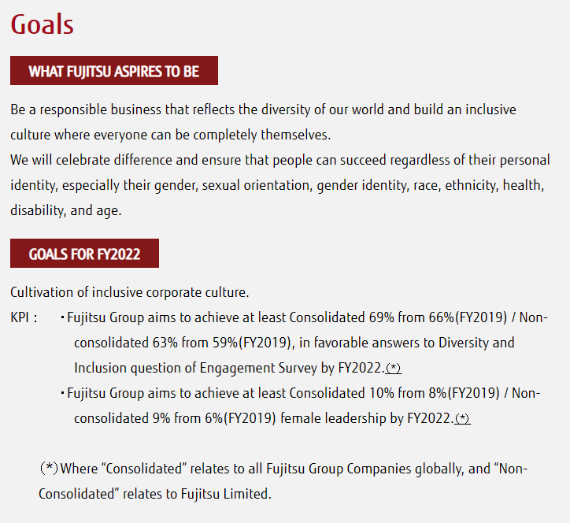
Identify a Unified Global Goal
Three Hallmarks of a Meaningful Global D&I Goal
Fujitsu’s Global D&I Goals
1
Aspirational: Present a common vision for the entire company to strive toward.
2
Measurable: Set a precise target to convey a sense of accountability for meeting that target.
3
Public: Demonstrate to employees and customers that D&I is as important as other business goals and to create upward accountability for progress.
Source: fujitsu.com/global/about/csr/diversity.
Source: Adapted From Fujitsu
Notes:
Presenter's Name
Presenter's Name

Slide 114
Collect Context-Specific Inputs
Fujitsu’s Checklist of Local Inputs, Northern & Western Europe
Illustrative
Collect demographic data at multiple levels to understand differences in diversity across regions and business units.
Demographic Data: collect at global and local levels to identify trends such as areas of low retention of diverse talent
Annual Global Employee Engagement Survey
Biannual Local Employee Engagement Survey
ERG Focus Groups
‘Spotlight’ Conversations: learn more about recurring themes through additional focus groups
Legal Requirements: talk with Legal team about data restrictions and reporting obligations
Gauge employee sentiment through free form response in the local survey and focus group conversations.
Solicit Continual Feedback
To assess progress against goals, Fujitsu presents local goals to Employee Resource Group Focus Groups and ‘Spotlight’ Groups for continual feedback.
Source: Adapted From Fujitsu
Notes:
Presenter's Name
Presenter's Name

Slide 115
Co-Create Local Goals With Leaders
Sample Agenda for U.K. Annual Workshop to Localize and Take Action on D&I Goals
Illustrative
Local BU Leaders
D&I Leader
Talent Management Leader
1
Share Inputs
2
3
Set Localized D&I Goals
Establish an Action Plan
HR reviews the company’s global goals with leaders to set a direction for local goals and strategies. With feedback from ERGs, engagement survey results and data analysis, HR then presents context-specific inputs to leaders.
HR and business unit leaders co-create goals that align to cross-functional initiatives and specific areas for opportunity in the locality.
HR facilitates a session for leaders to reflect on goals and to identify interim actions that will help them perform against the new metrics. Action plans are reviewed quarterly in People Reviews to monitor progress.
Sample Checklist of People Leadership Goals (UK)
People Management (25%)
Contribute to recruitment and retention of women in engineering (working toward >20% female leadership)
Develop underrepresented talent on your direct team and in your BU (dedicating >3 hours per week)
Source: Adapted From Fujitsu
Notes:
Presenter's Name
Presenter's Name

Slide 116
Measure and Track Success Through Leader Scorecards
Fujitsu’s Balanced Leader Scorecard
Illustrative
Scorecards are evaluated every quarter by executive leaders as part of business unit leaders’ KPIs.
Q1 FY21
UK, Western Europe
Aliyah
VP, Finance
Contextualize progress by location and business unit.
Proportion of Women in Leadership Roles
 | Total | % Change
Midlevel Management
Upper Management
Senior Leadership
Proportion of Racially and Ethnically Diverse Individuals in Midlevel Management
 | Total | % Change
Black
Asian
Minority Ethnic
Prefer not to share
Incorporate country-specific inputs on scorecard.
Source: Adapted From Fujitsu
Notes:
Presenter's Name
Presenter's Name

Slide 117
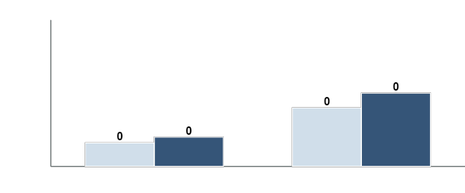
Fujitsu’s Results
Goals to Increase Female Leadership From FY 2019 to FY 2022
Percentage of Female Leadership (Globally and in Fujitsu UK)
2019
2022
50%
25%
0%
Global
U.K.
Source: Adapted From Fujitsu
“All of our leadership teams, certainly within the UK, are incredibly in the depths with D&I, from actively participating in D&I training to creating action plans to achieve local D&I goals. It’s absolutely clear that our leaders are accountable to ensuring that the high value we promise in the global Fujitsu Way actually becomes the experience that our employees have.”
Kelly Metcalf, Head of Diversity, Inclusion & Wellbeing, Northern and Western Europe
Notes:
Presenter's Name
Presenter's Name

Slide 118
Altria’s DEI Aiming Points
Overview
To meet ambitious diversity, equity and inclusion (DEI) goals, Altria operationalizes accountability — at the organizational, peer, and individual levels — to reinforce DEI as a clear priority for leaders. By establishing and assessing leaders using a diversity, equity and inclusion rating, Altria incentivizes all leaders to take ownership for meaningful DEI progress.
Solution Highlights
Co-create aiming points to build consensus: Altria brings leaders into the conversation from the beginning to co-create aiming points. Doing so helps build mutual understanding of, and commitment to, DEI as a strategic priority. Monitor leaders’ scorecards to track progress: Altria creates leader scorecards to ensure individual contributions to broader organizational targets. Foster peer-to-peer transparency to reinforce goals: By encouraging senior leaders to share DEI plans with each other, leaders are empowered to motivate one another to deliver against aiming points. Rate leader advocacy and establish requirements for progression: Through its DEI ratings, Altria formally assesses and captures leader allyship and advocacy. The ratings are integrated into performance evaluations to make clear that the inability to lead inclusively is a barrier to the highest performance and advancement.
About the Company
Altria
 | Industry: Tobacco Headquarters Location: Virginia, USA | Revenue: $26 Billion+ (2020) Employees: 7,300+ (2019)

Slide 119
An Opportunity for Accelerated Progress
Altria’s Previous Diversity Aspiration
Illustrative
Altria’s Previous (2015) Diversity Goals
Diversity-Only
Without a measurable inclusion goal, the initiative limits progress on culture change.
At Altria, diversity and inclusion is part of the fabric of how we work. As such, the leadership team is committed to fostering a diverse and inclusive workplace environment.
To demonstrate our continued commitment to diversity, we are rolling out an exciting diversity initiative, which we’ve named 20/20 by 2020. We commit to achieving 20% female and people of color representation in VP roles by 2020.
Limited Impact Focusing only on the most senior 1% doesn’t account for diversity in other parts of the organization.
Goal-, Not Action-, Oriented
An emphasis on goals without clearly articulating individual responsibility can result in leaders who cheer DEI on or simply watch from the sidelines.
Realization: Although Altria met its initial diversity goals, senior leaders realized the need for broader and more ambitious diversity and inclusion targets were unlikely to be realized without leadership commitment and support.
Source: Adapted From Altria
Notes:
Presenter's Name
Presenter's Name

Slide 120
Transform Leaders Into DEI Owners
Key Shifts Underpinning Altria’s Approach
Use a top-down approach to create and set goals.
Communicate organizational goals without clarifying leader priorities.
Silo or restrict the accessibility of leaders’ DEI information.
Include inclusion as an add-on to leadership goals or competencies.
Conventional Approach
Co-create aiming points to build consensus.
Monitor leaders’ scorecards to track progress.
Foster
peer-to-peer transparency to reinforce DEI goals.
Rate leader advocacy and establish requirements for progression.
Altria’s Approach
Source: Adapted From Altria
Notes:
Presenter's Name
Presenter's Name

Slide 121
Co-Create Aiming Points to Build Consensus
Key Stakeholders in the Co-Creation Process
Chief Diversity Equity & Inclusion Officer ensures aiming points align and are integrated with other DEI strategies.
CHRO assesses HR implications and clarifies how HR could best drive change in support of DEI initiatives.
Executive Leaders contribute perspectives based on the unique contexts of the business functions and units they oversee.
CEO provides strategic considerations, ensuring aiming points align with organizational capabilities, objectives and vision.
ERG Leader(s) represents and promotes the perspectives of different employee segments within the organization.
Aiming points: Specific, yet aspirational, measures of the organization’s and leaders’ diversity and inclusion goals.
Source: Adapted From Altria
Notes:
Presenter's Name
Presenter's Name

Slide 122
Monitor Leaders’ Scorecards to Track Progress
Standardized Leader Scorecard
Illustrative
Bernadette Scorecard, Chief Technology Officer
Monitor progress across each business unit and identify problem areas.
Agree or Strongly Agree | White |  | Black |  | Hispanic |  | Asian |  | Two or More
 | Men | Women | Men | Women | Men | Women | Men | Women | Men | Women
I feel comfortable being myself at work.
My opinions seem to count.
Everyone at my company has an equal opportunity to reach their goals.
My manager seeks diverse perspectives to help drive results.
I feel a sense of belonging at my company.
Regardless of background, everyone at Altria has an equal opportunity to succeed.
Disaggregate collected data for a holistic understanding of diversity and inclusion across different demographic groups.
Racial and ethnic breakdown of women at Altria (%)
 | Total | Asian | Black | Hispanic | 2+
VP+
Dir.
Aiming Point: Increase our VPs and directors who are LGBTQ+, a person with a disability, or veteran
Current status against aiming point (%):
 | Aiming Point | VP+ | Dir. | 13-12 | 11-10 | 9 & Below
Number
LGBTQ+ | 8%
PWD | 7%
Veterans | 6%
Aiming Point: At least 30% VPs and directors are Asian, Black, Hispanic or two or more races
Current status against aiming point (%):
 | Aiming Point | VP+ | Dir. | 13-12 | 11-10 | 9 & Below
AAPI Women | 4%
AAPI Men | 4%
Black Women | 6%
Black Men | 6%
Hispanic Women | 5%
Hispanic Men | 5%
2+ Women | 2%
2+ Men | 2%
Identify leading indicators to monitor how, and how quickly, leaders are tracking against goals.
Leading Indicators (Jan 1, 2020 – Dec, 2020)
 | Promotions |  |  |  |  | Starts and Exits |  | % of Employees
 | Total | To 13-12 | To Dir. | To VP | VP+ | Starts | Exits
Number
Source: Adapted From Altria
Notes:
Presenter's Name
Presenter's Name

Slide 123
Foster Peer-to-Peer Transparency to Reinforce Goals
Greater DEI Plan and Scorecard Sharing
Create standard scorecards. Standardized scorecards across business functions and operating companies increases visibility into leaders’ contributions to enterprise goals and creates a common set of key metrics.
Foster transparency to motivate leaders. Senior leaders are encouraged to share DEI plans and scorecards with peers and across their organizations. By doing so, Altria seeks to motivate leaders toward action and reinforce DEI as a shared leadership priority.
Altria’s Leader Scorecards
Reed Scorecard
Reed Improvement Plan
Stessy Scorecard
Stessy Scorecard
Stessy Scorecard
Stessy Scorecard
Past 30 Minute Thursday Topics:
Leading through technology
Recognizing your team virtually
Getting productive with google tools
Driving empathy on a remote team
Description | Comments
Inclusive Team | …
Gender Parity | …
Team Diversity | …
Planned Initiatives | … | …
Expected Outcome/ Measurement | … | …
Support & Resourcing | … | …
Socialize insights and learnings. Leaders share plans to address gaps and areas of improvement, enabling them to celebrate wins, acknowledge challenges and share learnings.
Source: Adapted From Altria
Notes:
Presenter's Name
Presenter's Name

Slide 124
Rate Leader Advocacy and Establish Progression Requirements
Altria’s Inclusion Rating System
Articulate specific sample behaviors. Leaders are evaluated on explicit behaviors and actions to ensure inclusion is more than a ‘check-the-box’ exercise.
Integrate inclusion into development goals. Leaders work toward advocacy by engaging their managers around specific work or focus areas where they plan to create and track inclusion objectives.
Operationalize inclusion as a must-have. Leaders must be assessed an “ally” or “advocate” to earn an “exceptional” performance rating and/or advance. Altria plans to assess ratings distribution going forward and, where necessary, recalibrate expectations.
Source: Adapted From Altria
Notes:
Presenter's Name
Presenter's Name

Slide 125
Altria’s Approach Delivers
Altria’s Increased Organization-Wide Diversity and Inclusion
“Our new approach has given me a new way of thinking about these issues and a renewed sense of urgency, especially as I think about how to meaningfully bring inclusion and a focus on diversity into my day-to-day work as a leader. This shift is already having a positive impact on my team’s ability to integrate this work with our other business strategies.”
Altria Senior Executive
“I was initially skeptical of this revamped strategy, but have since come around. It’s been heartening to see commitment to these ideals and the accountability measures to keep leaders honest and on track. Now all leaders understand that diversity, equity, and inclusion is central to success in their positions.”
Altria ERG Leader
Notes:
Presenter's Name
Presenter's Name

Slide 126
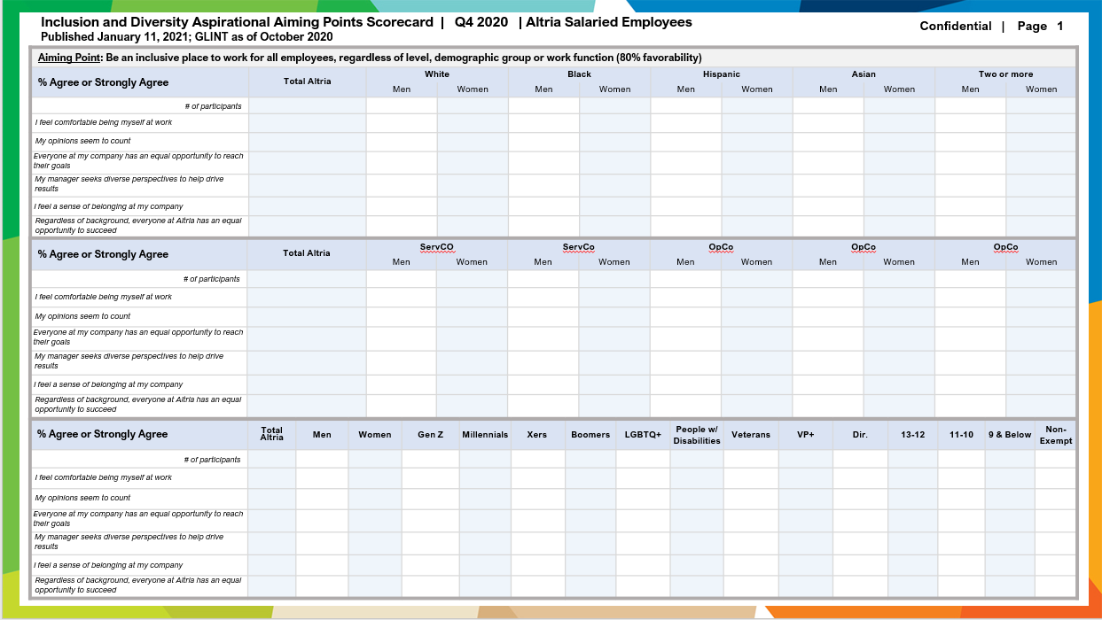
Clarify DEI as an Organizational Priority
Altria’s Organizational Aiming Points
Source: Altria
Notes:
Presenter's Name
Presenter's Name

Slide 127
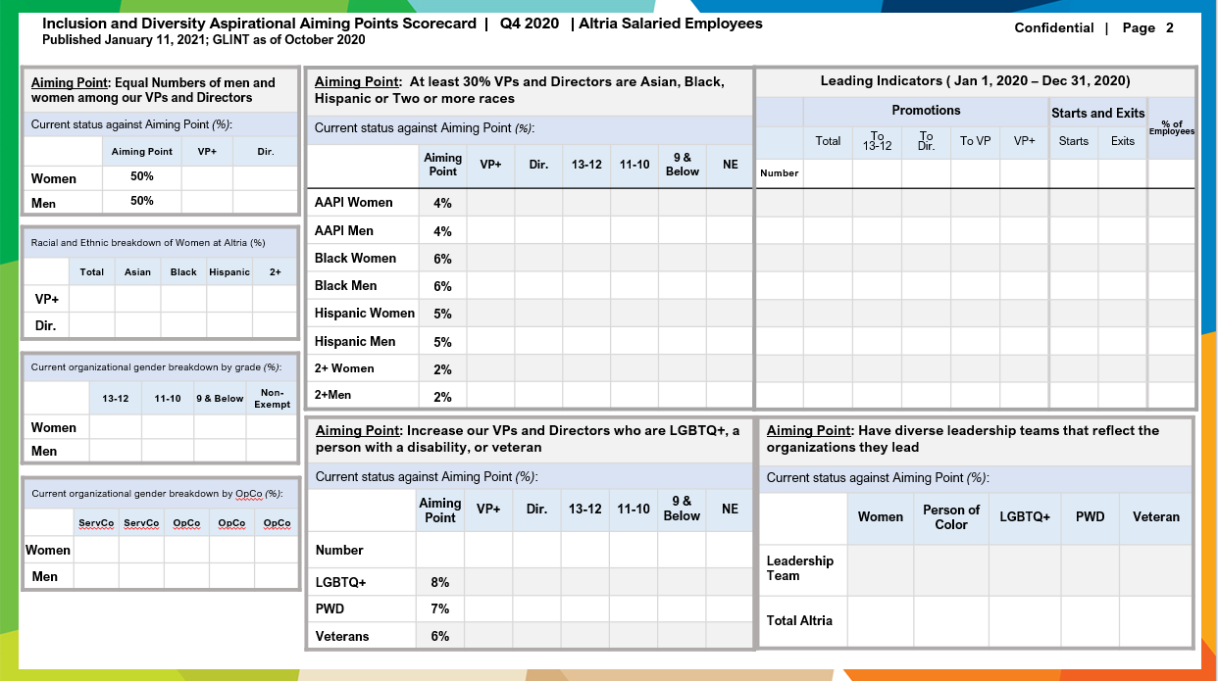
Clarify DEI as an Organizational Priority
Altria’s Organizational Aiming Points
Source: Altria
Notes:
Presenter's Name
Presenter's Name

